Slide 1
Tutorial 10:
Performing What-If Analyses

Slide 2
Objectives
Explore the principles of cost-volume-profit relationships
Create a one-variable data table
Create a two-variable data table
Create and apply different Excel scenarios with the Scenario Manager
Generate a scenario summary report

Slide 3
Objectives
Generate a scenario PivotTable report
Explore the principles of a product mix
Run Solver to calculate optimal solutions
Create and apply constraints to a Solver model
Save and load a Solver model

Slide 4
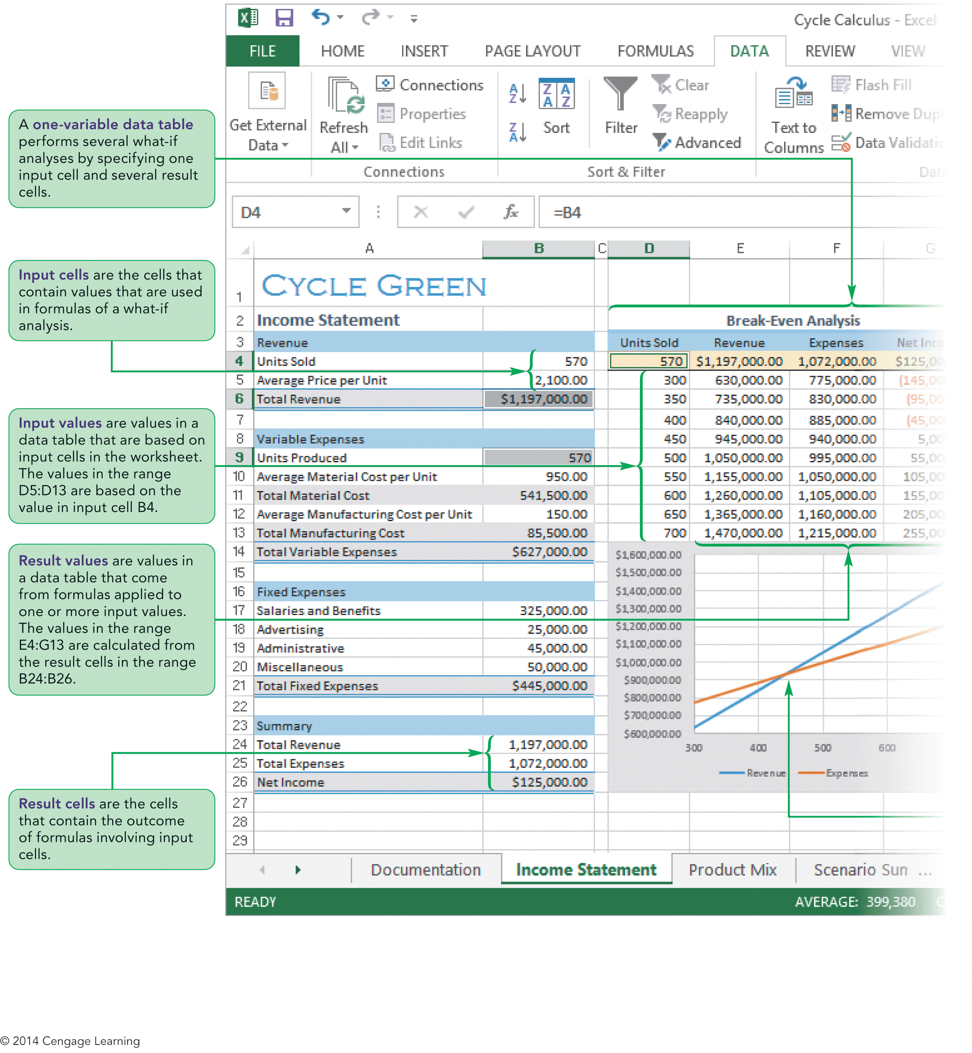
Visual Overview:
Data Tables and What-If Analysis

Slide 5
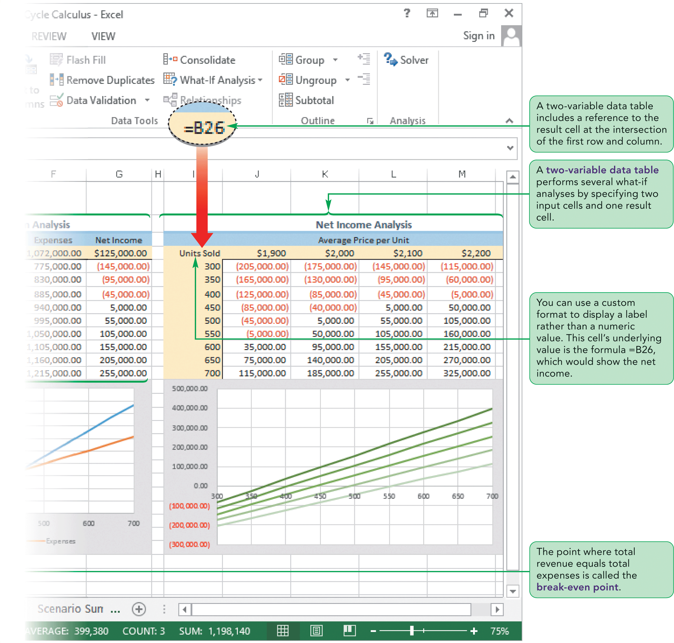
Visual Overview:
Data Tables and What-If Analysis

Slide 6
Understanding Cost-Volume
Relationships
Cost-volume-profit (CVP) analysis
  Studies the relationship between expenses, sales volume, and profitability
  Helps predict the effect of cutting overhead or raising prices on a company’s net income

Slide 7
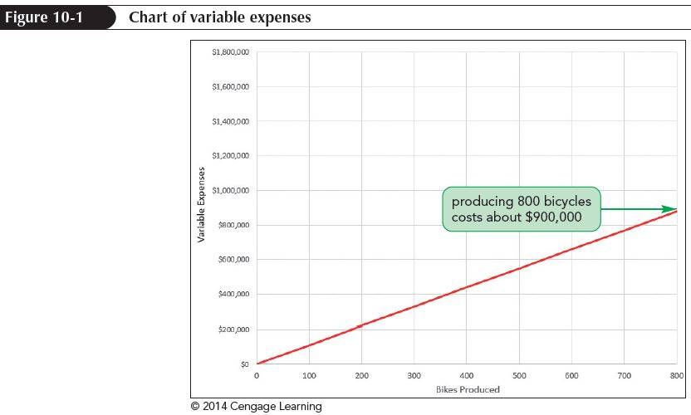
Understanding Cost-Volume
Relationships
Comparing Expenses and Revenue
  Types of expenses
    Variable expenses change in proportion to the amount of business a company does
    Fixed expense must be paid regardless of sales volume
    Mixed expense is part variable and part fixed

Slide 8
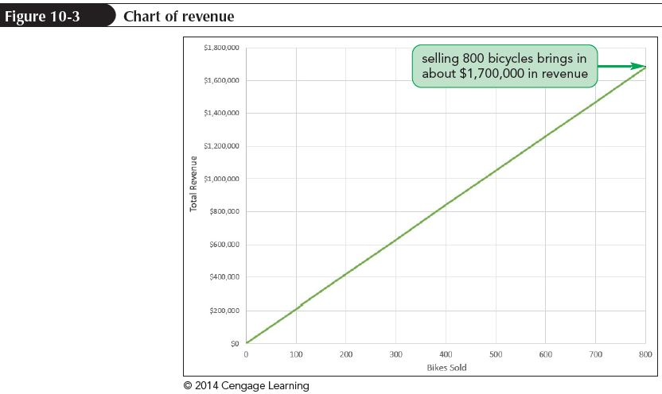
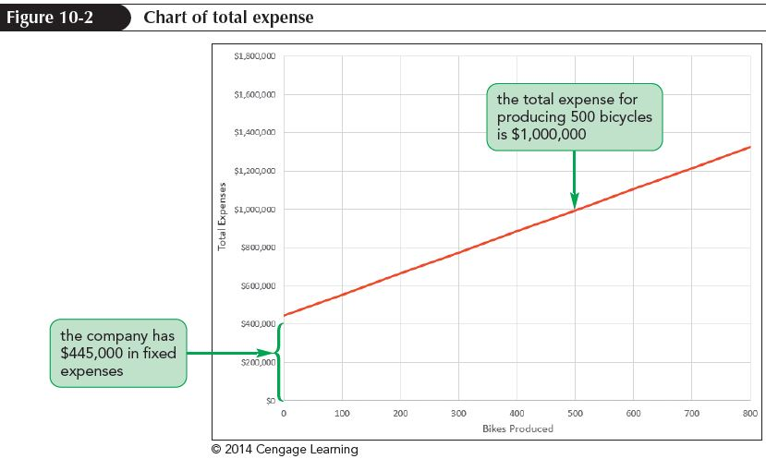
Understanding Cost-Volume
Relationships

Slide 9
Understanding Cost-Volume
Relationships
Exploring the Break-Even Point
  The point where total revenue equals total expenses is called the break-even point
    When sales are above the break-even point, a company profits
    When sales are below the break even point, a company loses money
  CVP analysis is sometimes called break-even analysis

Slide 10
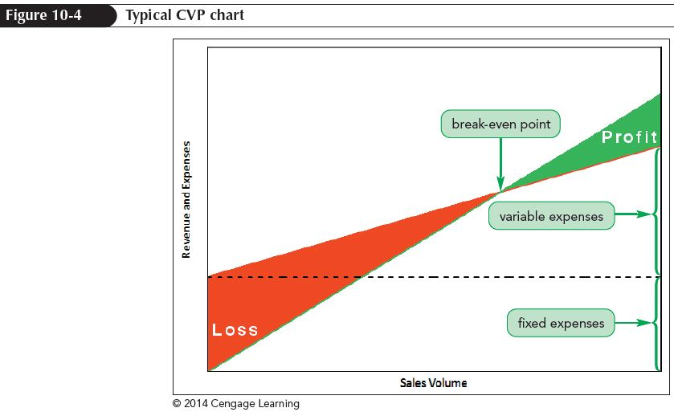
Understanding Cost-Volume
Relationships
Exploring the Break-Even Point (cont’t)
  A CVP chart shows the relationship between total expenses and total revenue; the break-even point occurs where the two lines cross

Slide 11
Understanding Cost-Volume
Relationships
Finding the Break-Even Point with What-if Analysis
  Lets you explore the impact of changing different values in a worksheet
  Can use to explore the impact of changing financial conditions on a company’s profitability
  One way of finding the break-even point is to use Goal Seek, but a more efficient approach is to use a data table

Slide 12
Working with Data Tables
A data table is an Excel table that displays the results from several what-if analyses; the table consists of input cells and result cells
  Input cells are the cells whose value would be changed in a what-if analysis
  Result cells are cells whose values are impacted by the changing input values
  You can use one-variable data tables and two-variable data tables

Slide 13
Working with Data Tables
Creating a One-Variable Data Table
  Specify one input cell and any number of result cells
  The range of possible values for the input cell is entered in the first row or column of the data table; the corresponding result values appear in the subsequent rows or columns
  Useful in business to explore how changing a single input cell can impact several financial results

Slide 14
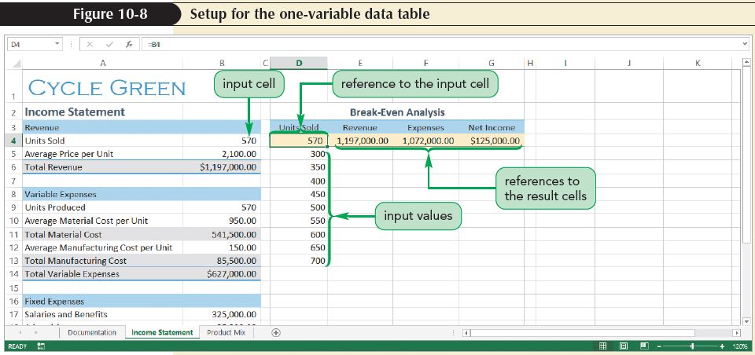
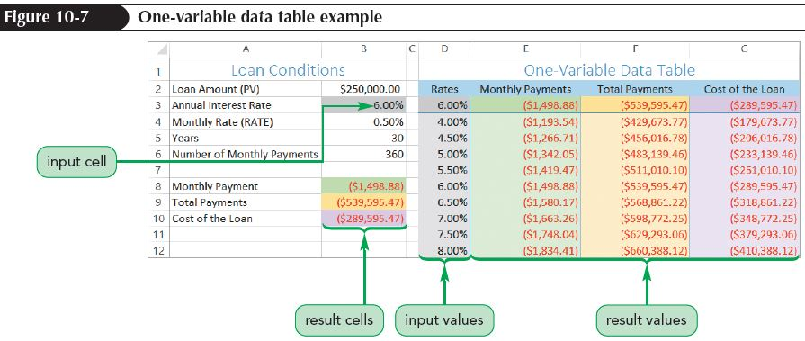
Working with Data Tables

Slide 15
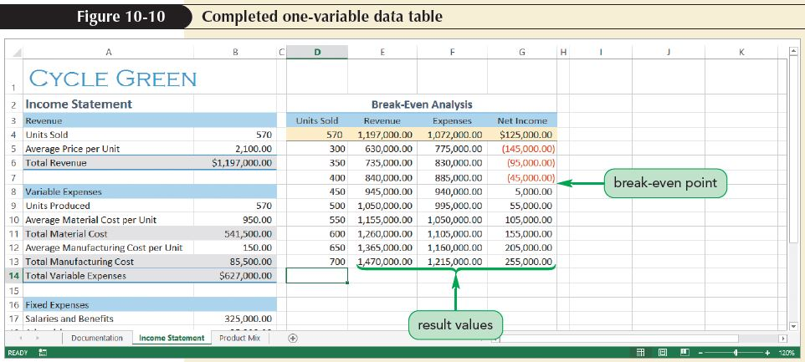
Working with Data Tables
Creating a One-Variable Data Table (con’t)
  Identify the result value cell based on input values
    The row input cell is used when the input values have been placed in the first row of the data table
    The column input cell is used when the input values are placed in the data table’s first column

Slide 16
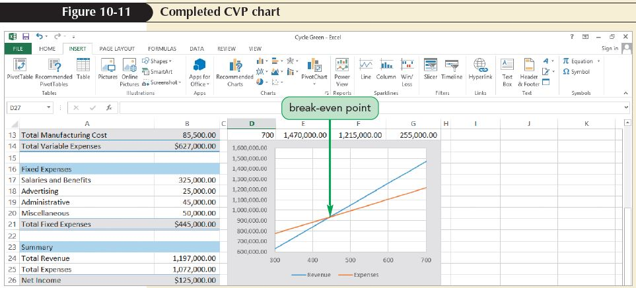
Working with Data Tables
Charting a One-Variable Data Table
  Gives a better picture of relationship between sales volume, revenue, and total expenses

Slide 17
Working with Data Tables
Modifying a Data Table
  Data tables are dynamic; changes in the worksheet are automatically reflected in the data table values
  Includes changes to cells that are not part of the data table but are involved in the values displayed in the result cells

Slide 18
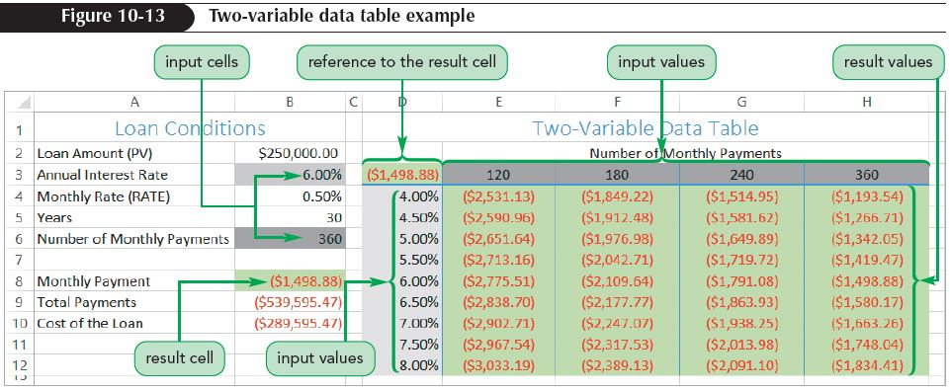
Working with Data Tables
Creating a Two-Variable Data Table
  Lets you view the relationship between two input cells, but can display only a single result value
  Analyzes a variety of combinations simultaneously

Slide 19
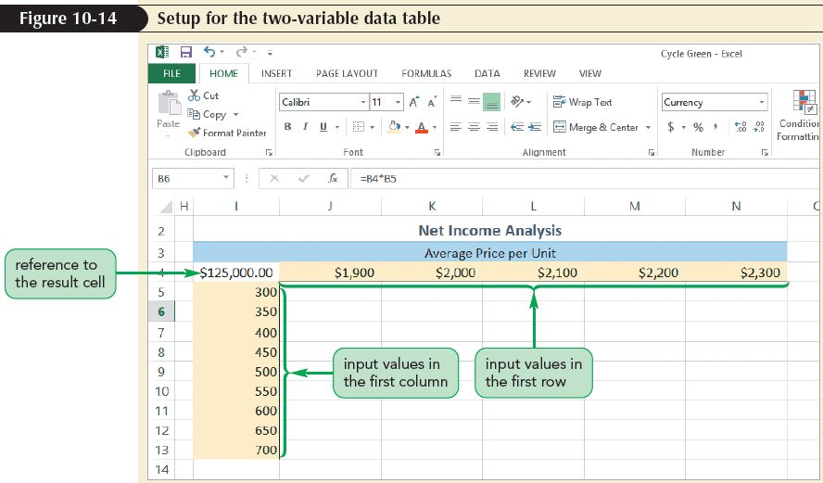
Working with Data Tables

Slide 20
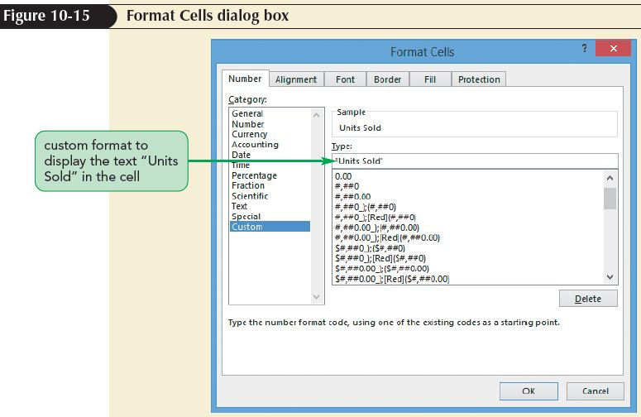
Working with Data Tables
Formatting the Result Cell
  You can hide a cell value using the custom format “text”, where text is the text you want to display in place of the cell value

Slide 21
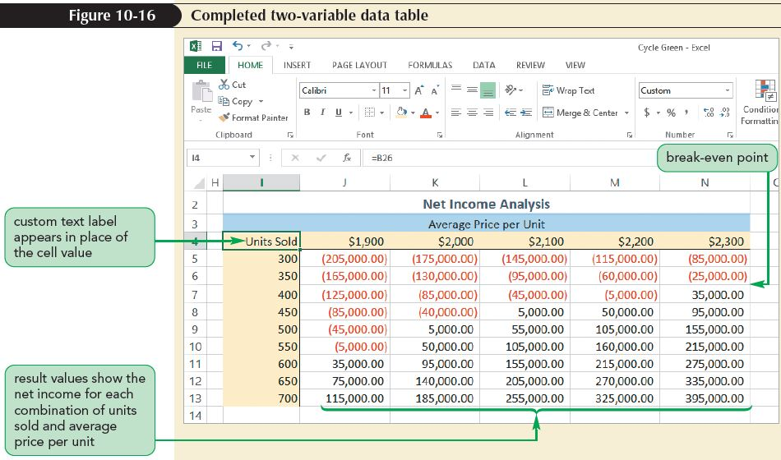
Working with Data Tables

Slide 22
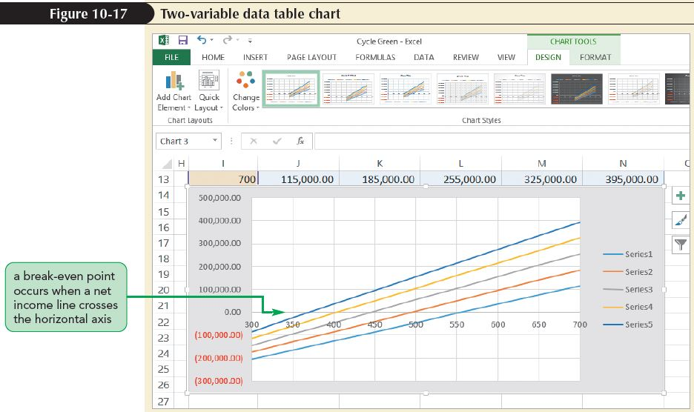
Working with Data Tables
Charting a Two-Variable Data Table
  You can chart the values from a two-variable data table using lines to represent the different columns of the table

Slide 23
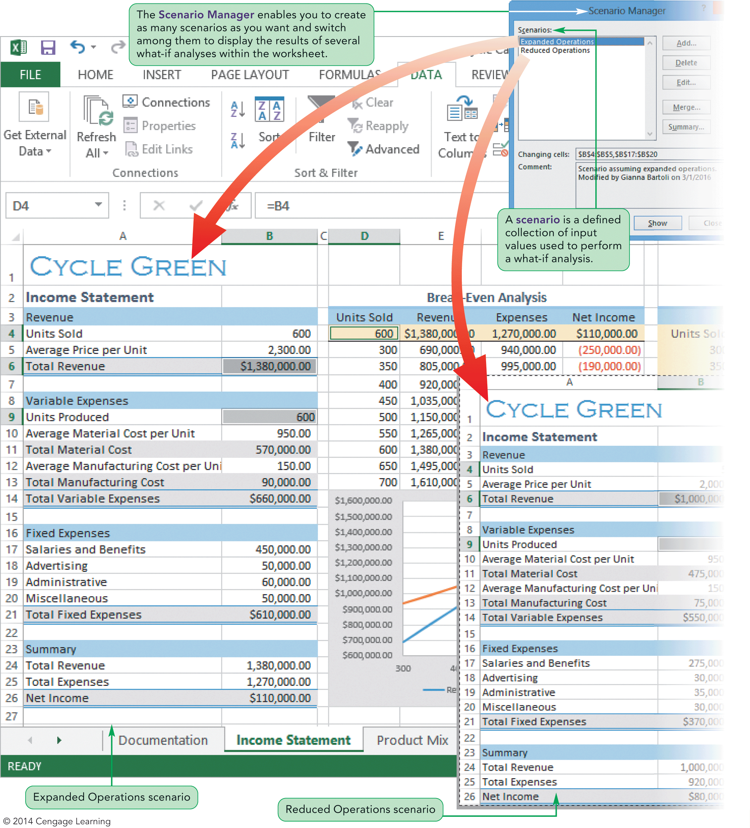
Visual Overview:
What-If Scenarios

Slide 24
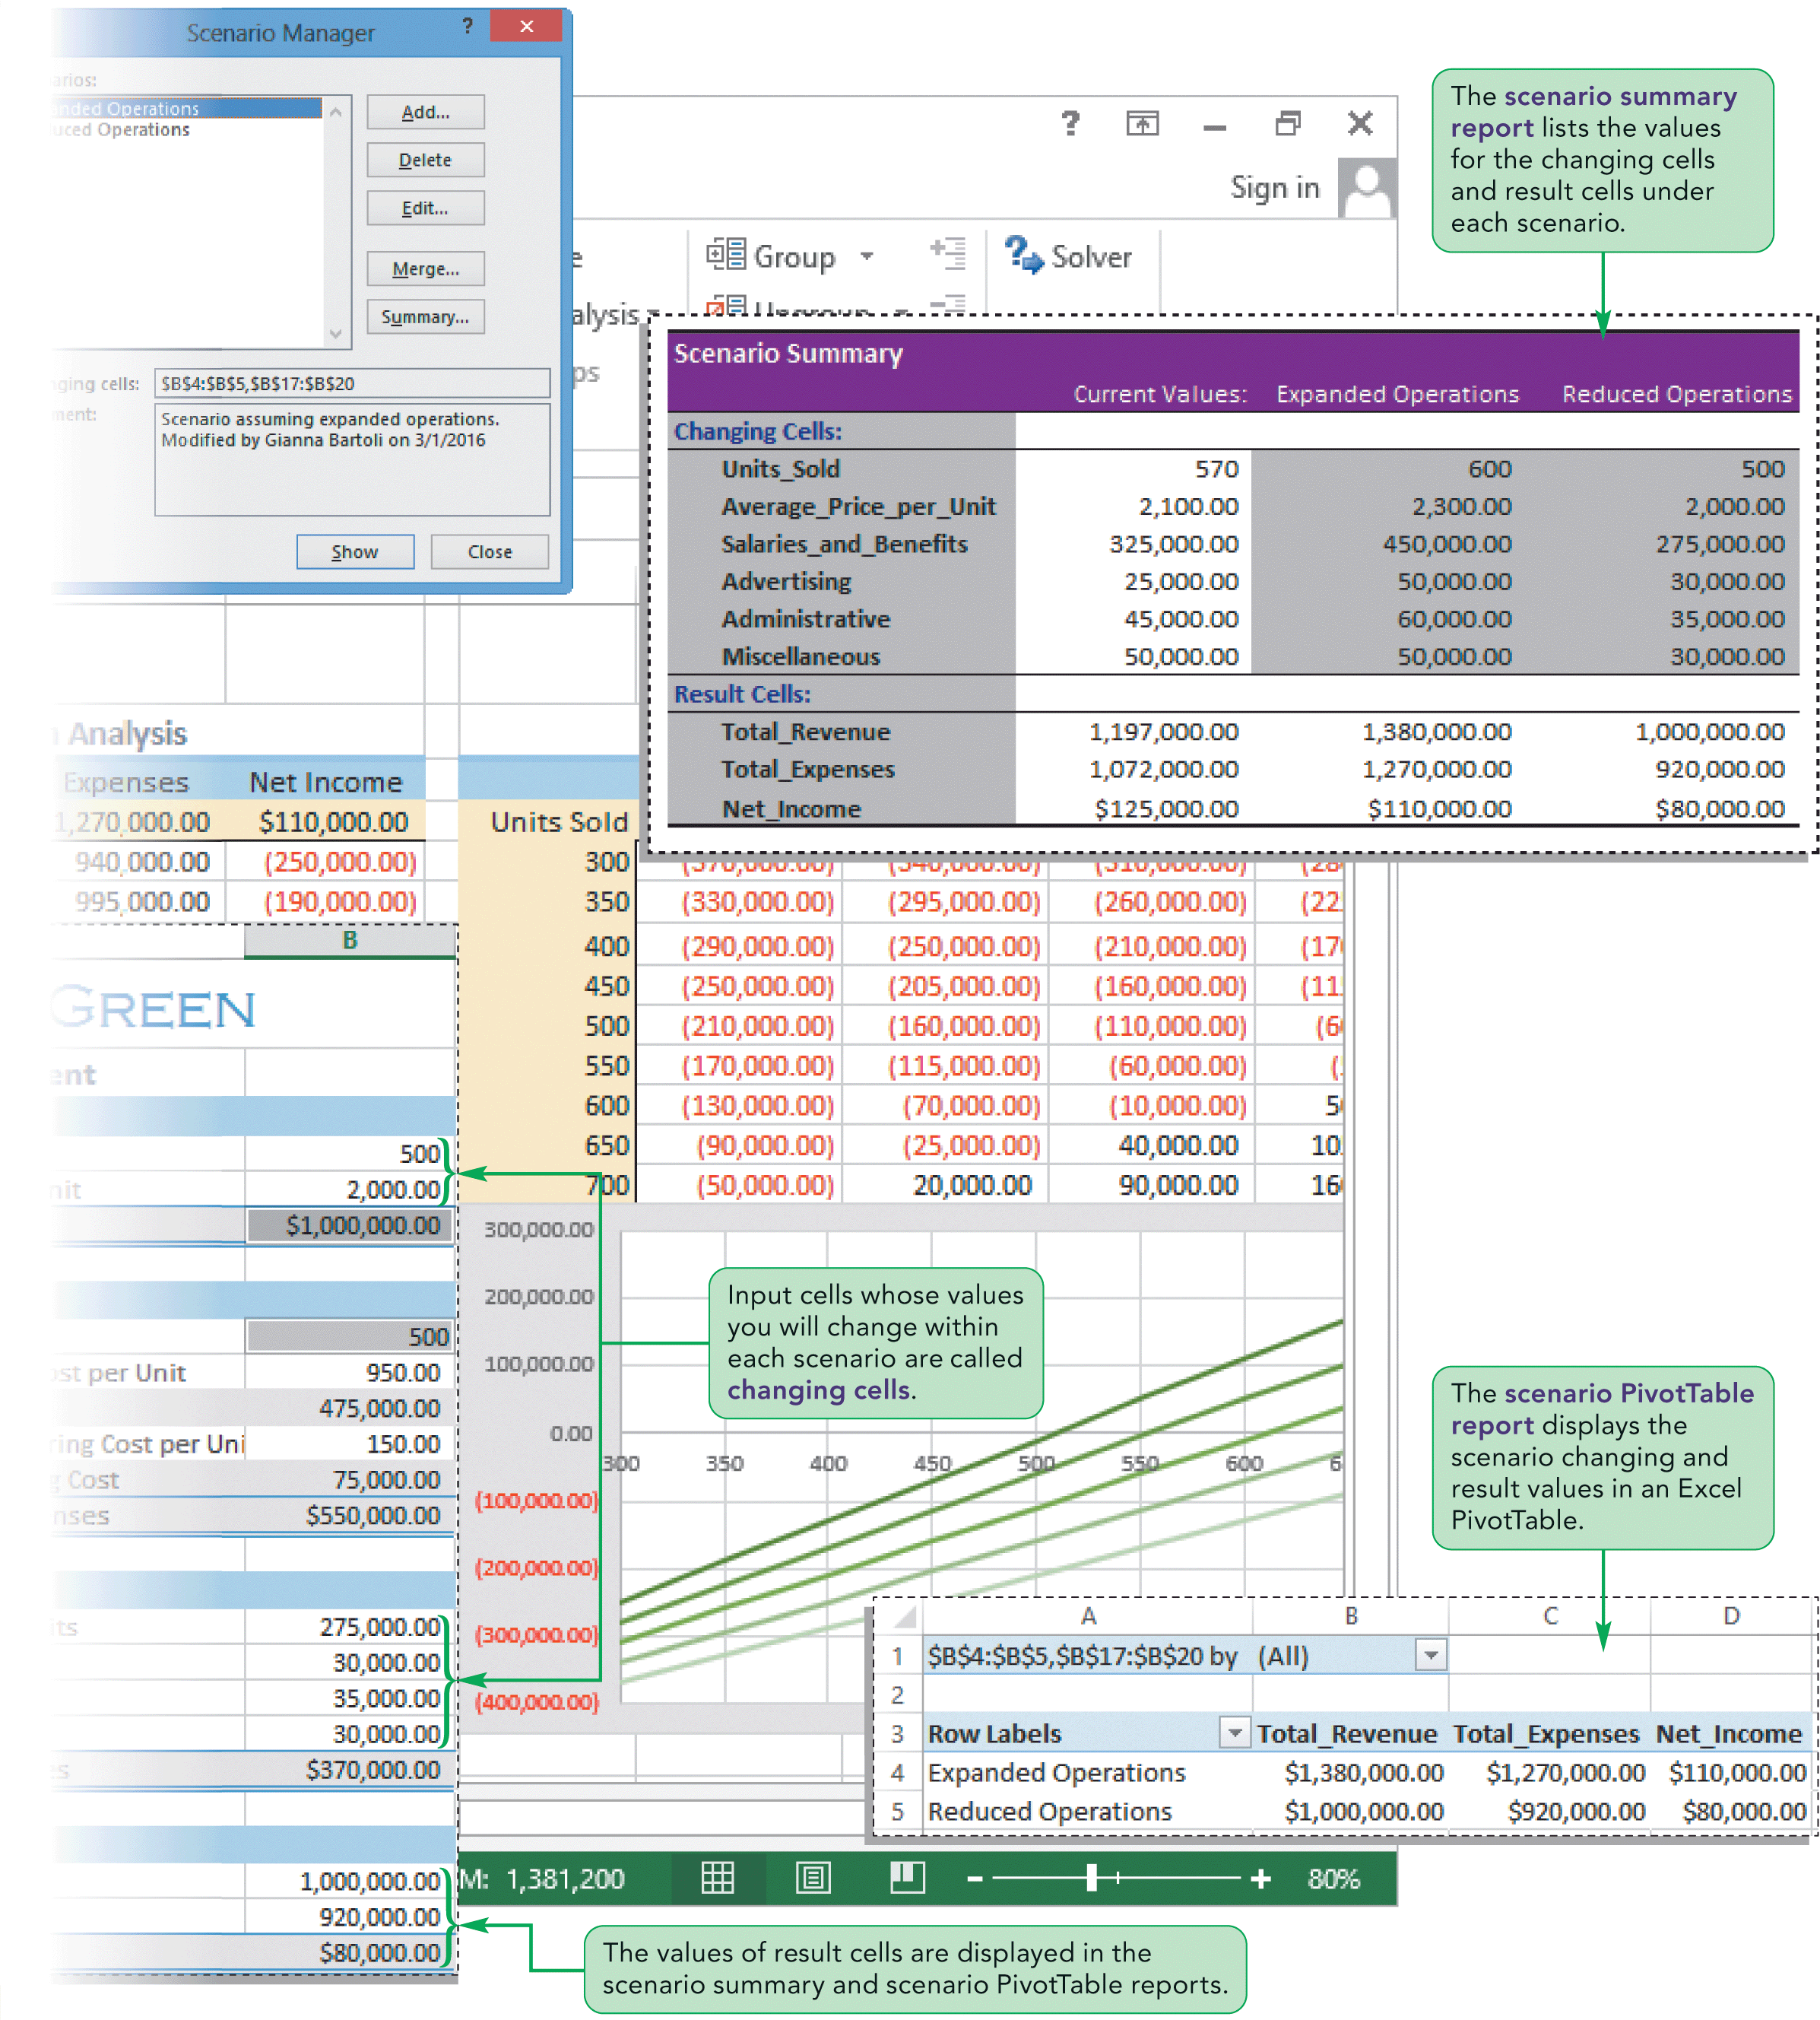
Visual Overview:
What-If Scenarios

Slide 25
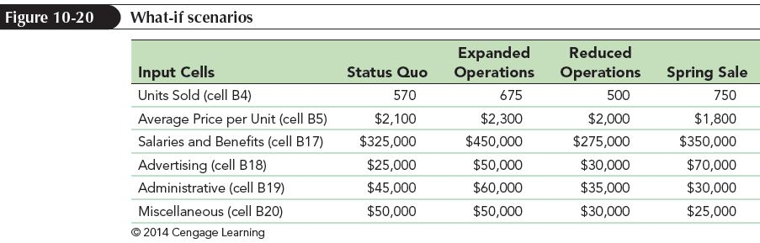
Developing Financial Scenarios with the Scenario Manager
Create scenarios to perform a what-if analysis with more than two input cells
A scenario is a defined set of values for different cells grouped under a common name

Slide 26
Developing Financial Scenarios with the Scenario Manager
Create scenarios using the Scenario Manager
  Lets you define input values within a named scenario and quickly switch from one to the other
  Can be used to create summary reports
Before using the Scenario Manager
  Define names for all input and result cells that you intend to use in the analysis
  Defined names automatically appear in reports generated by the Scenario Manager
  Using defined names makes it easier to work with scenarios and understand the scenario reports

Slide 27
Developing Financial Scenarios with the Scenario Manager
Defining a Scenario
  Each scenario includes a scenario name, input cells, and values for each input cell
  Number of scenarios is limited only by computer’s memory
  Input cells are referred to as “changing cells”
    Contain values that are changed under the scenario
    Can be located anywhere in the worksheet

Slide 28
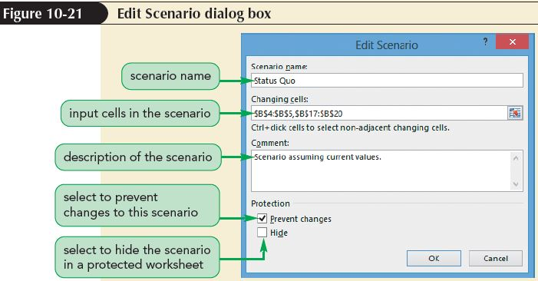
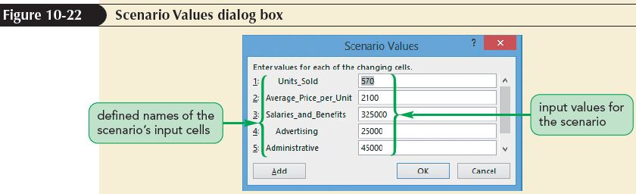
Developing Financial Scenarios with the Scenario Manager

Slide 29
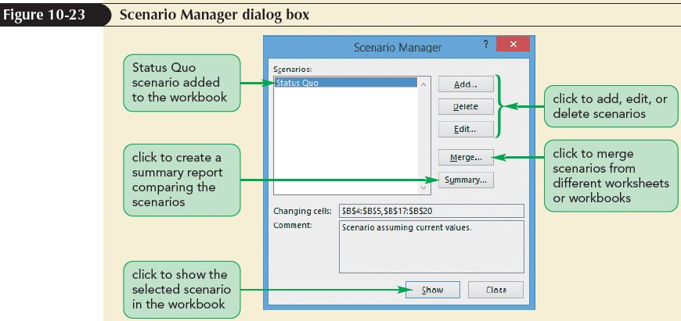
Developing Financial Scenarios with the Scenario Manager

Slide 30
Developing Financial Scenarios with the Scenario Manager
Viewing Scenarios
  View the effect of each scenario by selecting it in the Scenario Manager dialog box
  Switch from one scenario to another by clicking the Show button in the Scenario Manager dialog box
  Excel automatically changes the values of the input cells to match the scenario

Slide 31
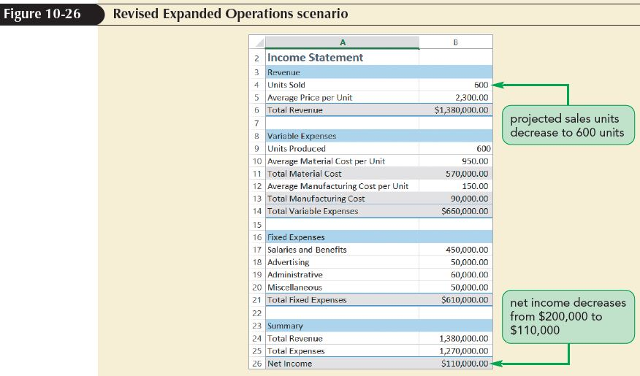
Developing Financial Scenarios with the Scenario Manager
Editing a Scenario
  Edit the assumptions to view other possible outcomes
  Worksheet calculations are automatically updated to reflect the new scenario

Slide 32
Creating a
Scenario Summary Report
Create a report either as an Excel table or as an Excel PivotTable to compare the results from multiple scenarios on a single worksheet
To create a scenario summary report, you must identify which result cells you want to include in the report
The scenario summary report displays the values of the input cells and result cells under each scenario
  Each scenario is listed by name
  The current worksheet values are also displayed
  The report used the defined names you created

Slide 33
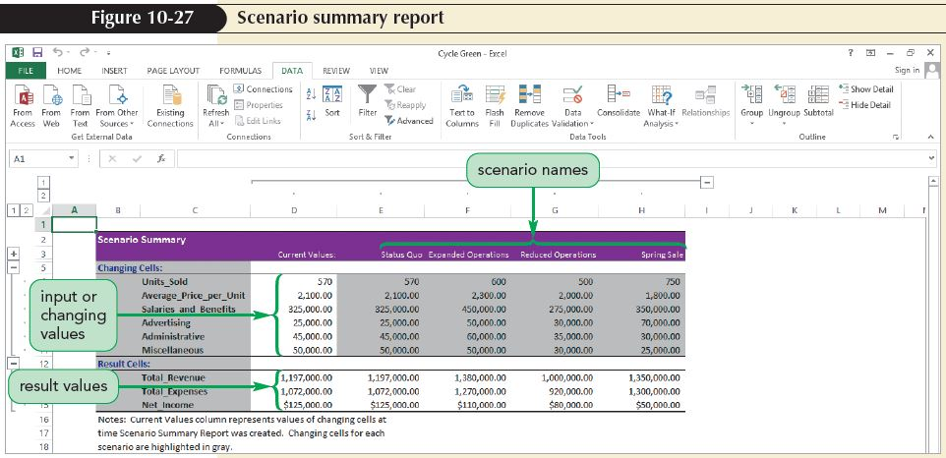
Creating a
Scenario Summary Report

Slide 34
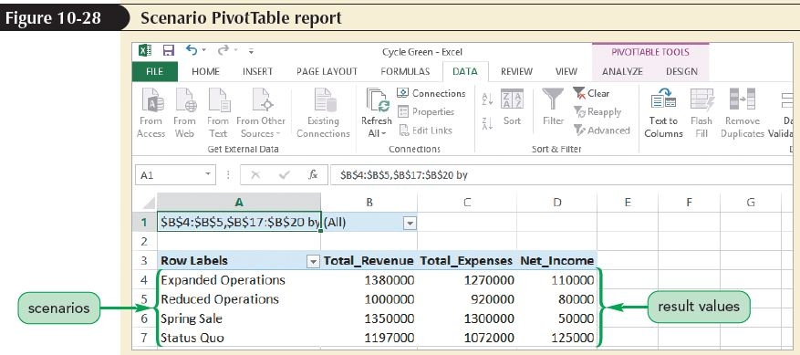
Creating a
Scenario Summary Report
A Scenario PivotTable report displays results from each scenario as a PivotTable field in a PivotTable
Scenario PivotTable reports are created through the Scenario Manager used to create a summary report

Slide 35
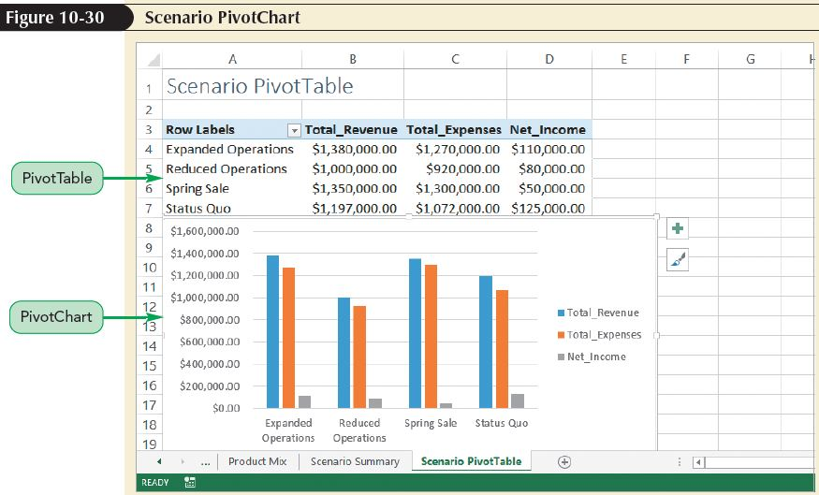
Creating a
Scenario Summary Report
You can edit the scenario PivotTable to make it easier to read
Results for a scenario PivotTable can be displayed in a PivotChart

Slide 36
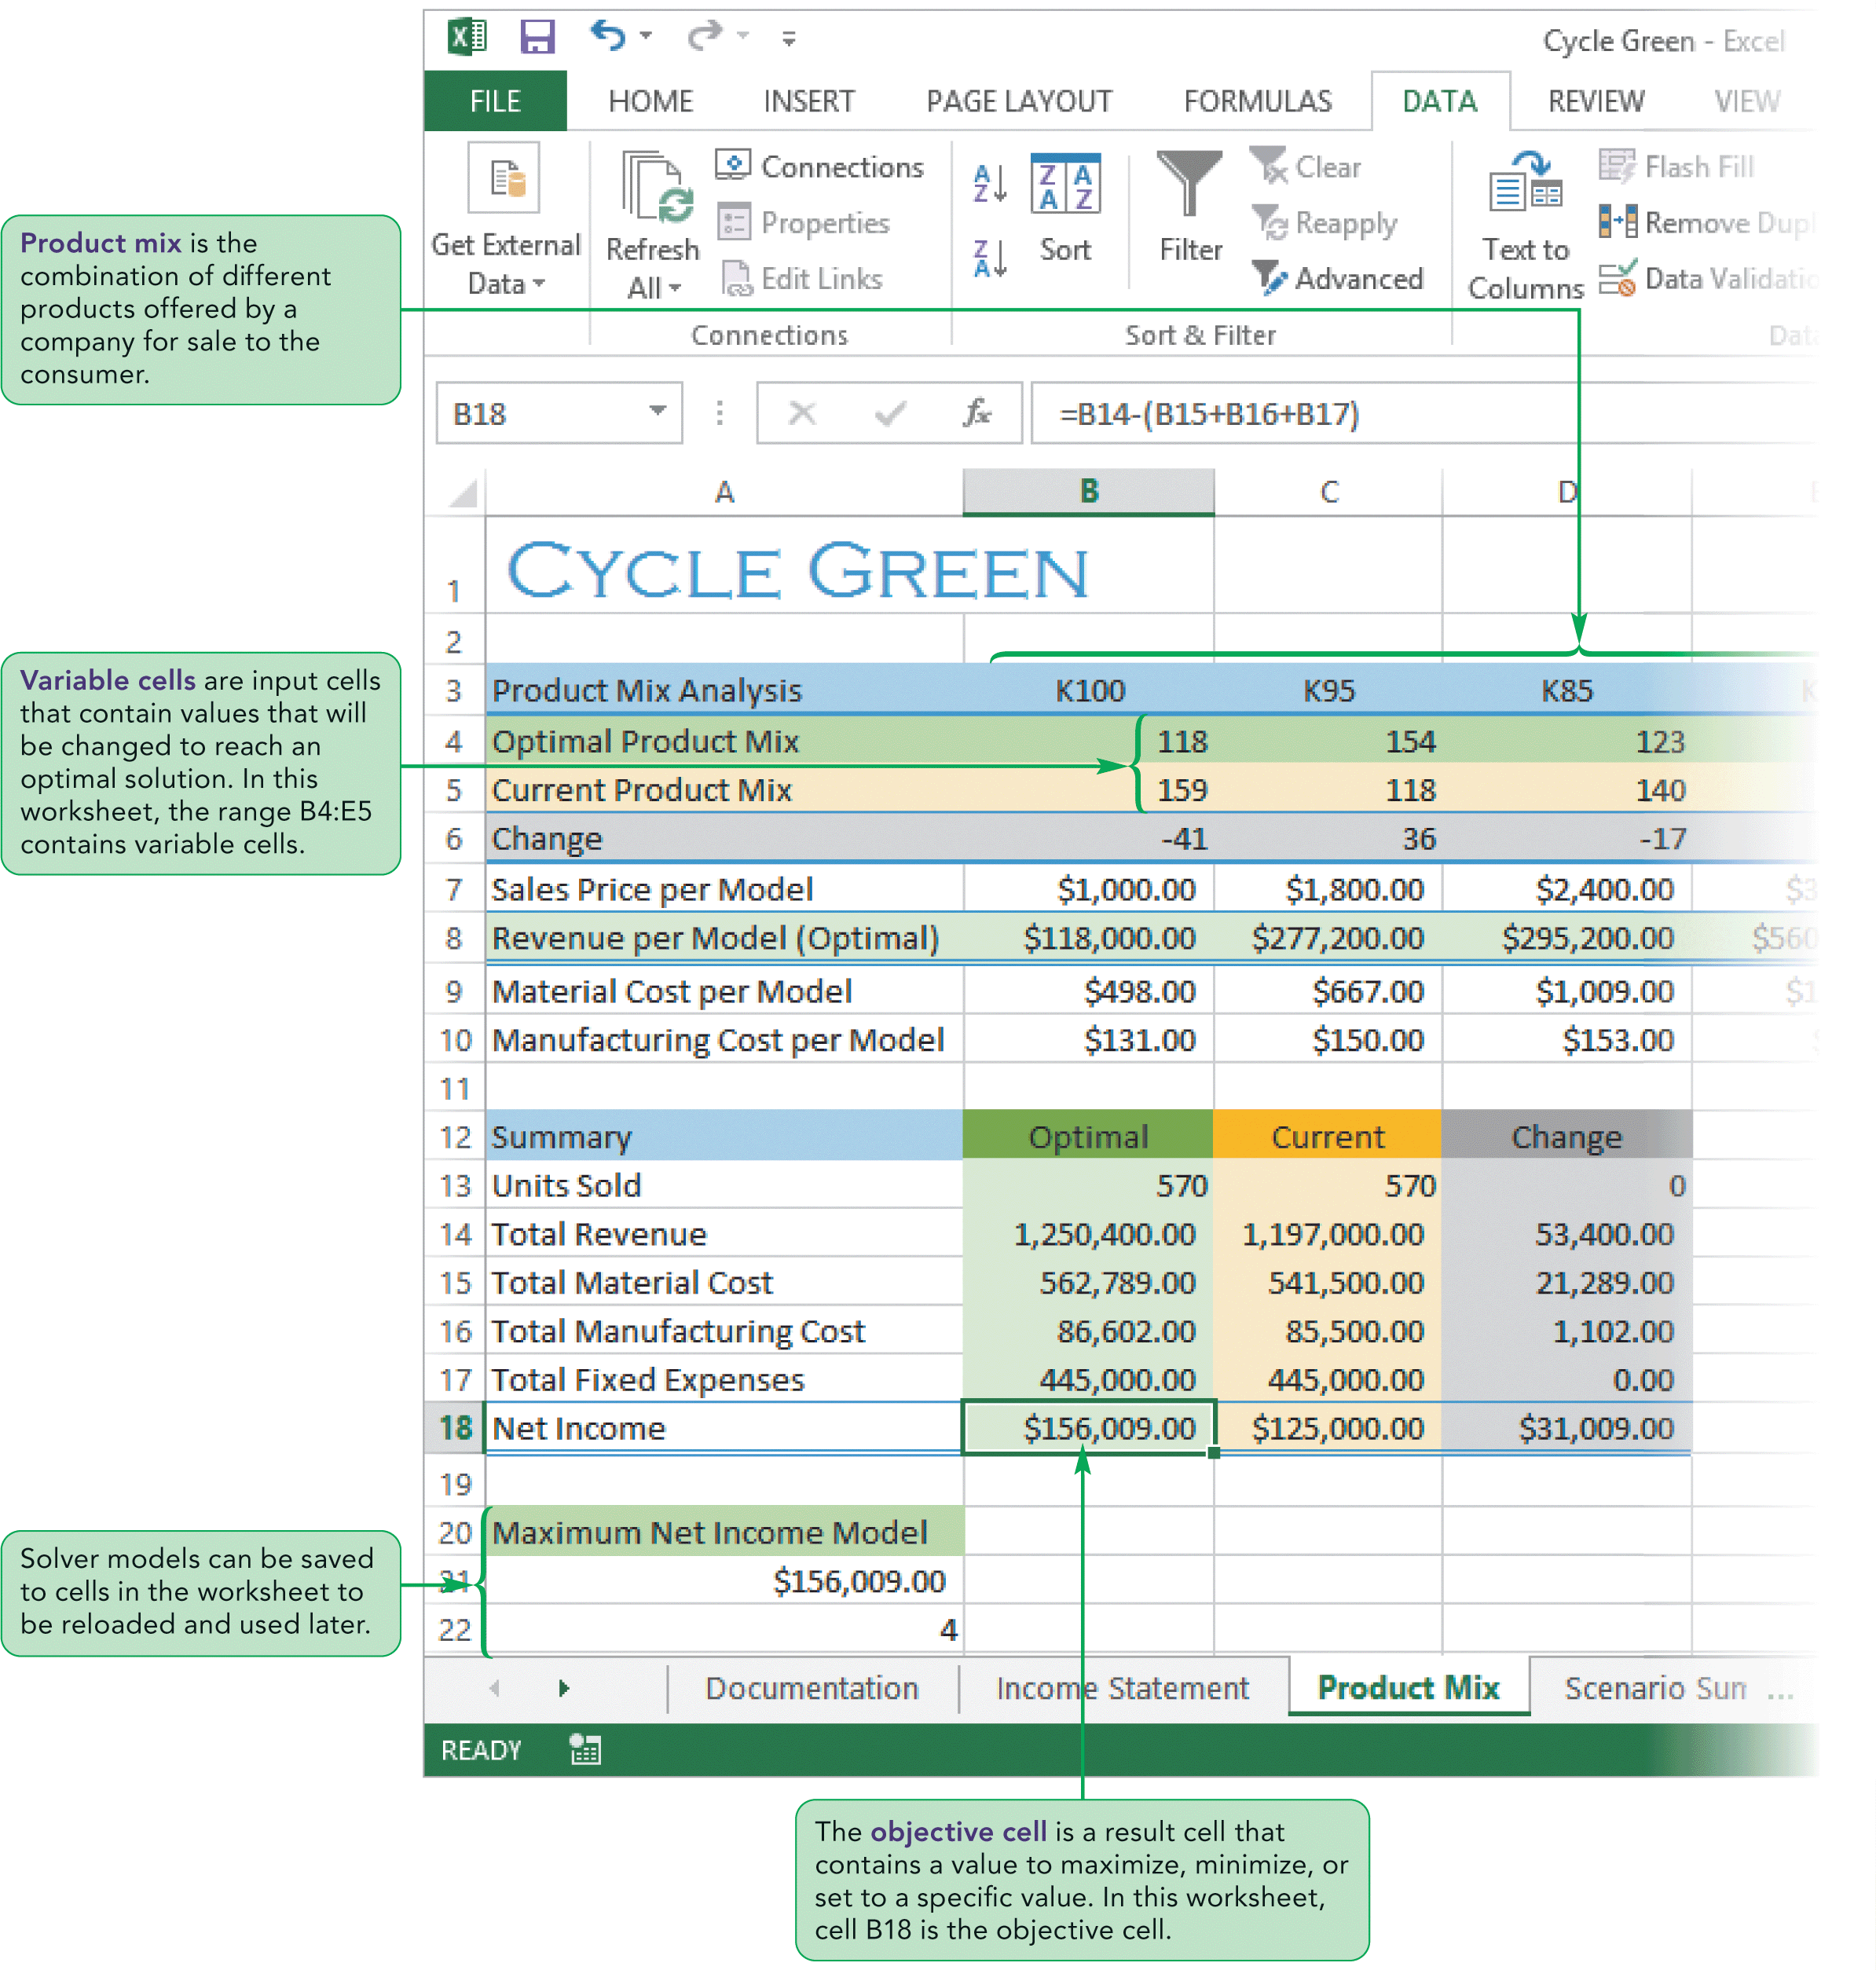
Visual Overview:
Optimal Solutions with Solver

Slide 37
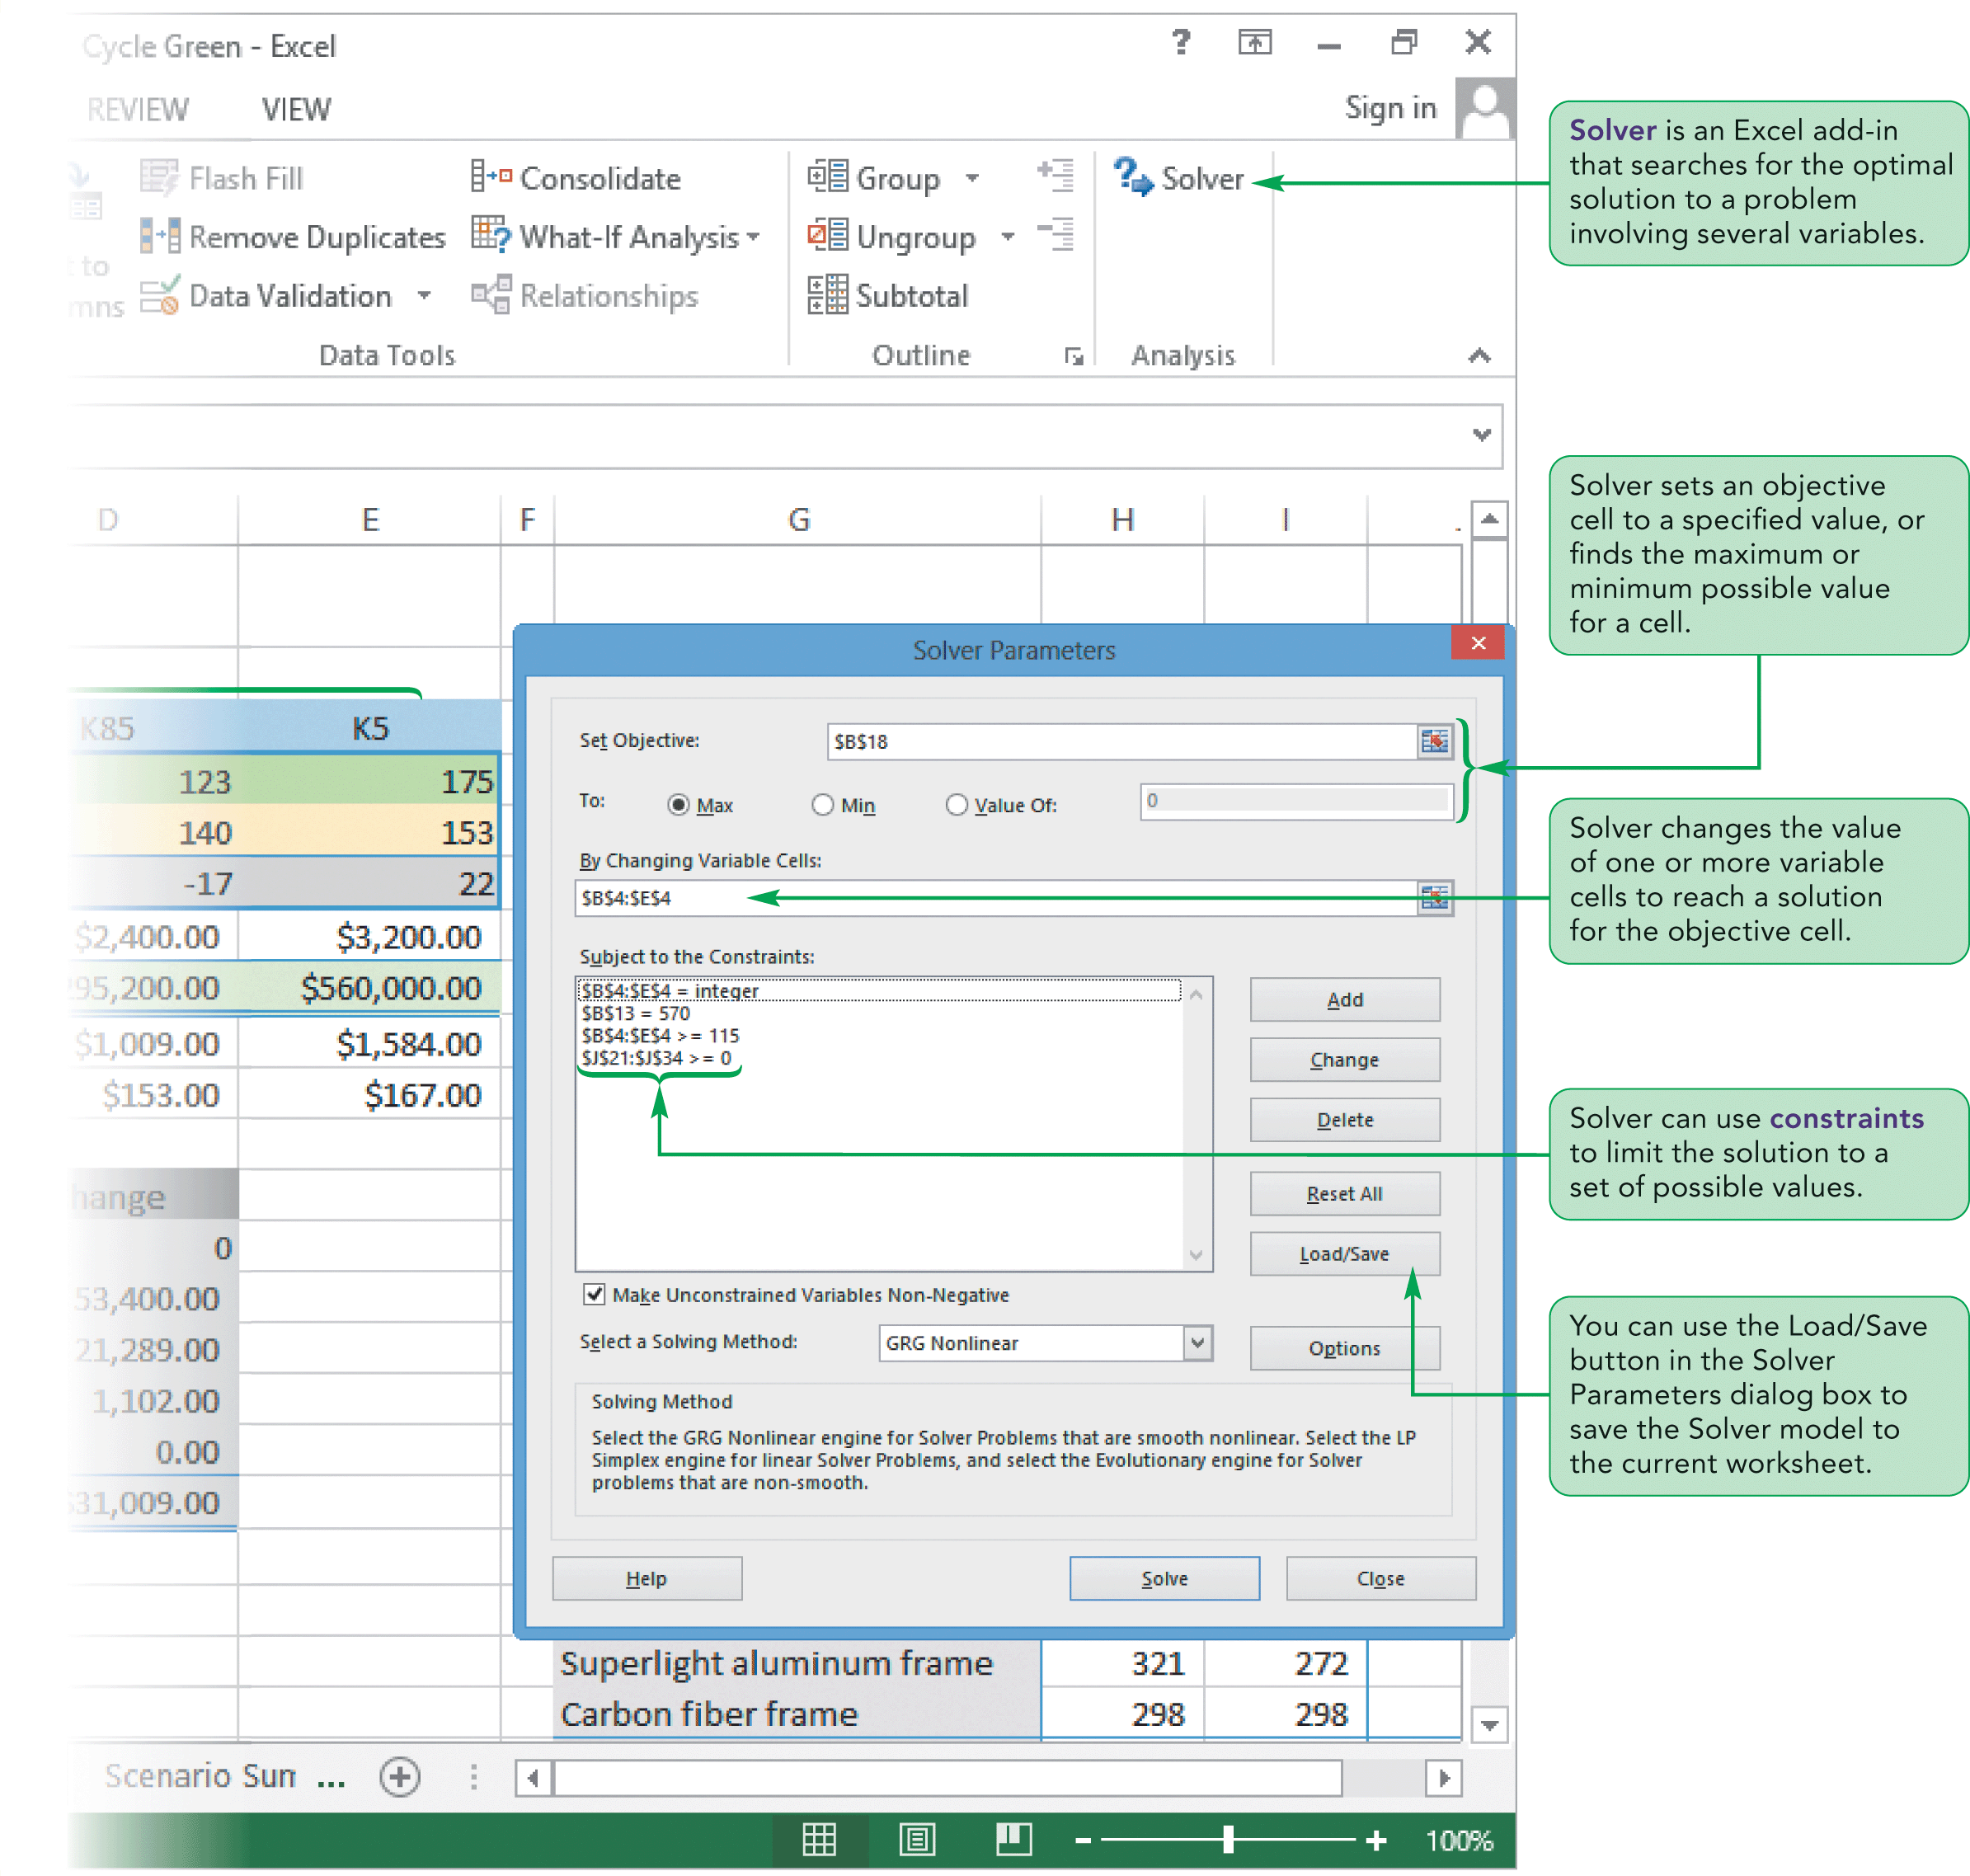
Visual Overview:
Optimal Solutions with Solver

Slide 38
Introducing Product Mix
The combination of products offered by a company is known as the company’s product mix
Products differ in their sales price, production costs, and attractiveness to consumers
A company might find that it is more profitable to devote more of its resources to selling one product over another
Goal is to maximize profits while meeting the demands of the market
The optimal product mix is the product mix that will result in the most profit for the company

Slide 39
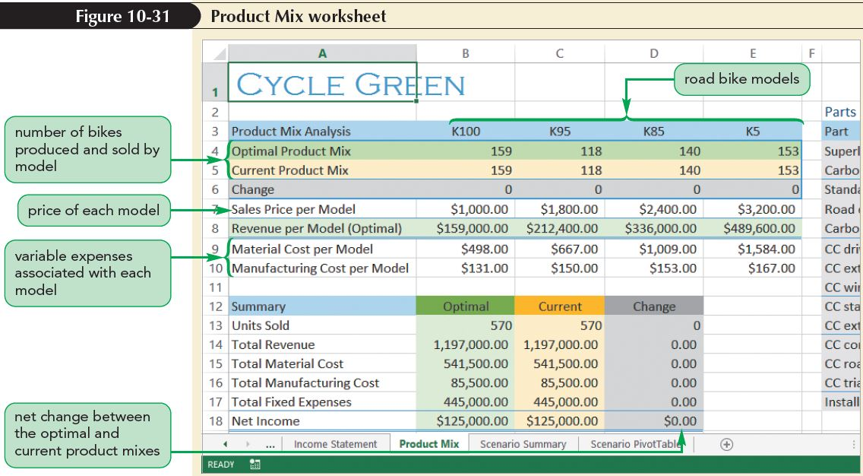
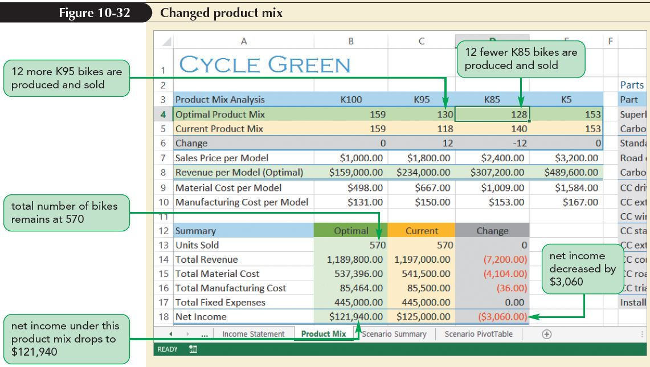
Introducing Product Mix

Slide 40
Introducing Product Mix
Different product mixes result in lower or higher profit for the company
The best way to find the optimal product mix usually isn’t obvious; there are too many possible combinations
To find the one product mix that results in the maximum net profit for the company, you can use Solver

Slide 41
Finding an Optimal Solution
Using Solver
Solver finds the numeric solution to a problem involving several input values
Solver can:
  Be used to find the combination of input values that maximizes profits
  Be used to find a set of input values that minimizes costs
  Act like Goal Seek and find the input values required to match a given result

Slide 42
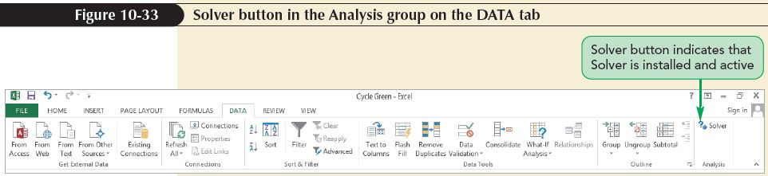
Finding an Optimal Solution
Using Solver
Activating Solver
  Solver is an add-in—a program that adds customized commands and features to Microsoft Office programs
  Solver might need to be activated before you can use it

Slide 43
Finding an Optimal Solution
Using Solver
Setting the Objective Cell and Variable Cells
  Every Solver model needs an objective cell and one or more variable cells
  An objective cell is a result cell that is maximized, minimized, or set to a specific value
  A variable cell is an input cell that changes so that the objective cell can meet its defined goal

Slide 44
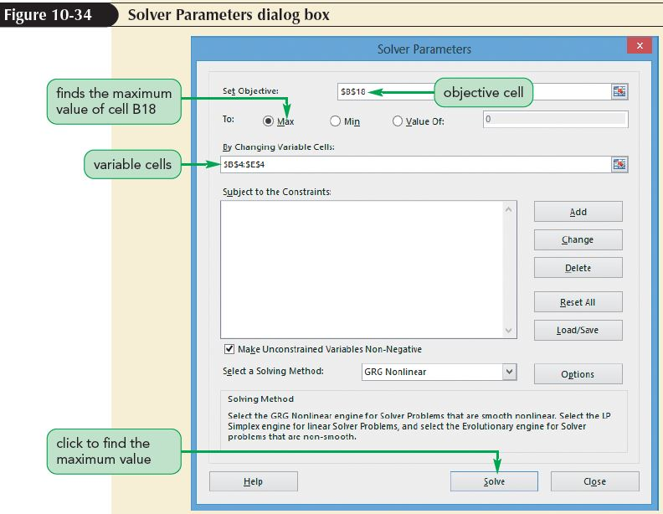
Finding an Optimal Solution
Using Solver

Slide 45
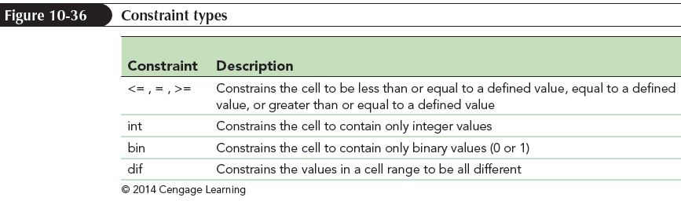
Finding an Optimal Solution
Using Solver
Adding Constraints to Solver
  Almost every Solver model needs one or more constraints
  A constraint is a limit that is placed on the solution
  Solver supports six types of constraints

Slide 46
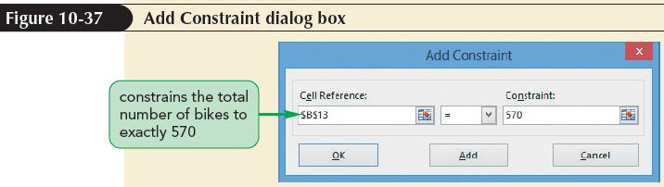
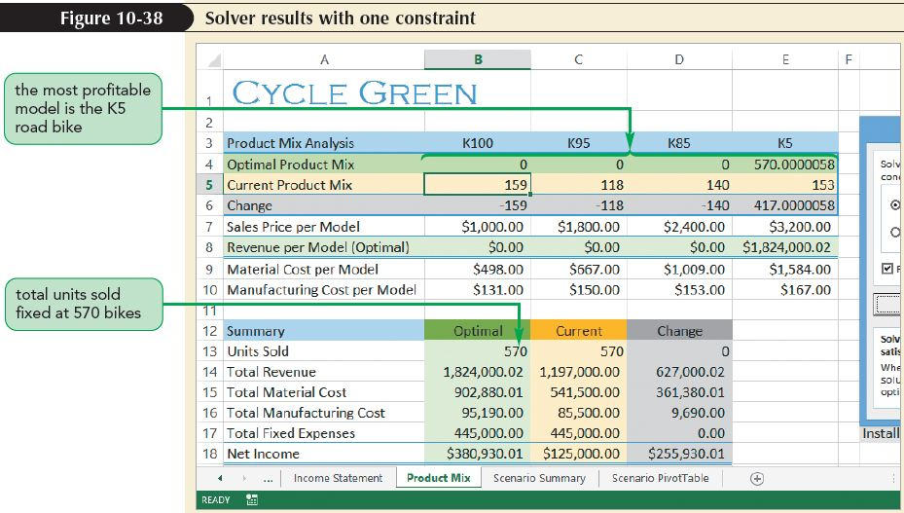
Finding an Optimal Solution
Using Solver

Slide 47
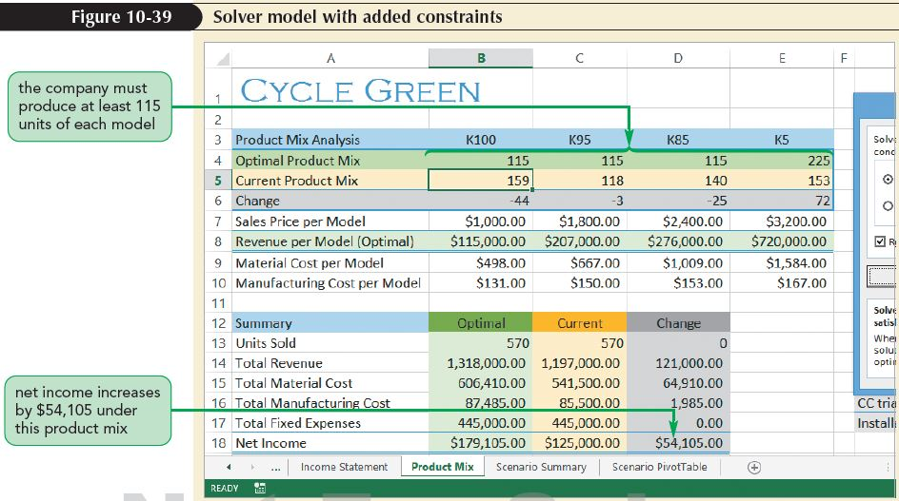
Finding an Optimal Solution
Using Solver

Slide 48
Creating a Solver Answer Report
Solver can create three different reports
  Answer report summarizes the results of a successful solution by displaying information about the objective cell, changing cells, and constraints
  Sensitivity report and limits report are often used in science and engineering to investigate the mathematical aspects of the Solver solution; these reports allow you to quantify the reliability of the solution

Slide 49
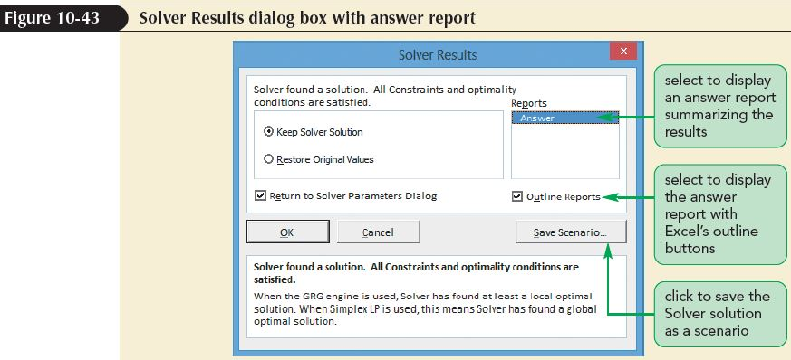
Creating a Solver Answer Report

Slide 50
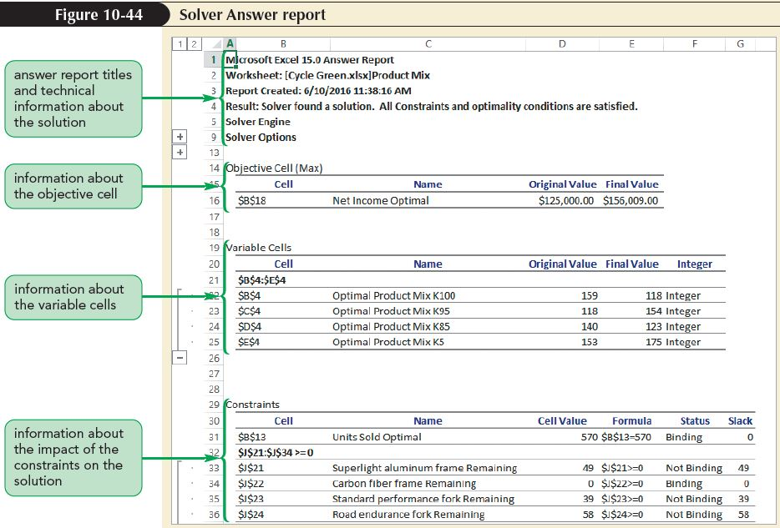
Creating a Solver Answer Report
The answer report is divided into the following sections:
  Title
  Solver Engine
  Solver Options
  Objective Cell
  Variable Cell
  Constraints

Slide 51
Creating a Solver Answer Report
The status of each constraint is listed as either Binding or Not Binding
  A binding constraint must be included in the Solver model and is a limiting factor in arriving at the solution
  A nonbinding constraint does not need to be included as part of the Solver model
The Constraints section also shows the slack for each constraint; the slack is the difference between the value in the cell and the value at the limit of the constraint

Slide 52
Saving and Loading Solver Models
You can apply several Solver models to the same data
You can store the Solver parameters for a model in worksheet cells that you can later retrieve and use to rerun that Solver model
By saving the Solver model parameters to cells on the worksheet, you can create as many models as you need to effectively analyze the data
You can then load and apply these different models to your analysis as new data is entered

Slide 53
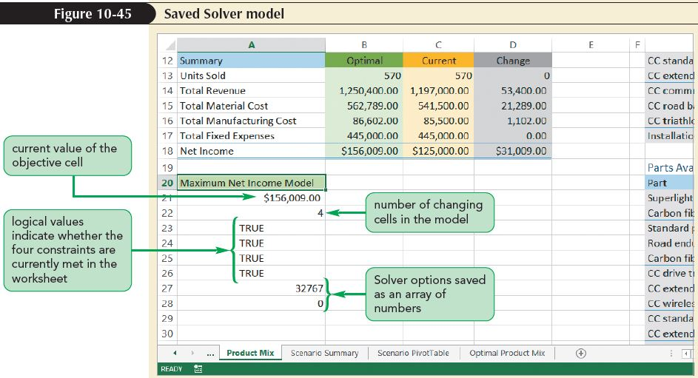
Saving and Loading Solver Models

