Slide 1
Tutorial 9:
Exploring Financial Tools and Functions

Slide 2
Objectives
2
2
2
Work with financial functions to analyze loans and investments
Create an amortization schedule
Calculate a conditional sum
Interpolate and extrapolate a series of values
Calculate a depreciation schedule

Slide 3
Objectives
Determine a payback period
Calculate a net present value
Calculate an internal rate of return
Trace a formula error to its source

Slide 4
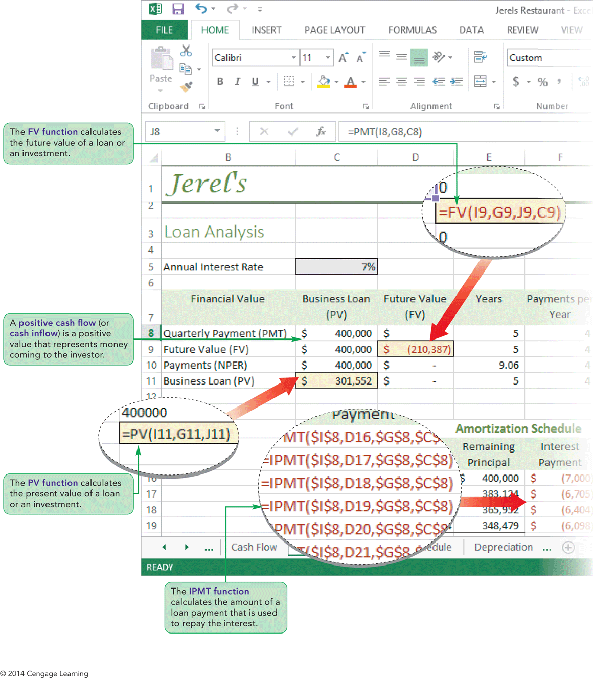
Visual Overview:
Loan and Investment Functions

Slide 5
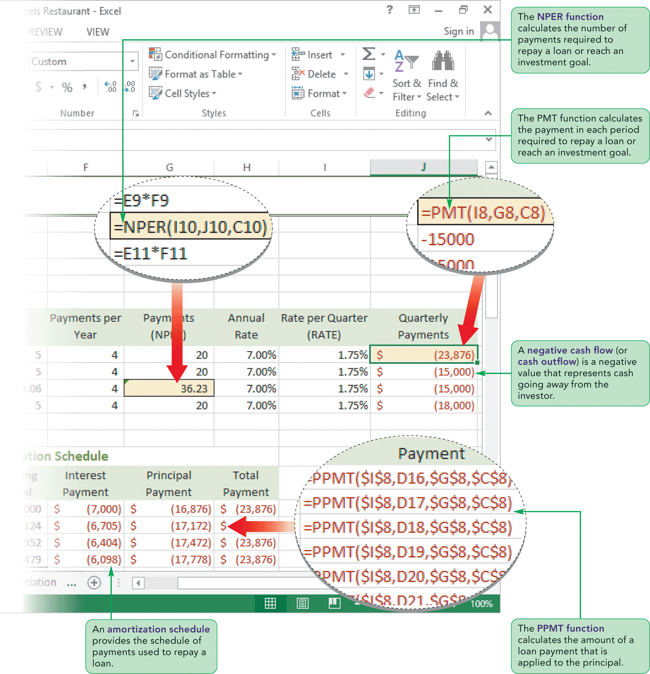
Visual Overview:
Loan and Investment Functions

Slide 6
Calculating Borrowing Costs
Calculating a Payment with the PMT Function
  The PMT function is used to determine the size of payments made periodically to either repay a loan or reach an investment goal
  The syntax of the PMT function is:
PMT(rate, nper, pv[, fv=0][, type=0])
    Rate is the interest rate per period
    NPER is the total number of payment periods
    PV is the present value of the loan or investment
    FV is the future value of the loan or investment after all of the scheduled payments have been made

Slide 7
Calculating Borrowing Costs
Calculating a Payment with the PMT Function (con’t)
  Optional type argument specifies whether payments are made at end (type=0) or beginning (type=1) of each period
  Interest rate and payment period must use same time unit
  Cash flow indicates the direction of money to and from an individual or a company
    Positive cash flow represents money that is coming to the individual or received
    Negative cash flow represents money that is leaving the individual or spent

Slide 8
Calculating Borrowing Costs
Calculating a Payment with the PMT Function (con’t)
  The pv argument for a loan is positive because it represents the amount of money being borrowed (coming to the individual)
  The PMT function for a loan returns a negative value because it represents money being spent to repay the loan (going away from the individual)
  The pv argument is negative when used with investments because it represents the initial amount of money being invested (or spent)
  The PMT function returns a positive value when used with investments because it represents returns from the investment coming back to the individual

Slide 9
Calculating Borrowing Costs
Calculating a Future Value with the FV Function
  Use the default value of 0 for the future value when the intent is to repay a loan completely
  When a loan will not be completely repaid, you can use the FV function to calculate the loan’s future value
  The syntax of the FV function is:
  FV(rate, nper, pmt[, pv=0][, type=0])

Slide 10
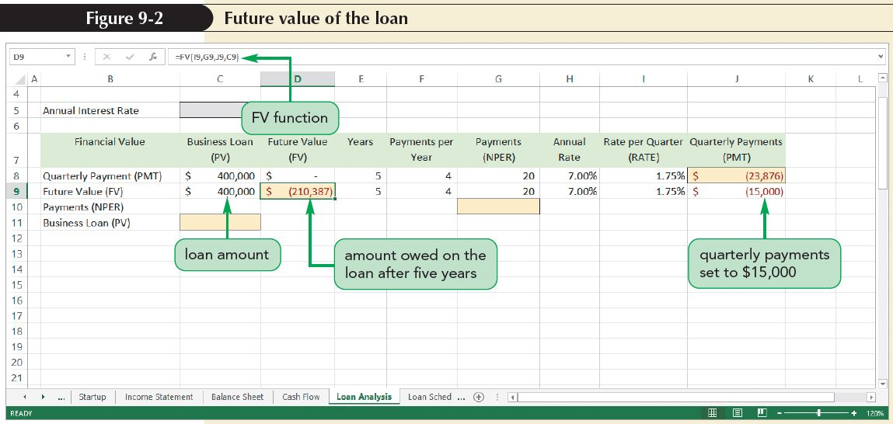
Calculating Borrowing Costs

Slide 11
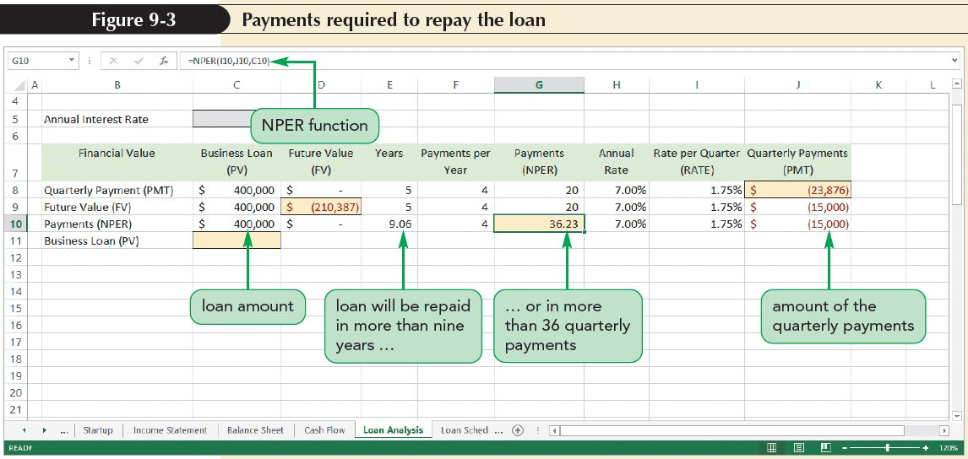
Calculating Borrowing Costs
Calculating the Payment Period with the NPER Function
  Returns the number of payment periods, not necessarily the number of years
  The syntax of the NPER function is:
  NPER(rate, pmt, pv [, fv=0] [, type=0])

Slide 12
Calculating Borrowing Costs
Calculating the Present Value with the PV Function
  The PV function calculates the present value of a loan or an investment
    For a loan, the present value would be the size of the loan
    For an investment, the present value is the amount of money initially placed in the investment account
  The syntax of the PV function is:
PV(rate, nper, pmt[, fv=0][, type=0])

Slide 13
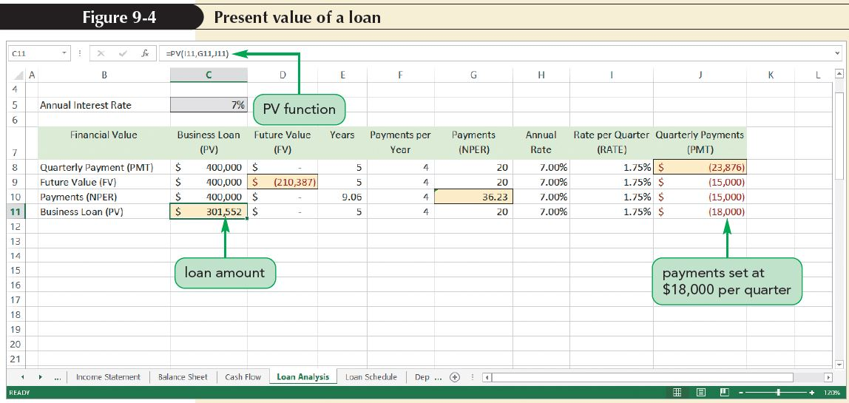
Calculating Borrowing Costs

Slide 14
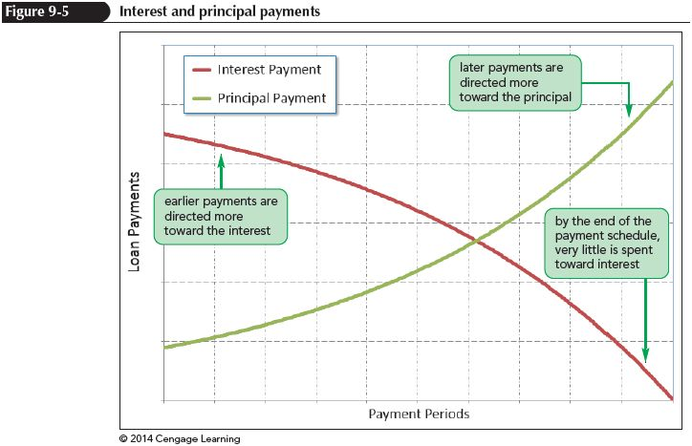
Creating an Amortization Schedule
Amortization schedule specifies how much of each loan payment is devoted toward interest and toward repaying the principal
Principal is the
amount of the
loan that is
still unpaid

Slide 15
Creating an Amortization Schedule
Calculating Interest and Principal Payments
  To calculate the amount of a loan payment devoted to interest and to principal, use the IPMT and PPMT functions
  The IPMT function returns the amount of a particular payment that is used to pay the interest on the loan; it has the syntax:
  =IPMT(rate, per, nper, pv[, fv=0][, type=0])
  The per argument defines the period for which you want to calculate the interest due

Slide 16
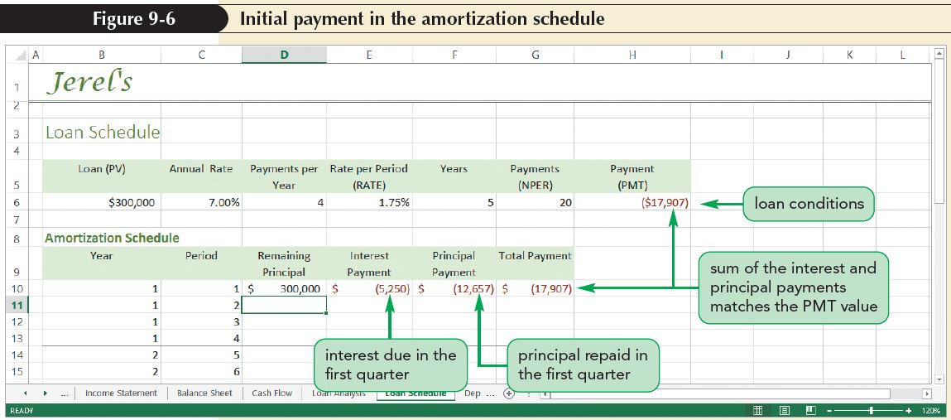
Creating an Amortization Schedule
Calculating Interest and Principal Payments (con’t)
  The PPMT function calculates the amount used to repay the principal
  The PPMT function has the following syntax:
=PPMT(rate, per, nper, pv[, fv=0][, type=0])

Slide 17
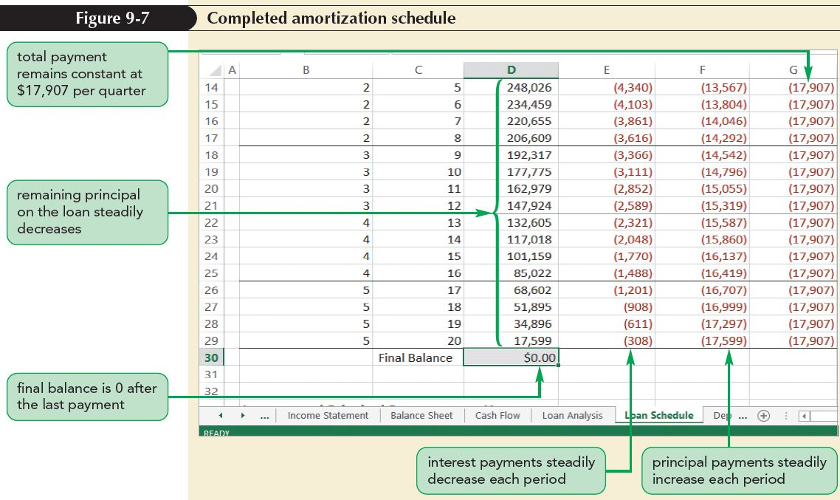
Creating an Amortization Schedule

Slide 18
Creating an Amortization Schedule
Calculating Cumulative Interest and Principal Payments
  Cumulative totals of interest and principal payments can be calculated using the CUMIPMT and CUMPRINC functions
  The CUMIPMT function calculates the sum of several interest payments and has the syntax:
  CUMIPMT(rate, nper, pv, start, end, type)
    Start is the starting payment period for the interval you want to sum
    End is the ending payment period

Slide 19
Creating an Amortization Schedule
Calculating Cumulative Interest and Principal Payments (con’t)
  This function has no fv argument; the assumption is that loans are always completely repaid
  Note that the type argument is not optional; you must specify whether the payments are made at the start of the period (type=0) or at the end (type=1)

Slide 20
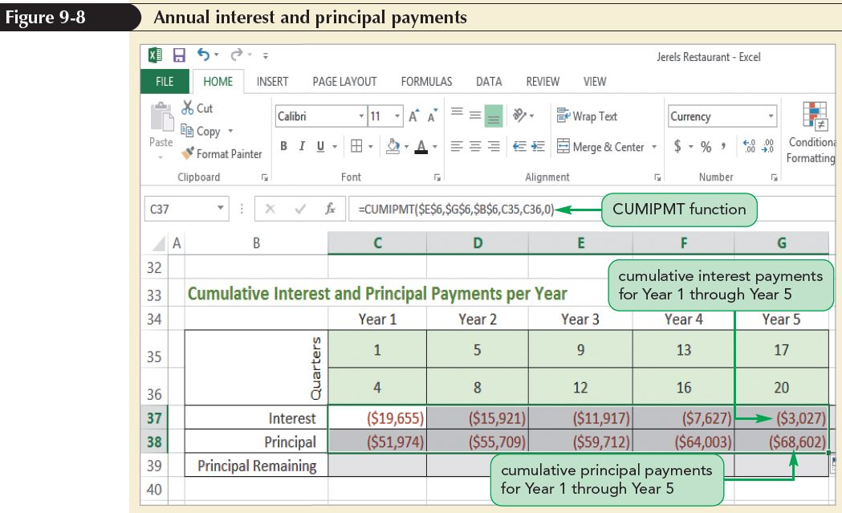
Creating an Amortization Schedule

Slide 21
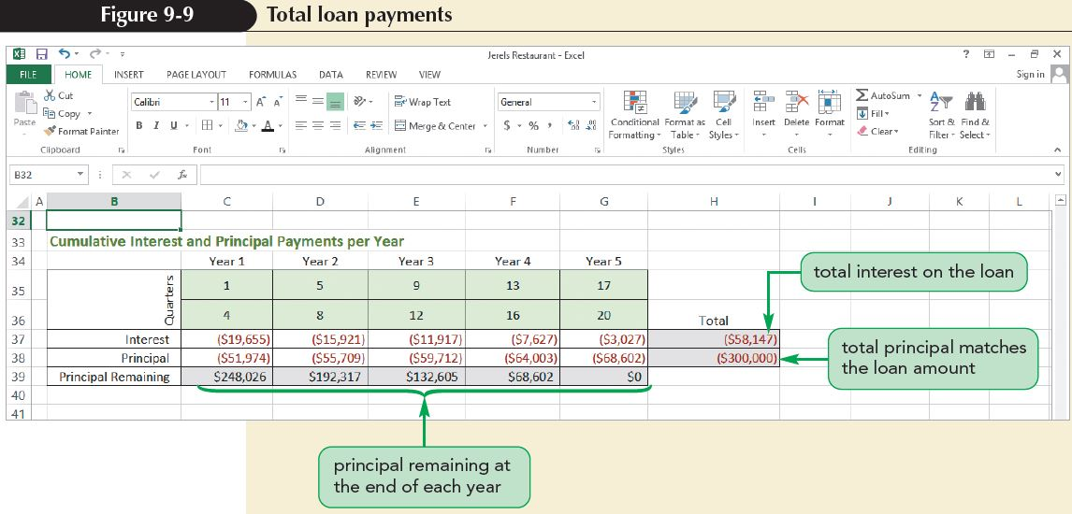
Creating an Amortization Schedule

Slide 22
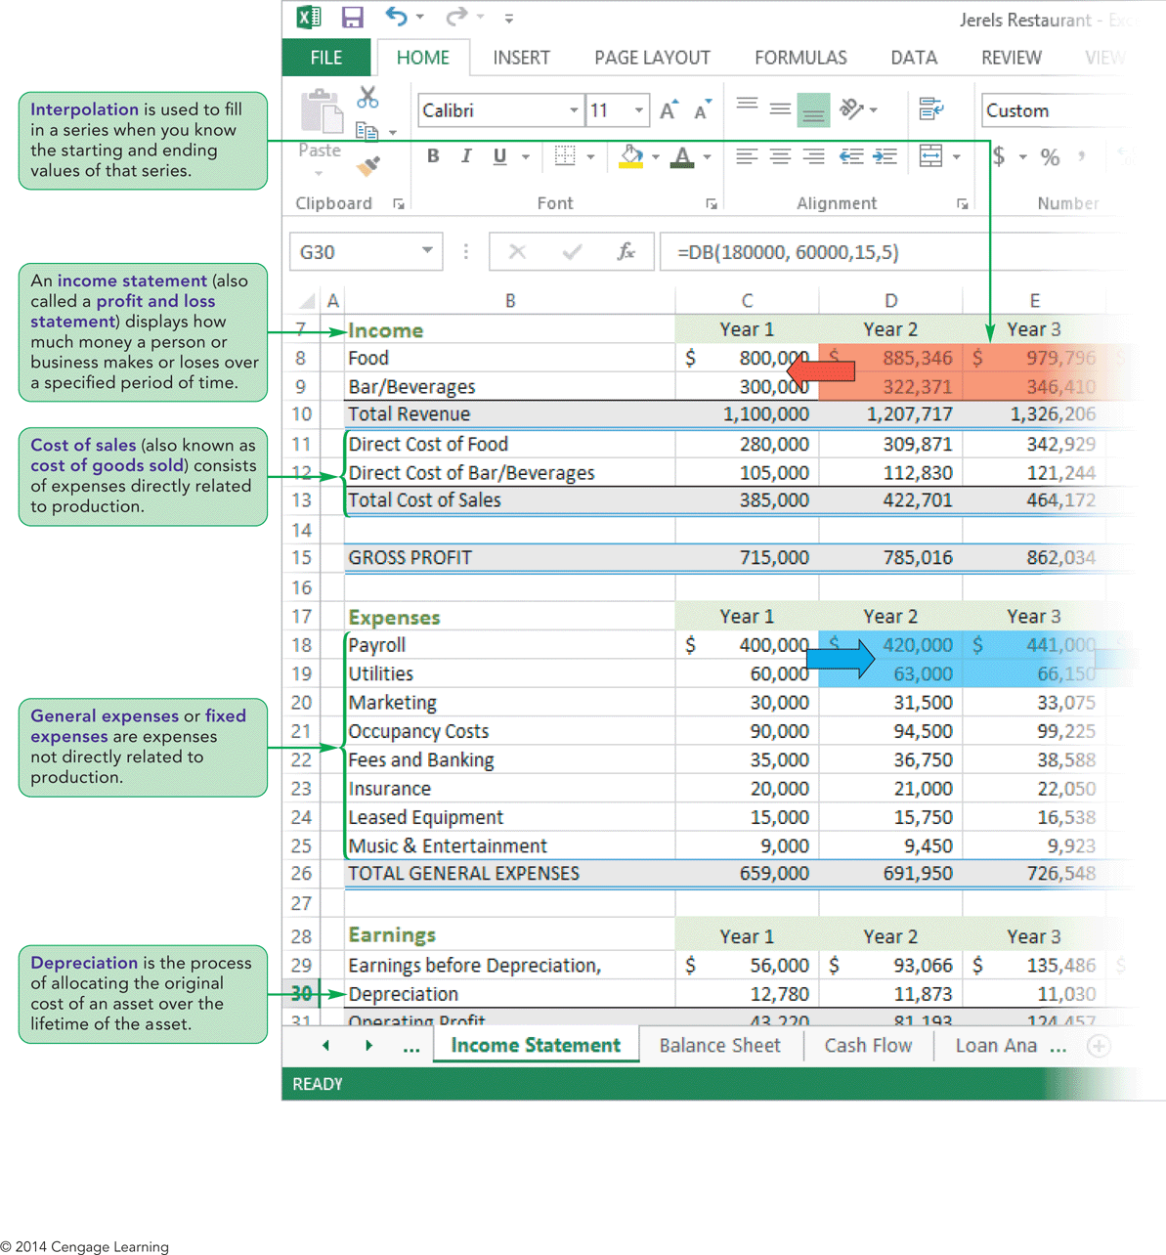
Visual Overview: Income Statement and Depreciation

Slide 23
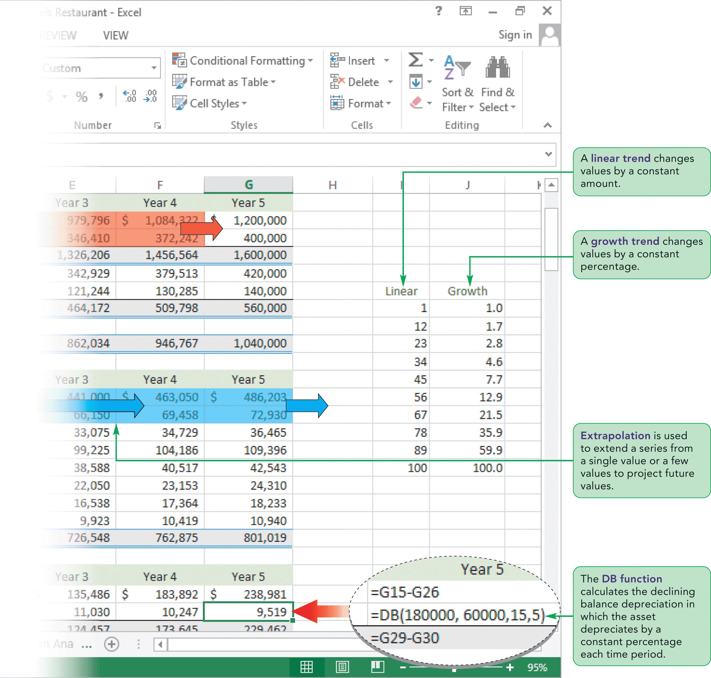
Visual Overview: Income Statement and Depreciation

Slide 24
Projecting Future
Income and Expenses
A key business report is the income statement, also known as a profit and loss statement, which shows a business’s income and expenses over a specified period of time
Income statements are often created:
  Monthly
  Semiannually
  Annually

Slide 25
Projecting Future
Income and Expenses
Most income statements are divided into three main sections:
  The Income section projects the income from sales as well as the cost of supplying those items
  The Expenses section projects the general expenses incurred from operations
  The Earnings section estimates the net profit and tax liability

Slide 26
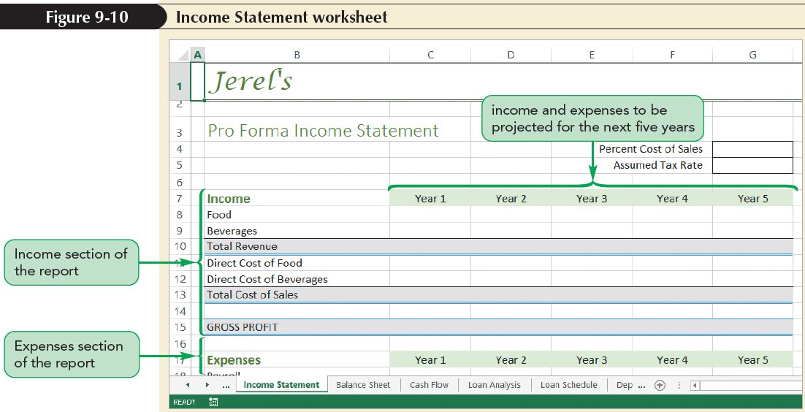
Projecting Future
Income and Expenses

Slide 27
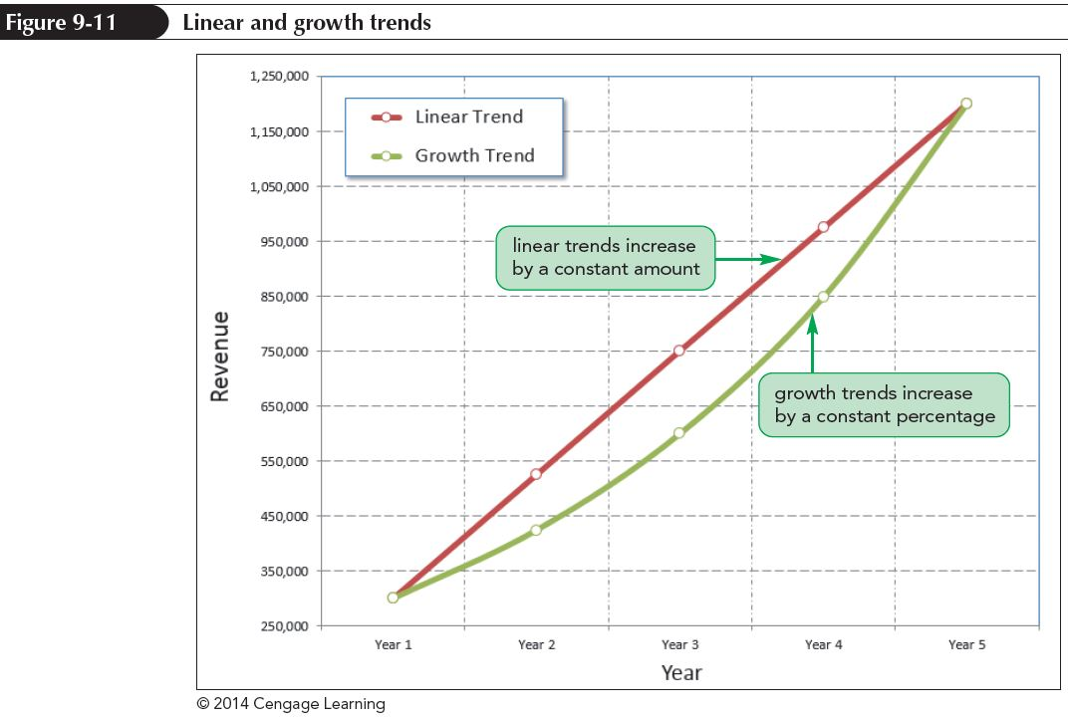
Projecting Future
Income and Expenses
Exploring Linear and Growth Trends
  Linear trend
    Values change by a
    constant amount
    Appears as a straight
    line
  Growth trend
    Values change by a
    constant percentage
    Appears as a curve;
    greatest increases
    occur near end of series

Slide 28
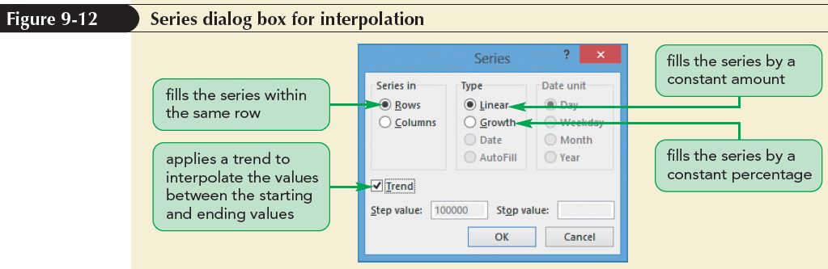
Projecting Future
Income and Expenses
Interpolating from a Starting Value to an Ending Value
  If you know beginning and ending values in a series and whether they constitute a linear or growth trend, AutoFill can fill in missing values

Slide 29
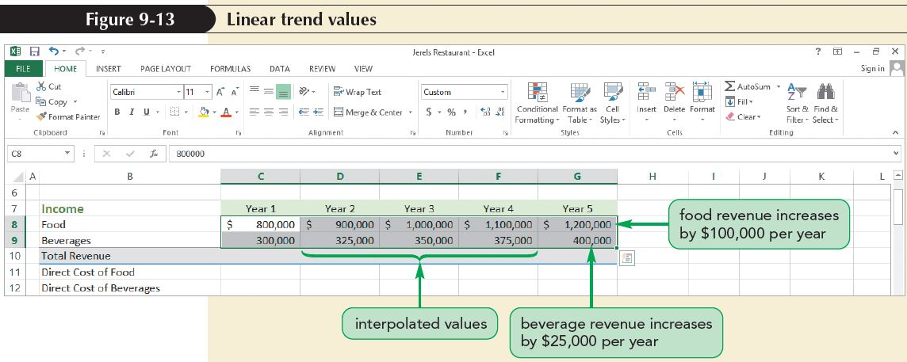
Projecting Future
Income and Expenses

Slide 30
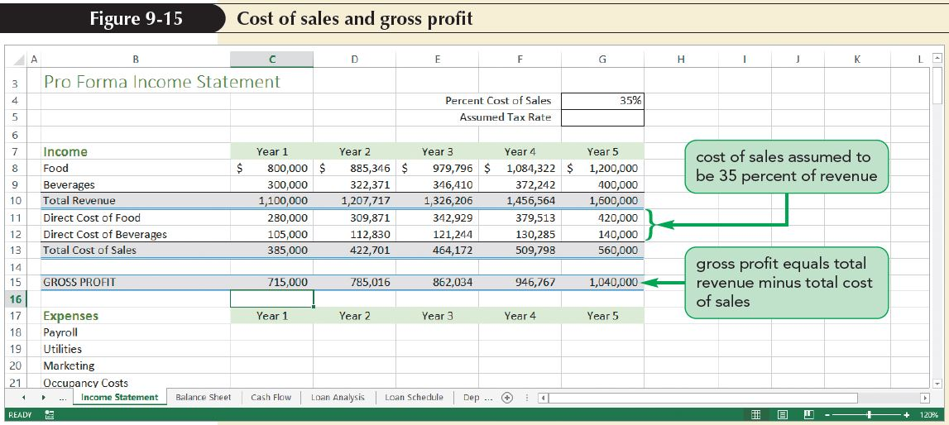
Projecting Future
Income and Expenses
Calculating the Cost of Sales
  Another part of the income statement is the cost of sales, also known as the cost of goods sold
  The difference between sales revenue and cost of goods sold is known as gross profit

Slide 31
Projecting Future
Income and Expenses
Extrapolating from a Series of Values
  Differs from interpolation in that only a starting value is provided
  Succeeding values are estimated by assuming that values follow a trend
  Excel can extrapolate a data series based on either a linear trend or a growth trend
    With a linear trend, values are assumed to change by a constant amount
    With a growth trend, values are assumed to change by a constant percentage

Slide 32
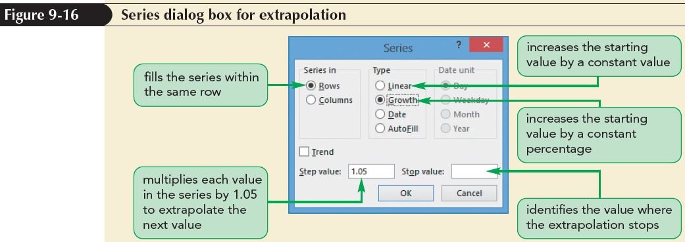
Projecting Future
Income and Expenses
Extrapolating from a Series of Values
  To extrapolate a data series:
  Provide a step value representing the amount by which each value is changed
  You do not have to specify a stopping value

Slide 33
Calculating Depreciation of Assets
Tangible assets are a company’s non-cash assets such as equipment, land, buildings, and vehicles
Tangible assets wear down over time and lose their value; the loss of the asset’s original value doesn’t usually happen all at once, but is spread out over several years in a process known as depreciation
Different types of tangible assets have different rates of depreciation:
  Some items depreciate faster than others
  Some items maintain their value for longer

Slide 34
Calculating Depreciation of Assets
To calculate the depreciation of an asset, you need to know the following:
  Asset’s original cost
  Length of the asset’s useful life
  Asset’s salvage value (value at the end of its useful life)
  Rate at which the asset is depreciated over time
There are several ways to depreciate an asset
  Straight-line depreciation
  Declining balance depreciation

Slide 35
Calculating Depreciation of Assets
Straight-Line Depreciation
  With straight-line depreciation, the asset loses value by equal amounts each year until it reaches the salvage value at the end of its useful life
  The SLN function has the syntax:
  SLN(cost, salvage, life)
    Cost is the initial cost or value of the asset
    Salvage is the salvage value of the asset at the end of its useful life
    Life is the number of periods over which the asset will be depreciated

Slide 36
Calculating Depreciation of Assets
Declining Balance Depreciation
  Under declining balance depreciation, the asset depreciates by a constant percentage each year
    Depreciation value is highest early in its lifetime
    As asset loses value, depreciation amounts steadily decrease, though the percentage decrease remains the same
    Is an example of a negative growth trend
  Asset depreciates more quickly initially under declining balance model than a straight-line model

Slide 37
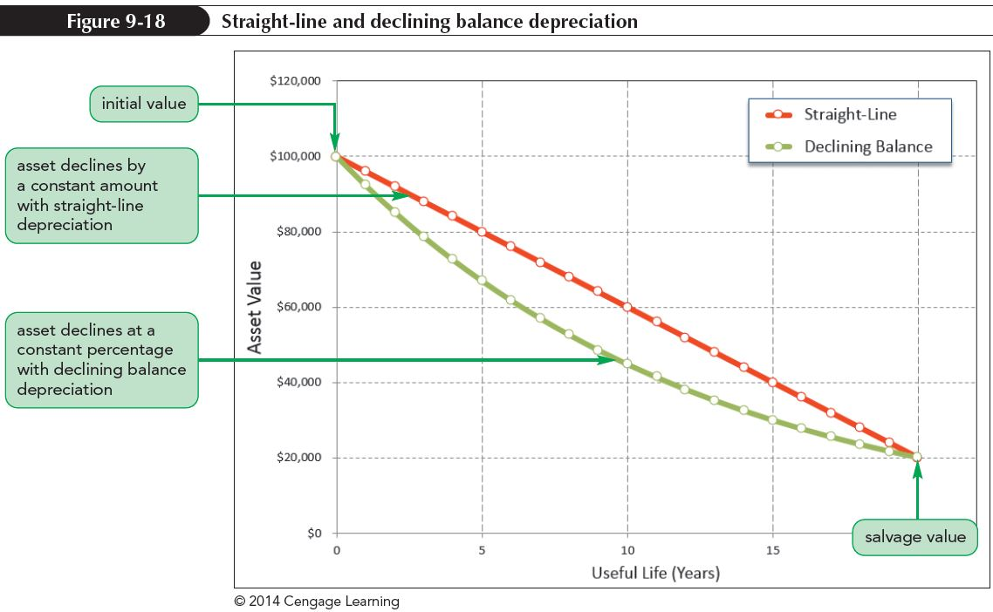
Calculating Depreciation of Assets
Declining Balance Depreciation (con’t)
  The DB function has the syntax:
  DB(cost, salvage, life, period[, month=12])

Slide 38
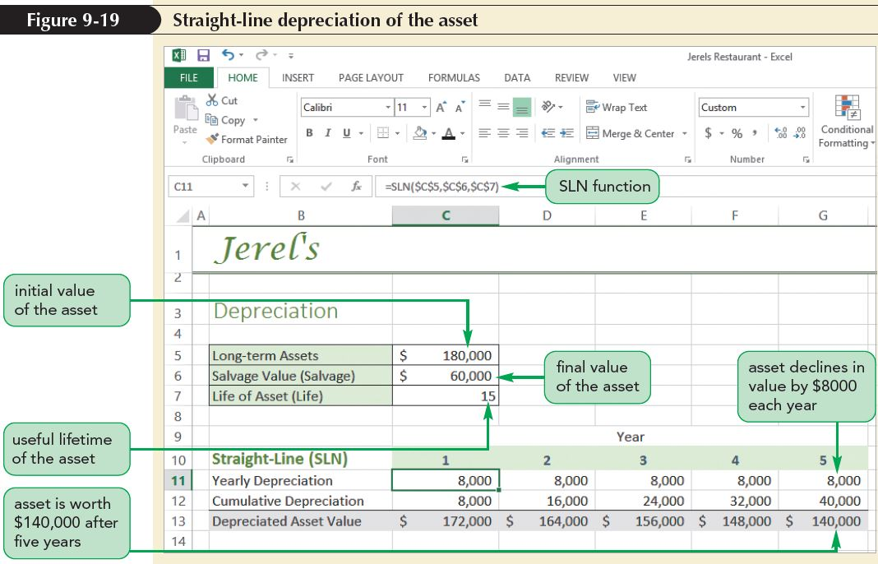
Calculating Depreciation of Assets

Slide 39
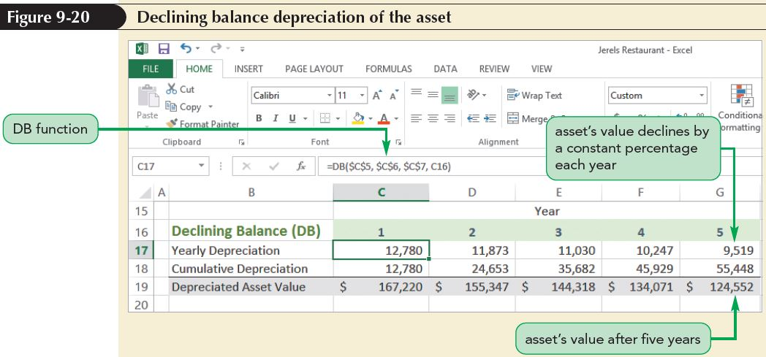
Calculating Depreciation of Assets

Slide 40
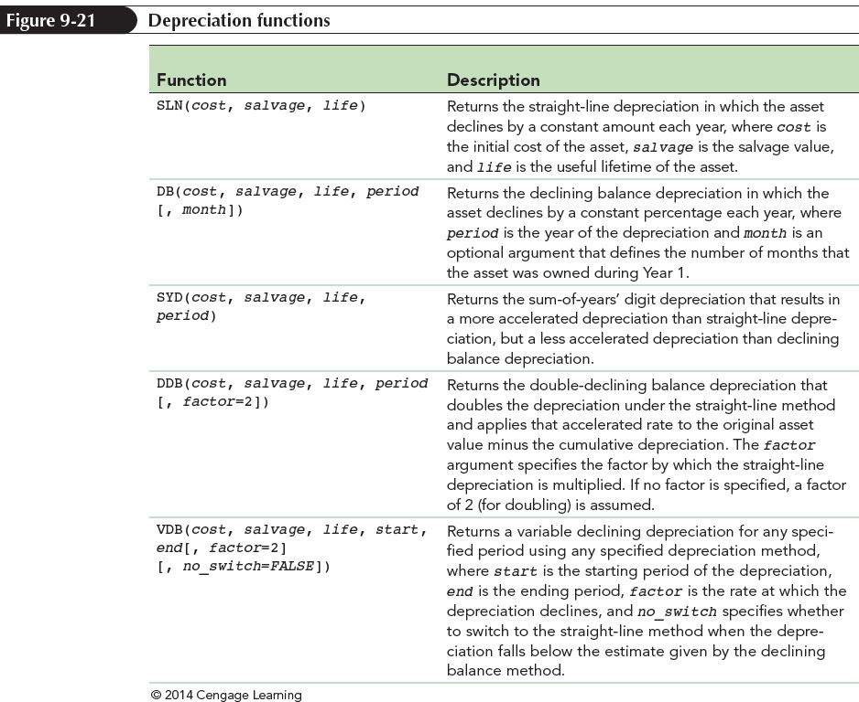
Calculating Depreciation of Assets

Slide 41
Calculating Depreciation of Assets
Adding Depreciation to an Income Statement
  Depreciation is part of a company’s income statement because, even though the company is not losing actual revenue, it is losing worth as its tangible assets decline in value, and that reduces its tax liability

Slide 42
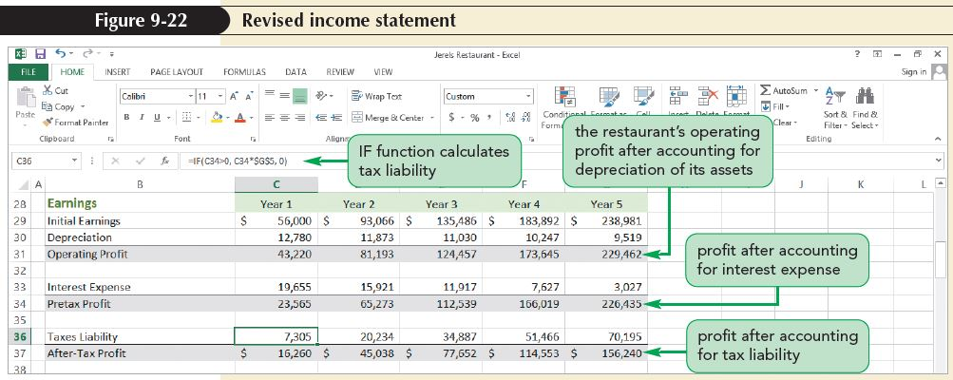
Adding Taxes and Interest Expenses to an Income Statement
Interest expenses are part of a company’s income statement

Slide 43
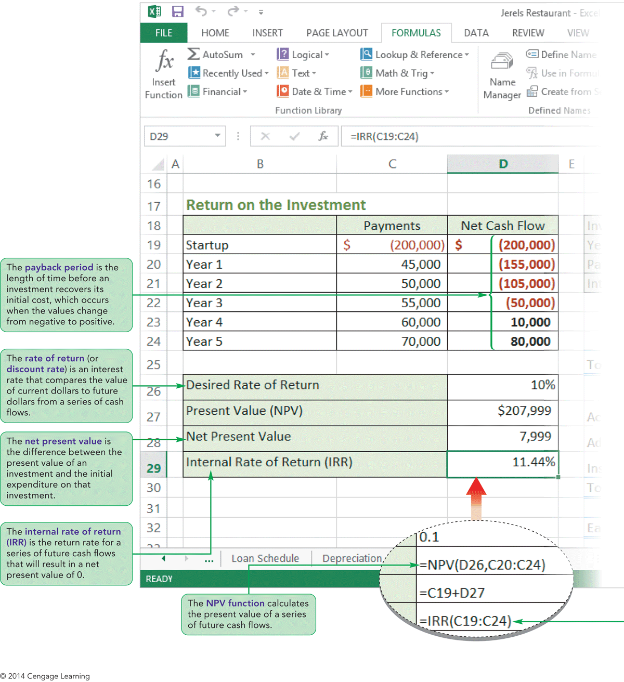
Visual Overview: NPV and IRR Functions and Auditing

Slide 44
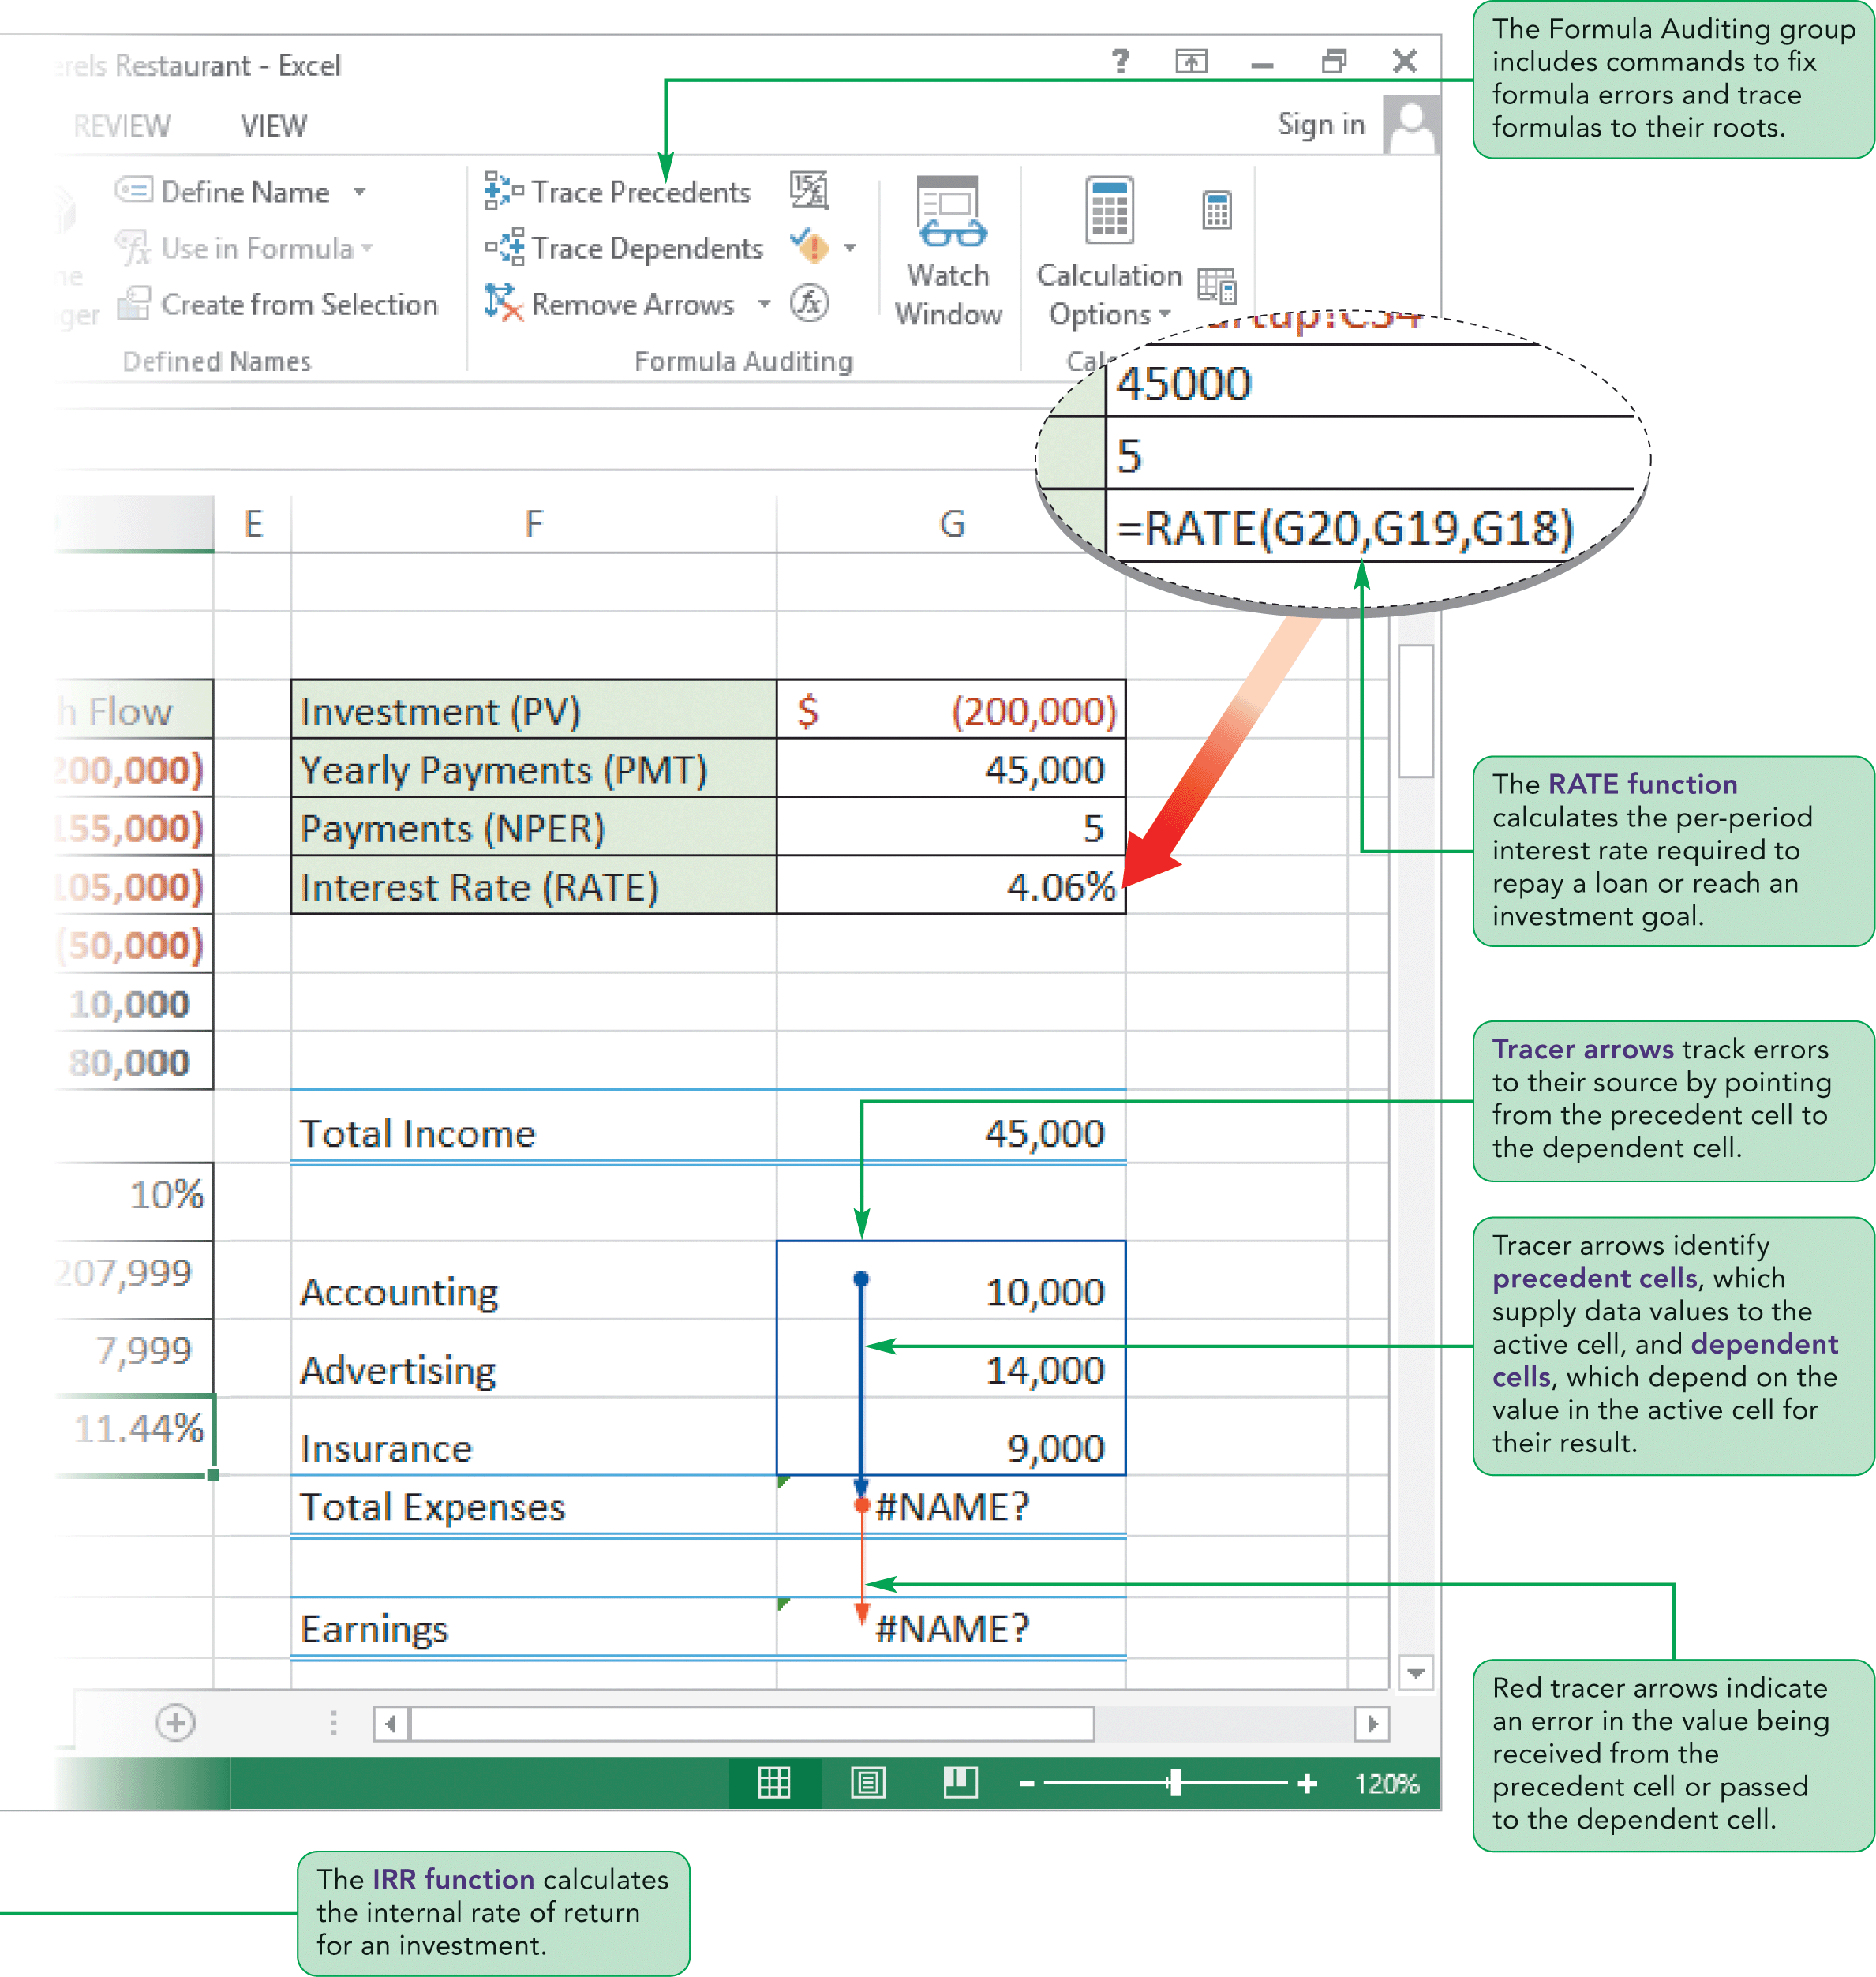
Visual Overview: NPV and IRR Functions and Auditing

Slide 45
Calculating Interest Rates with the RATE function
The pmt, fv, nper, and pv arguments corresponded to Excel functions
The rate argument also has a corresponding RATE function that calculates the interest rate based on the values of the other financial arguments
The RATE function is used primarily to evaluate the return from investments when you know the pv, fv, pmt, and nper values

Slide 46
Calculating Interest Rates with the RATE function
The syntax of the RATE function is
RATE(nper, pmt, pv[, fv=0][, type=0][, guess=0.1])
  nper is the number of payments
  pmt is the amount of each payment
  pv is the loan or investment’s present value
  fv is the future value
  type defines when the payments are made
  guess argument (optional) is used when the RATE function cannot calculate the interest rate value and needs an initial guess to arrive at a solution

Slide 47
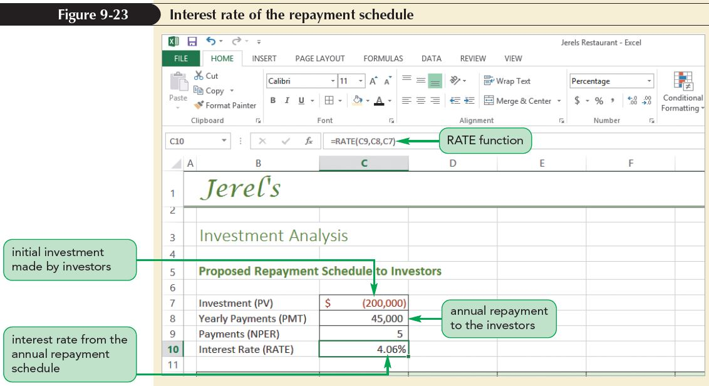
Calculating Interest Rates with the RATE function

Slide 48
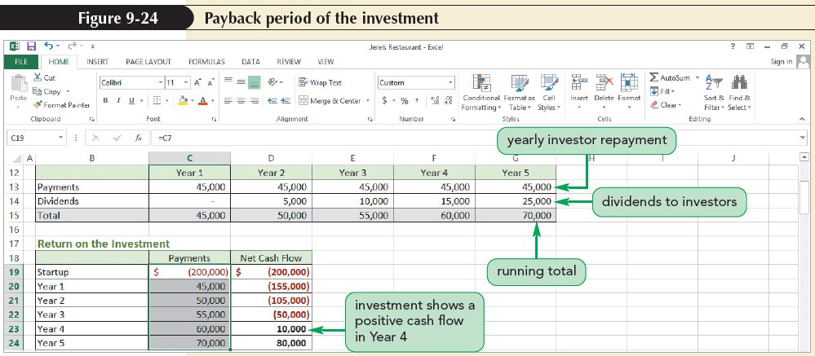
Viewing the Payback Period of an Investment
The payback period is the length of time required for an investment to recover its initial cost

Slide 49
Calculating Net Present Value
The payback period is a quick method of assessing the long-term value of an investment but it does not take into account the time value of money
The Time Value of Money
  The time value of money is based on the observation that money received today is worth more than later
  Can be expressed in terms of what represents a fair exchange between current dollars and future dollars
  You can use the PV function to calculate the time value of money under different rates of return
  You can use the FV function to estimate how much a dollar amount today is worth in terms of future dollars

Slide 50
Calculating Net Present Value
Using the NPV Function
  The PV function assumes that all future payments are equal
  If the future payments are not equal, you must use the NPV (net present value) function to determine what would be a fair exchange
  The syntax of the NPV function is:
  NPV(rate, value1[, value2, value3, ...])
  The NPV function assumes that payments occur at the end of each payment period and that the payment periods are evenly spaced

Slide 51
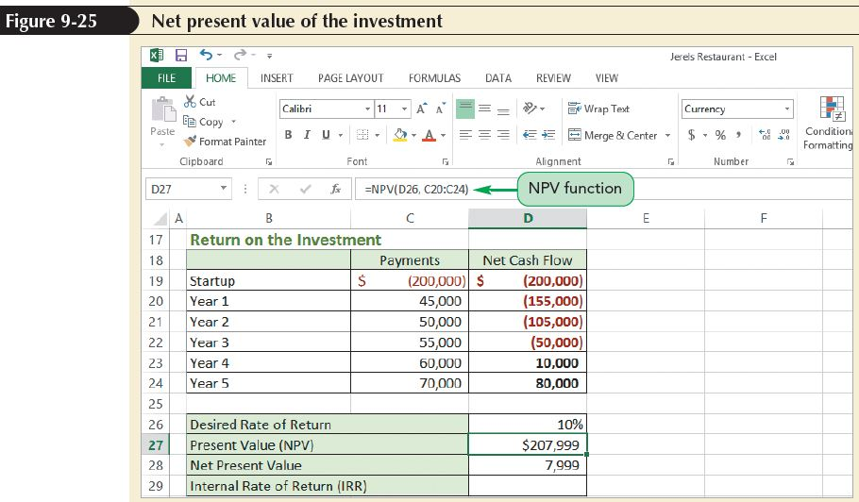
Calculating Net Present Value
Choosing a Rate of Return
  Risk is the possibility that the entire transaction will fail, resulting in a loss of the initial investment
  Investments with higher risks generally should have higher rates of return

Slide 52
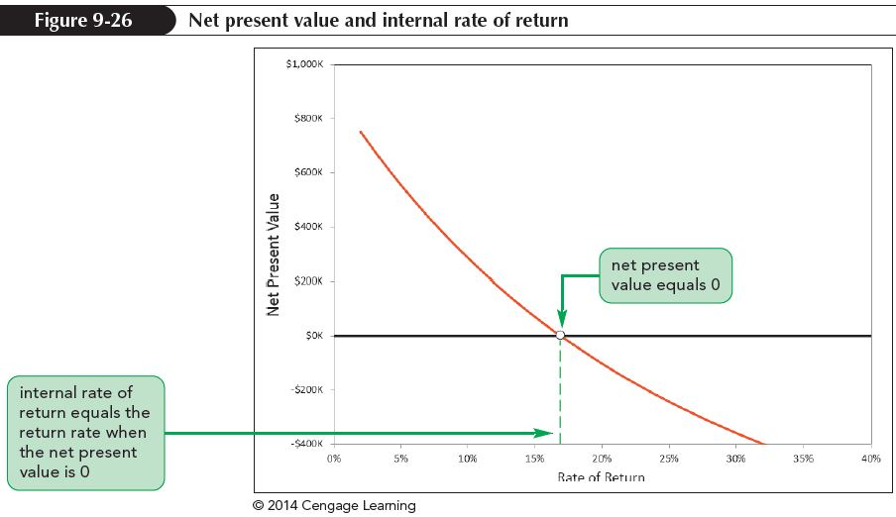
Calculating the
Internal Rate of Return
At some rate of return, the net present value of an investment will change from a positive value to a negative value

Slide 53
Calculating the
Internal Rate of Return
Internal rate of return (IRR)
  Point at which net present value of an investment equals 0
  Popular measure of the value of an investment
  Provides a basis of comparison between two investments
Investments with higher IRRs are usually preferred to those with lower IRRs

Slide 54
Calculating the
Internal Rate of Return
Using the IRR Function
  Use IRR function to calculate internal rate of return for an investment
  The IRR function has the syntax:
  IRR(values[, guess=0.1])
    Like NPV function, it assumes that payments and payoffs occur at evenly spaced intervals
    Unlike NPV function, you include the initial cost of the investment in the values list

Slide 55
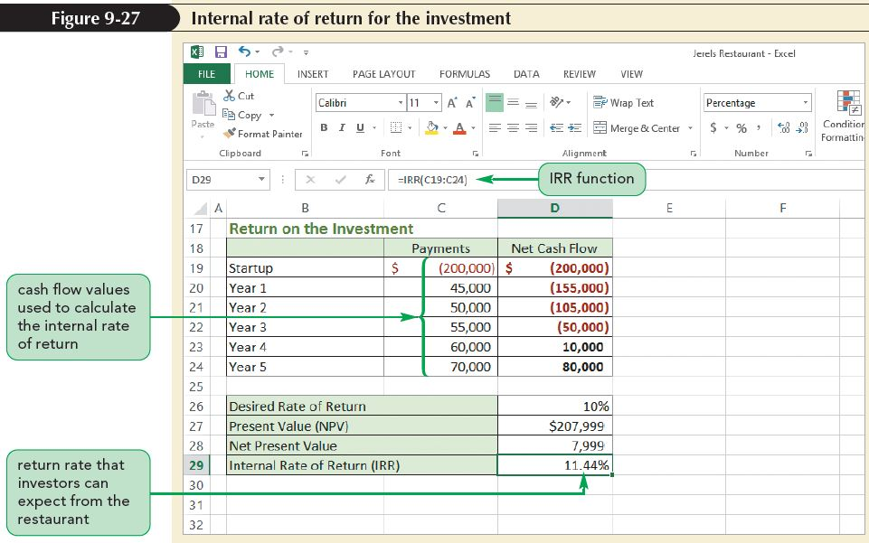
Calculating the
Internal Rate of Return

Slide 56
Calculating the
Internal Rate of Return
  Exploring the XNPV and XIRR Functions
    NPV and IRR functions assume that the cash flows occur at evenly spaced intervals
    Use XNPV and XIRR functions for cash flows that appear at unevenly spaced intervals
    The XNPV function calculates the net present value of a series of cash flows at specified dates and has the syntax:
    XNPV(rate, values, dates)
    The XIRR function calculates the internal rate of return for a series of cash flows made at specified dates and has the syntax:
    XIRR(values, dates[, guess=0.1])

Slide 57
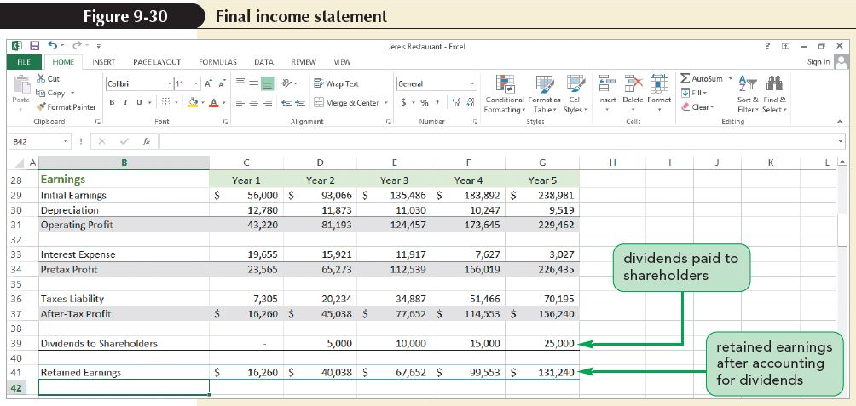
Calculating the
Internal Rate of Return

Slide 58
Auditing a Workbook
A challenge with large and complex workbooks is that the cell values and formulas are interconnected
Changing the value of one cell can alter the value returned by a formula located in a completely different part of the workbook
The source of the error can be unclear at first glance
Excel includes several auditing tools to help you explore the interconnectedness of the cells and formulas in a orkbook

Slide 59
Auditing a Workbook
Tracing an Error
  An error could be located in the cell containing the error value, or it could be in a dependent cell or a precedent cell
    A dependent cell is one whose value depends on the values of other cells in the workbook
    A precedent cell is one whose value is referenced by other cells
  A cell can be both a dependent cell and a precedent cell

Slide 60
Auditing a Workbook
Tracing an Error (con’t)
  To locate the source of an error value, you select any cell containing the error value and trace its precedent cells
  If any of the precedent cells displays an error value, you need to trace that cell’s precedents and so on until you reach an error cell that has no precedents; that cell is the source of the error values in all of its dependent cells

Slide 61
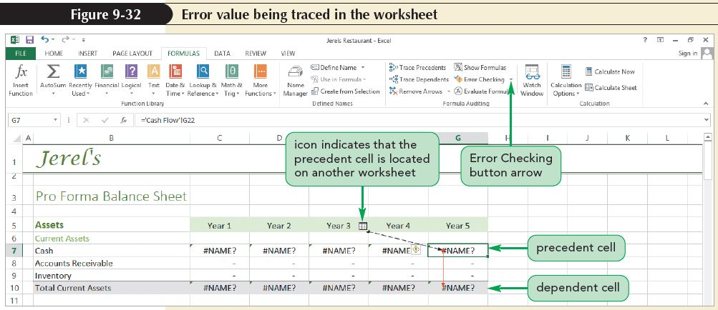
Auditing a Workbook
Tracing an Error (con’t)

Slide 62
Auditing a Workbook
Tracing an Error (con’t)
  Tracer arrows
    Provide a visual clue to relationship between two cells
    Point from precedent cell to dependent cell
    A blue tracer arrow indicates that no error has been received or passed
    A red tracer arrow indicates that an error has been received from the precedent cell or passed to the dependent cell

Slide 63
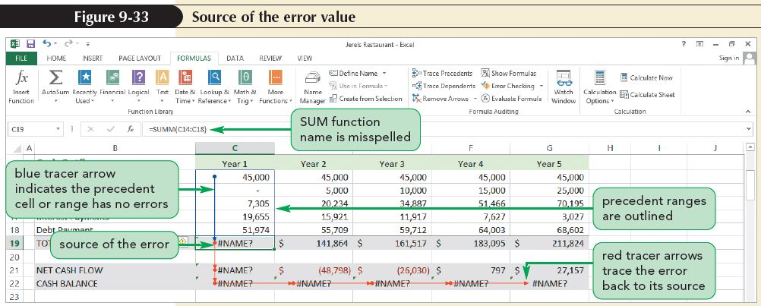
Auditing a Workbook
Tracing an Error (con’t)

Slide 64
Auditing a Workbook
Evaluating a Formula
  One drawback to using tracer arrows is that they can clutter a worksheet
  Sometimes you want to trace only a single formula to its roots
  Another way to explore the relationship between cells in a workbook is by evaluating formulas
  Use Evaluate Formula dialog box to display the value of different parts of the formula or “drill down” through cell references in the formula to discover the source of formula’s value

Slide 65
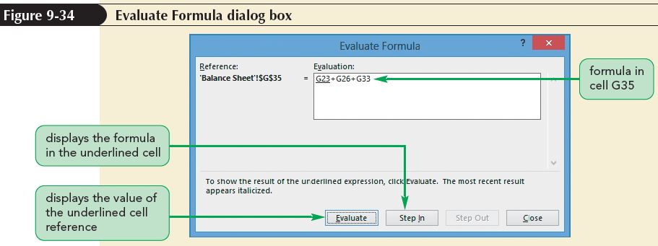
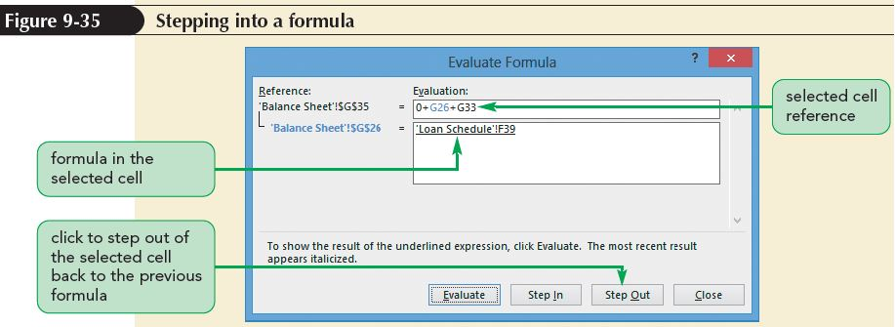
Auditing a Workbook

Slide 66
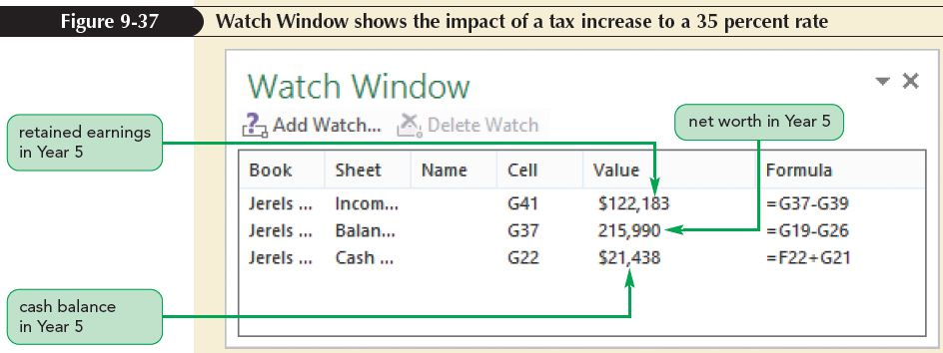
Auditing a Workbook
Using the Watch Window
  A Watch Window is a window that displays values of cells located throughout the workbook
  When you change a cell’s value, a Watch Window allows you to view the impact of the change on widely scattered dependent cells
  The window also displays the workbook, worksheet, defined name, cell value, and formula of each cell being watched

