Slide 1
Tutorial 7:
Developing an Excel Application

Slide 2
Objectives
Create an application
Create, edit, and delete defined names for cells and ranges
Paste a list of defined names as documentation
Use defined names in formulas
Add defined names to existing formulas

Slide 3
Objectives
Create validation rules for data entry
Protect the contents of worksheets and workbooks
Add, edit, and delete comments

Slide 4
Objectives
Learn about macro viruses and Excel security features
Add the DEVELOPER tab to the ribbon
Create and run a macro
Edit a macro using the Visual Basic Editor
Assign a macro to a keyboard shortcut and a button
Save and open a workbook in macro-enabled format

Slide 5
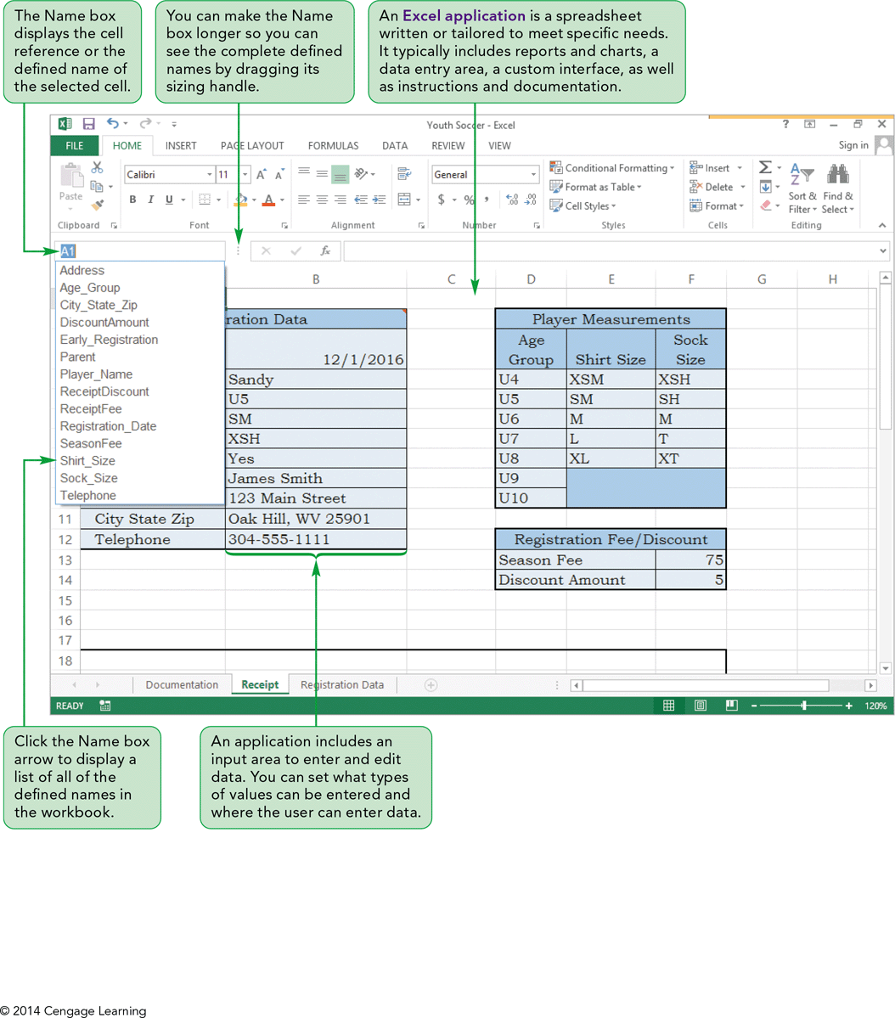
Visual Overview: Excel Application and Defined Names

Slide 6
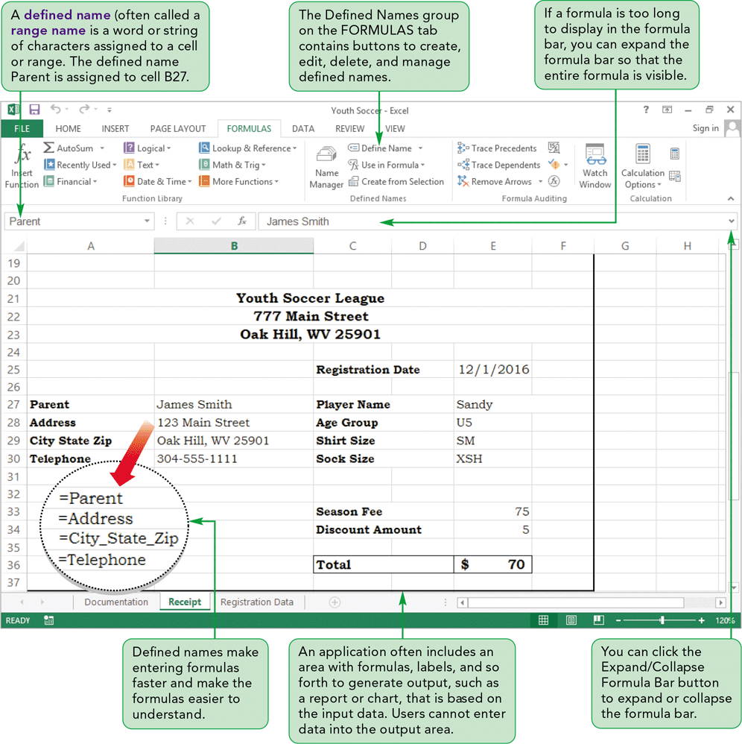
Visual Overview: Excel Application and Defined Names

Slide 7
Planning an Excel Application
An Excel application is a spreadsheet written or tailored to meet specific needs
Planning includes designing how the worksheet(s) will be organized; you can:
  Enter and edit data (setting where and what types of data can be entered)
  Store data after it has been entered
  Use formulas to manipulate and perform calculations on data
  Display outputs, such as reports and charts

Slide 8
Naming Cells and Ranges
Cell and range references do not indicate what data is stored in those cells
You can use a defined name to assign a meaningful, descriptive name to a cell or range
A defined name enables you to quickly navigate within a workbook to the cell or range with the defined name
You can use defined names to create more descriptive formulas

Slide 9
Naming Cells and Ranges
Rules for naming cells or ranges
  Must begin with a letter or _
  Can include letters and numbers as well as periods and underscores, but not other symbols or spaces
  Use an underscore between the words or capitalize the first letter of each word
  Cannot be a valid cell address, function name, or reserved word
  Can include as many as 255 characters
  The name is not case sensitive

Slide 10
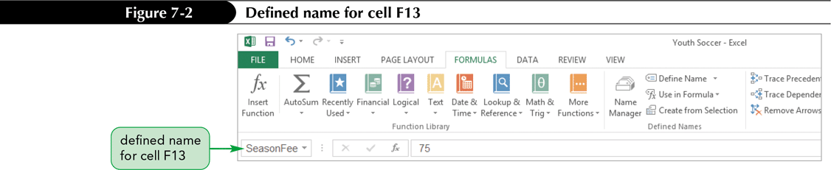
Naming Cells and Ranges
Using the Name Box to Create Defined Names
  The Name box is a quick way to create a defined name for a selected cell or range

Slide 11
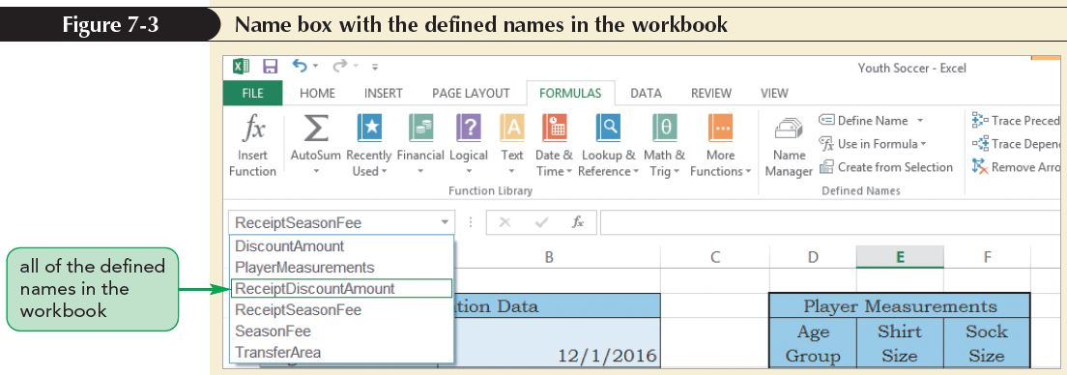
Naming Cells and Ranges
Selecting Cells and Ranges by Their Defined Names
  The Name box displays all of the defined names in a workbook
  Click a name in the Name box list to quickly select the cell or range referenced by that name

Slide 12
Naming Cells and Ranges
Creating Defined Names by Selection
  Quickly define names without typing them if the data is organized as a structured range of data with labels in the first or last column, or in the top or bottom row
  Defined names are based on the row or column labels

Slide 13
Naming Cells and Ranges
Editing and Deleting Defined Names
  The Name Manager dialog box lists all of the names currently defined in the workbook, including Excel table names
  In addition to the name, it identifies the current value for that name as well as the worksheet and cell or range it references
  Use the Name Manager dialog box to create a new name, edit or delete existing names, and filter the list of names

Slide 14
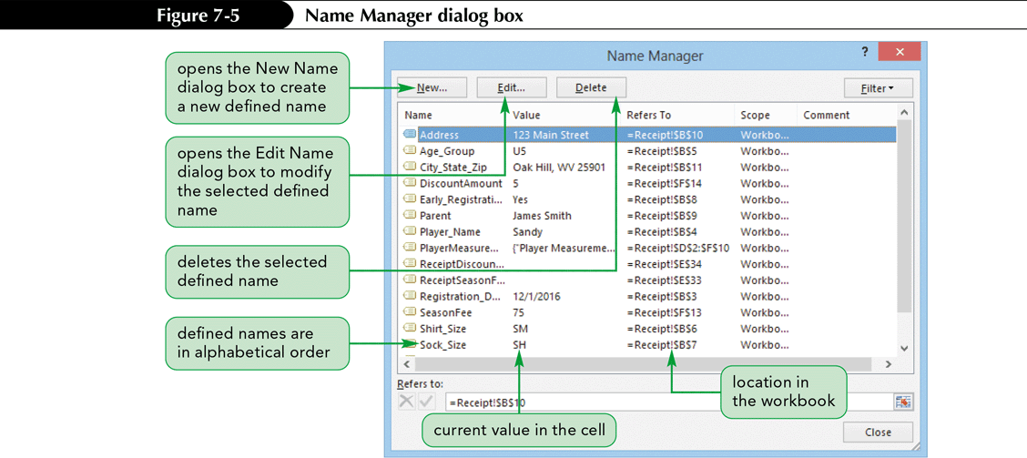
Naming Cells and Ranges

Slide 15
Naming Cells and Ranges
Using the Paste Names Command
  When a workbook contains many defined names, it can be helpful to list all of the defined names and their corresponding cell addresses in the workbook’s documentation
  You can generate a list of names using the Paste Names command
  If you edit a defined name or add a new defined name, the list of defined names and their addresses in the Documentation worksheet is not updated; you must paste the list again to update

Slide 16
Using Defined Names in Formulas
You can create more descriptive formulas by using defined names instead of cell or range references in formulas
Range references in formulas are not updated with their defined names; if you enter a range reference in a formula, its corresponding defined name does not automatically replace the range reference in the formula

Slide 17
Using Defined Names in Formulas
Defined names make formulas simpler to enter and understand
To use a defined name in a formula:
  Enter the formula as usual
  As you type a defined name in a formula, the Formula AutoComplete box appears, listing functions and defined names that begin with the letters you typed
  You can double-click the name you want in the Formula AutoComplete box or press the Tab key

Slide 18
Using Defined Names in Formulas
Adding Defined Names to Existing Formulas
  You might name cells after creating formulas in the worksheet or you might not use the names
  Because defined names are not automatically substituted for the cell addresses in a formula, you can replace cell addresses in existing formulas in the worksheet with their defined names to make the formulas more understandable

Slide 19
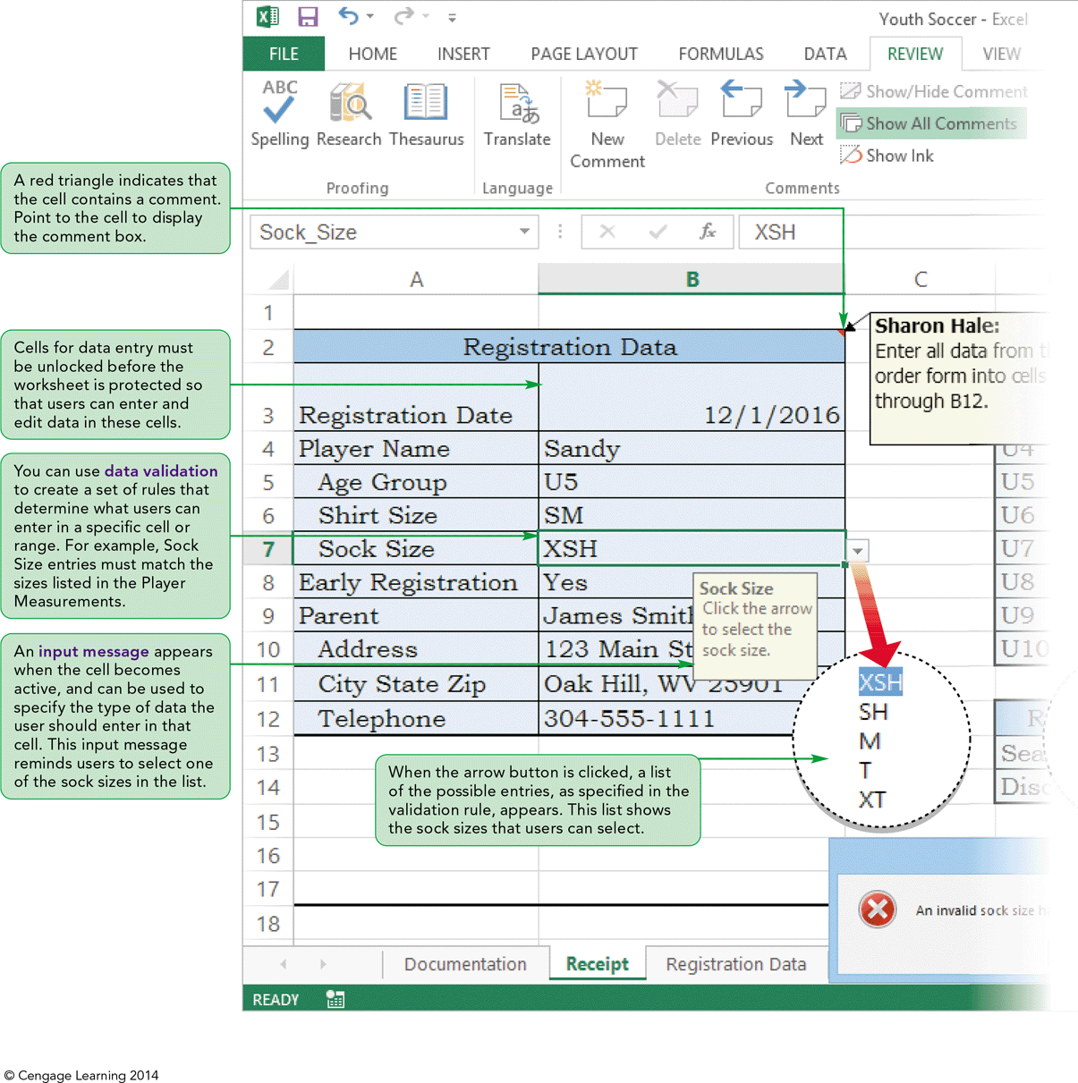
Visual Overview:
Data Validation and Protection

Slide 20
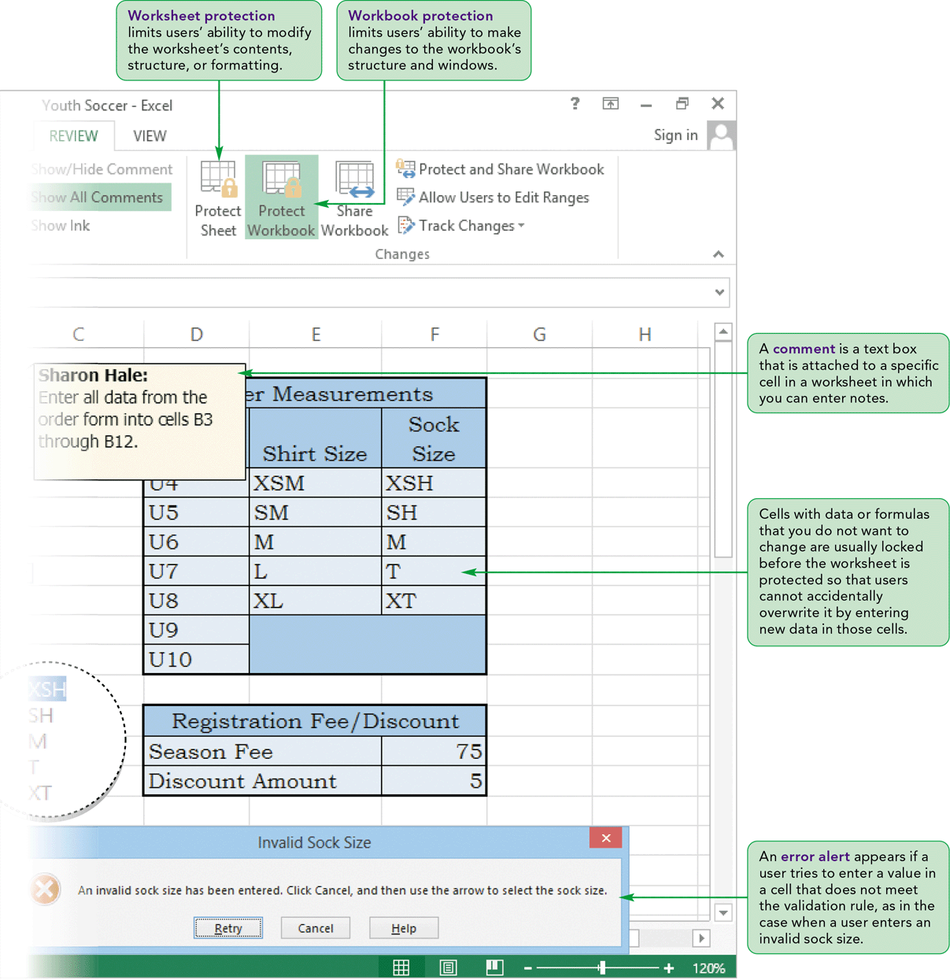
Visual Overview:
Data Validation and Protection

Slide 21
Validating Data Entry
To ensure that correct data is entered and stored in a worksheet, you can use data validation
Each validation rule defines criteria for the data that can be entered and stored in a cell or range
You can add input and error alert messages for the user to that cell or range
You specify the validation criteria, the input message, and the error alert for the active cell in the Data Validation dialog box

Slide 22
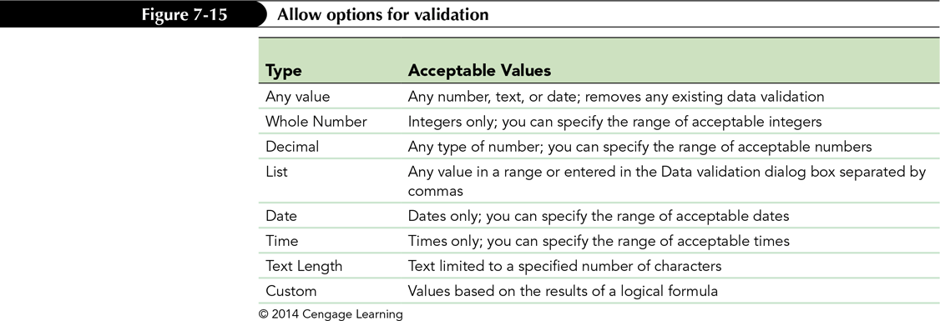
Validating Data Entry
Specifying Validation Criteria
  When creating a validation rule, you specify the type of data that is allowed as a list or range of acceptable values (called validation criteria)

Slide 23
Validating Data Entry
Creating an Error Alert Style and Message
  An error alert determines what happens after a user tries to make an invalid entry in a cell that has a validation rule defined
  The three error alert styles are:
    Stop: Prevents the entry from being stored in the cell
    Warning: Prevents the entry from being stored in the cell unless the user overrides the rejection and decides to continue using the data
    Information: Accepts the data value entered, but allows the user to choose to cancel the data entry

Slide 24
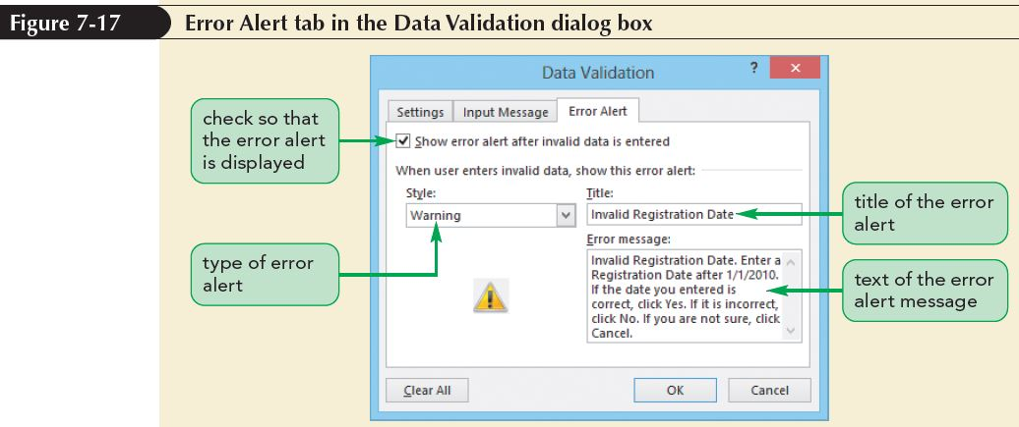
Validating Data Entry

Slide 25
Validating Data Entry
Creating an Input Message
  One way to reduce the chance of a data-entry error is to display an input message when a user makes the cell active
  An input message provides additional information about the type of data allowed for that cell
  Input messages appear as ScreenTips next to the cell when the cell is selected
  Can add an input message to a cell even if you don’t set up a rule to validate the data in that cell

Slide 26
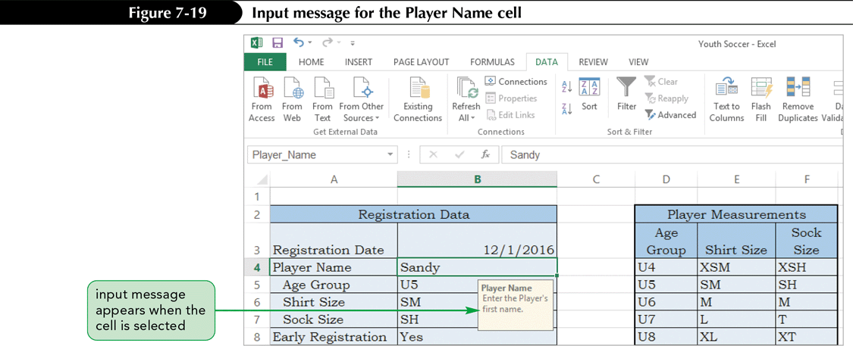
Validating Data Entry

Slide 27
Validating Data Entry
Creating a List Validation Rule
  Use the data validation feature to restrict a cell to accept only entries that are on a list you create
  Create the list of valid entries in the Data Validation dialog box or use a list of valid entries in a single column or row
  Once you create a list validation rule for a cell, a list box with the possible values appears when the user selects the cell

Slide 28
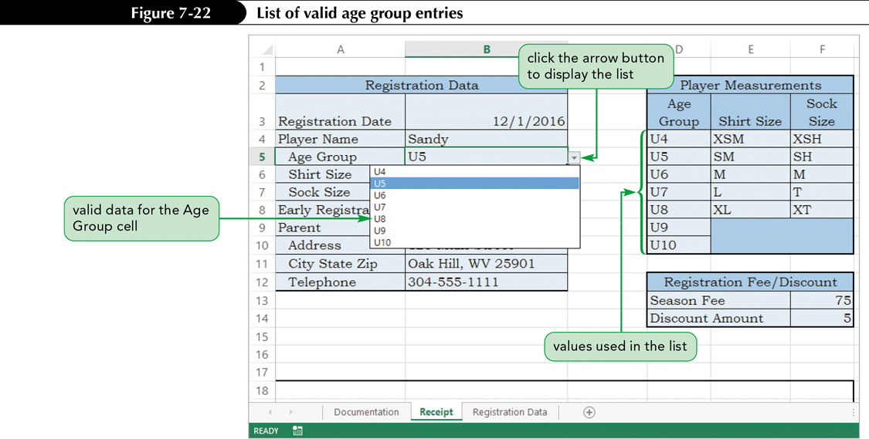
Validating Data Entry

Slide 29
Validating Data Entry
Testing Data Validation Rules
  Test validation rules by entering incorrect values that violate the validation rules
  The only way an error occurs in cells that have a list validation is if an incorrect entry is typed or pasted in the cell
  Entering invalid data will ensure that validation rules work as expected

Slide 30
Protecting a Worksheet and a Workbook
Another way to minimize data-entry errors is to limit access to certain parts of the workbook
Worksheet protection prevents users from changing cell contents, such as editing formulas in a worksheet
Workbook protection also prevents users from changing the workbook’s organization, such as inserting or deleting worksheets in the workbook
You can keep users from viewing the formulas used in the workbook

Slide 31
Protecting a Worksheet and a Workbook
Locking and Unlocking Cells
  Every cell in a workbook has a locked property that determines whether changes can be made to that cell
  The locked property has no impact as long as the worksheet is unprotected
  After you protect a worksheet, the locked property controls whether the cell can be edited
  Unlock a cell by turning off the locked property
  By default, the locked property is turned on for each cell, and worksheet protection is turned off

Slide 32
Protecting a Worksheet and a Workbook
Locking and Unlocking Cells (continued)
  Unless you unlock cells in a worksheet before protecting the worksheet, all of the cells in the worksheet will be locked, and you won’t be able to make any changes
  Usually, you will protect the worksheet but leave some cells unlocked
    First, turn off the locked property of cells in which data can be entered
    Then, you protect the worksheet to activate the locked property for the remaining cells

Slide 33
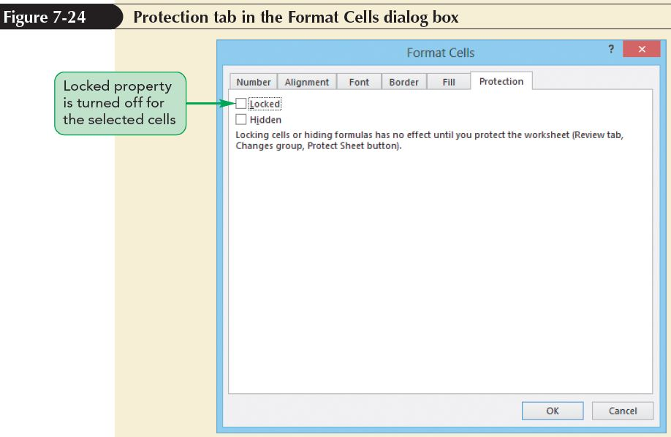
Protecting a Worksheet and a Workbook

Slide 34
Protecting a Worksheet and a Workbook
Protecting a Worksheet
  When you set up worksheet protection, you specify which actions are still available to users in the protected worksheet
  You can limit the user to selecting only unlocked cells, or allow the user to select any cell in the worksheet; these choices remain active as long as the worksheet is protected
  A protected worksheet can always be unprotected
  You can add a password that must be entered to turn off the protection

Slide 35
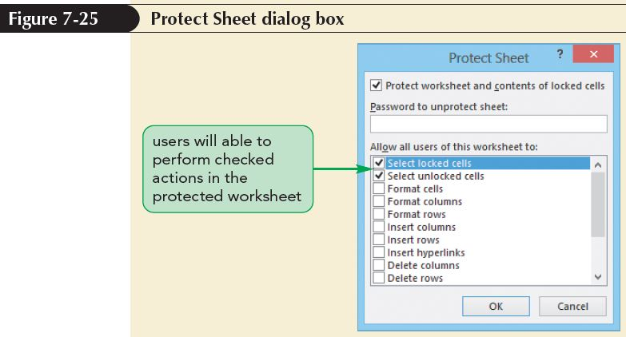
Protecting a Worksheet and a Workbook

Slide 36
Protecting a Worksheet and a Workbook
Protecting a Workbook
  Worksheet protection applies only to the contents of a worksheet, not to the worksheet itself
  To keep a worksheet from being modified, you need to protect the workbook
  You can protect both the structure and the windows of a workbook
  Protecting the structure prevents users from renaming, deleting, hiding, or inserting worksheets

Slide 37
Protecting a Worksheet and a Workbook
Unprotecting a Worksheet and a Workbook
  You can turn off worksheet protection at any time
  You must unprotect a worksheet to edit its contents
  You can unprotect the workbook
  If you need to insert a new worksheet or rename an existing worksheet, you can unprotect the protected workbook, make the changes to the structure, and then reapply workbook protection

Slide 38
Inserting Comments
Comments are often used in workbooks to:
  Explain the contents of a particular cell, such as a complex formula
  Provide instructions to users
  Share ideas and notes from several users collaborating on a project
If you collaborate on a workbook, the top of the comment boxes would show the name of each user who created that comment

Slide 39
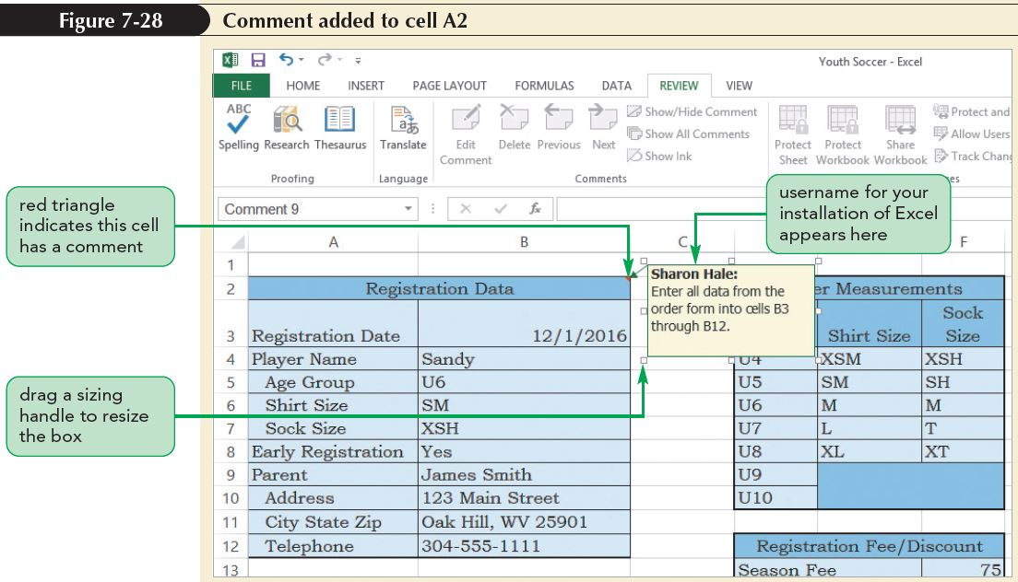
Inserting Comments
A small red triangle appears in the upper-right corner of a cell with a comment
The comment box appears when you point to a cell with a comment

Slide 40
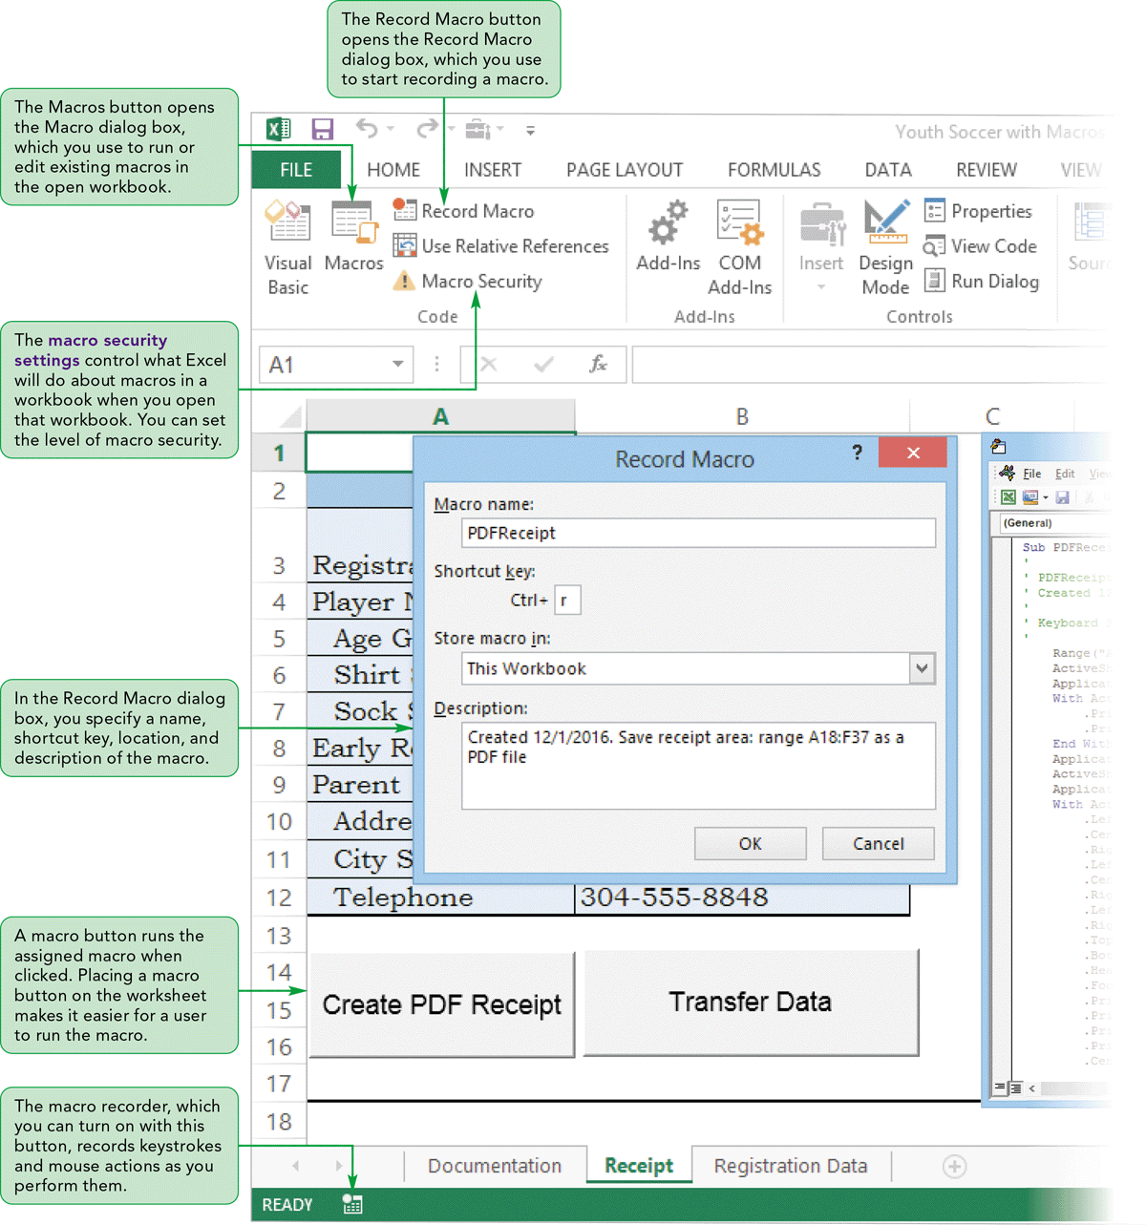
Visual Overview:
Working with Macros

Slide 41
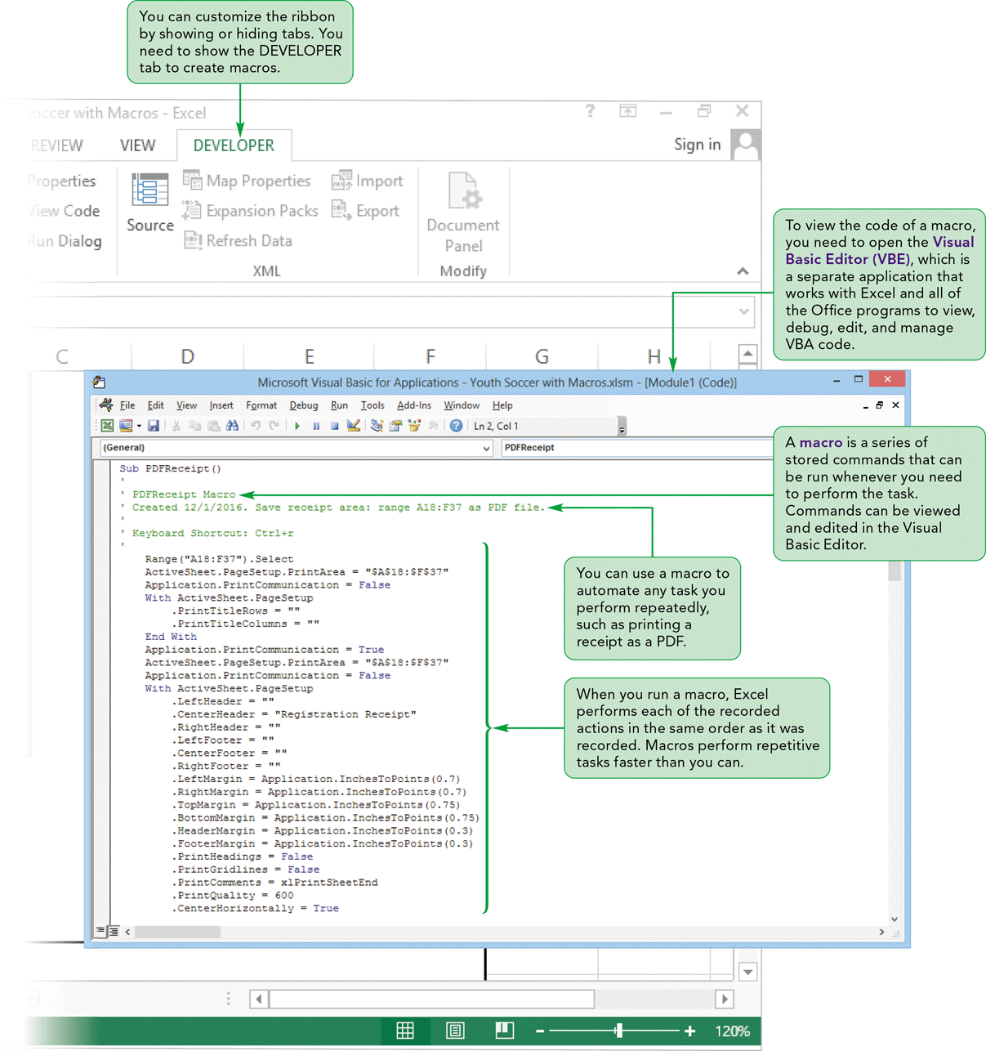
Visual Overview:
Working with Macros

Slide 42
Automating Tasks with Macros
Macros automate any task you perform repeatedly
Macros perform repetitive tasks consistently and faster than you can.
After the macro is created and tested, you can be assured the tasks are done exactly the same way each time
To create and run macros, you need to use the DEVELOPER tab

Slide 43
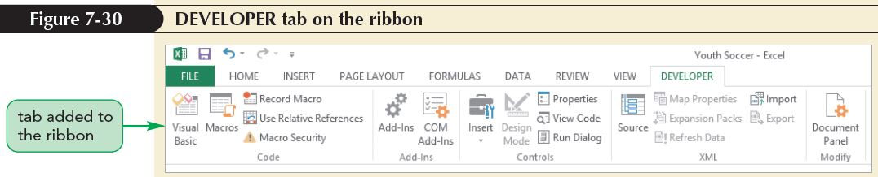
Automating Tasks with Macros
The DEVELOPER tab has five groups:
  One for code
  One for add-ins
  One for controls
  One for XML
  One to modify document controls

Slide 44
Protecting Against Macro Viruses
A virus is a computer program designed to copy itself into other programs with the intention of causing mischief or harm
Macro viruses use a program’s own macro programming language to distribute the virus
  Can be destructive
  Can modify or delete files that may not be recoverable

Slide 45
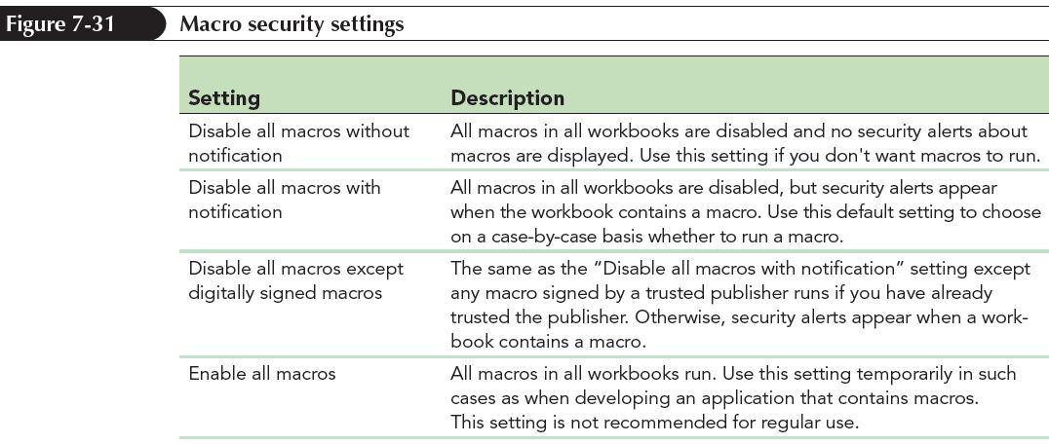
Protecting Against Macro Viruses
Macro Security Settings
  Control what Excel will do about macros in a workbook when you open that workbook

Slide 46
Protecting Against Macro Viruses
Macro Security Settings (continued)
  Set macro security in the Trust Center
  The Trust Center is a central location for all of the security settings in Office
  By default, all potentially dangerous content is blocked without warning
  If content is blocked, the Message Bar (also called the trust bar) opens below the ribbon, notifying you that some content was disabled
  You can click the Message Bar to enable content

Slide 47
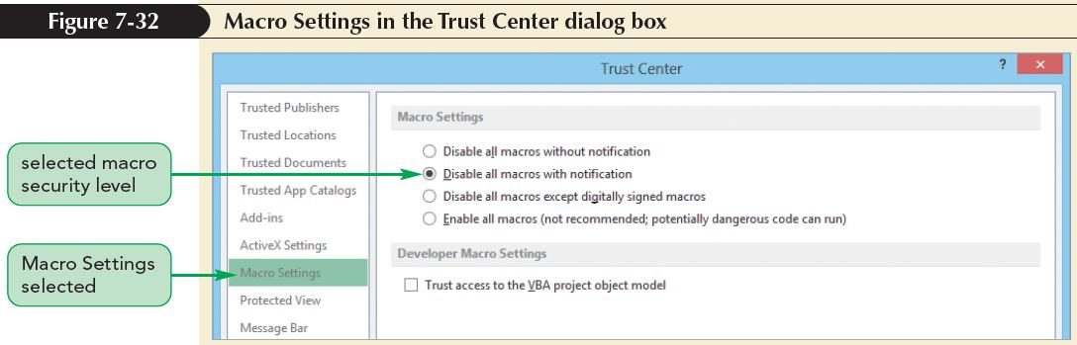
Protecting Against Macro Viruses

Slide 48
Recording a Macro
You can create an Excel macro in one of two ways:
  Use the macro recorder to record keystrokes and mouse actions as you perform them
  Enter a series of commands in the Visual Basic for Applications (VBA) programming language

Slide 49
Recording a Macro
The macro recorder can record only those actions you perform with the keyboard or mouse
The macro recorder is a good choice for creating simple macros
For more sophisticated macros, you might need to write VBA code directly in the Visual Basic Editor (VBE)

Slide 50
Recording a Macro
By default, the macro is stored in the current workbook (only available with that workbook)
Another option is to store the macro in the Personal Macro workbook, a hidden workbook named PERSONAL.xlsb that opens whenever you start Excel
  Stores commonly used macros
  Is most convenient for users on stand-alone computers
Can store the macro in a new workbook

Slide 51
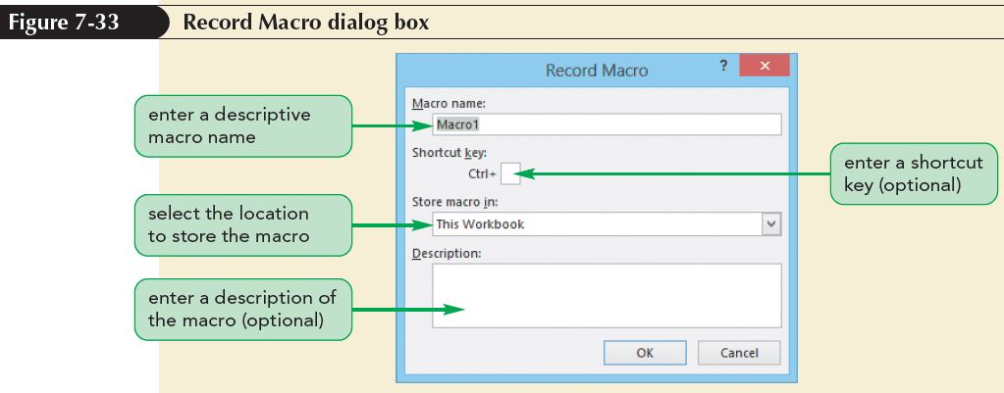
Recording a Macro

Slide 52
Running a Macro
After you record a macro, you should run it to test whether it works as intended
Running a macro means Excel performs each of the steps in the same order as when it was recorded
To run the macro you created, you can either use the shortcut key you specified or select the macro in the Macro dialog box

Slide 53
Running a Macro
The Macro dialog box lists all of the macros in the open workbooks
From this dialog box, you can:
  Select and run a macro
  Edit the macro with VBA
  Run the macro one step at a time so you can determine in which step an error occurs
  Delete the macro

Slide 54
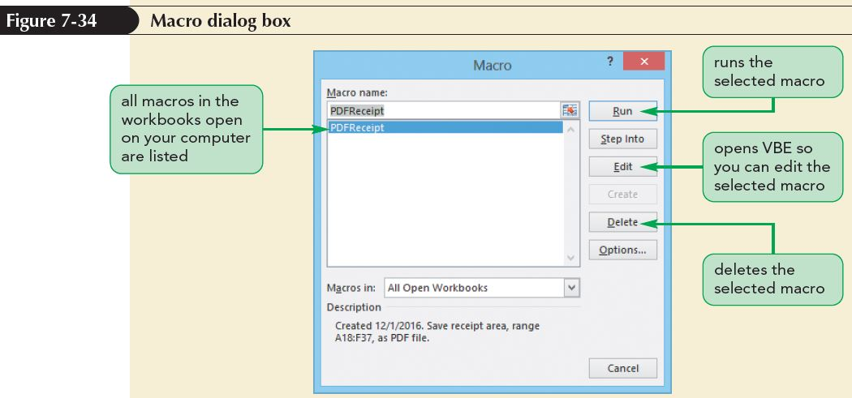
Running a Macro

Slide 55
Creating the TransferData Macro
Fixing Macro Errors
  If a macro does not work correctly, you can fix it
  You have the following options to fix a macro:
    Rerecord the macro using the same macro name
    Delete the recorded macro, and then record the macro again
    Run the macro one step at a time to locate the problem, and then use one of the previous methods to correct the problem

Slide 56
Working with the Visual Basic Editor
To view the code of a macro, open the Visual Basic Editor (VBE)—allows you to view, debug, edit, and manage VBA code
The VBE consists of several components, including:
  The Code window that contains the VBA code
  A menu bar with menus of commands you use to edit, debug, and run VBA statements
You can access the Visual Basic Editor through the Macro dialog box or the Visual Basic button in the Code group on the DEVELOPER tab

Slide 57
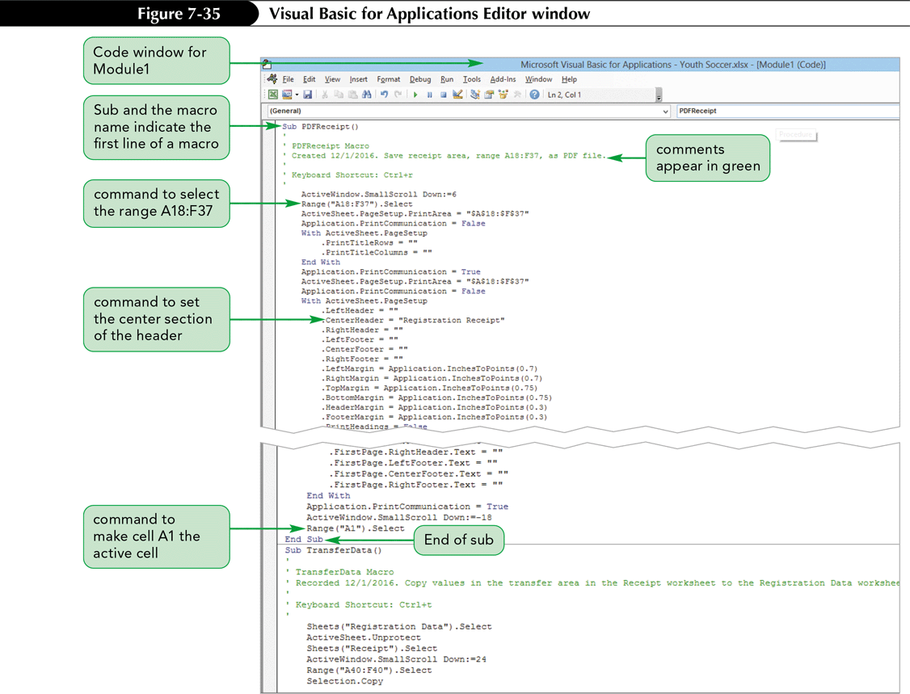
Working with the Visual Basic Editor

Slide 58
Working with the Visual Basic Editor
Understanding the Structure of Macros
  In VBA, macros are called sub procedures
  Each sub procedure begins with the keyword Sub followed by the name of the sub procedure and a set of parentheses
  Sub procedures are organized into modules

Slide 59
Working with the Visual Basic Editor
Editing a Macro Using the Visual Basic Editor
  The Visual Basic Editor provides tools to assist you in writing error-free code
  As you type a command, the editor will provide pop-up windows and text to help you insert the correct code

Slide 60
Creating Macro Buttons
Another way to run a macro is to assign it to a button placed directly in the worksheet
Macro buttons are often a better way to run macros than shortcut keys
Clicking a button (with a descriptive label) is often more intuitive and simpler for users than trying to remember different combinations of keystrokes

Slide 61
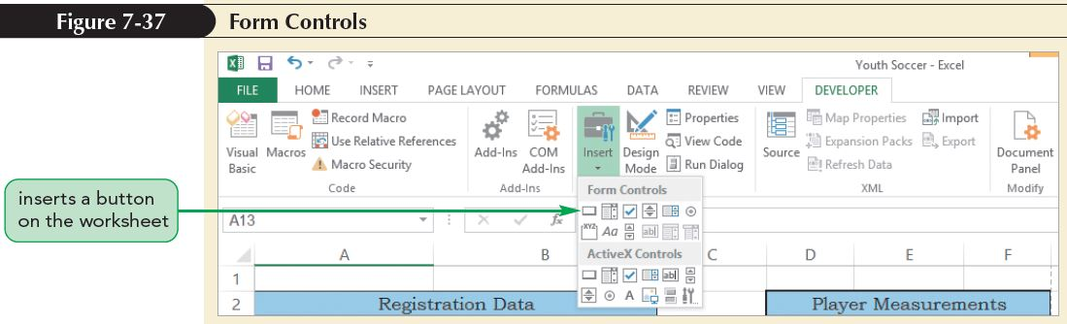
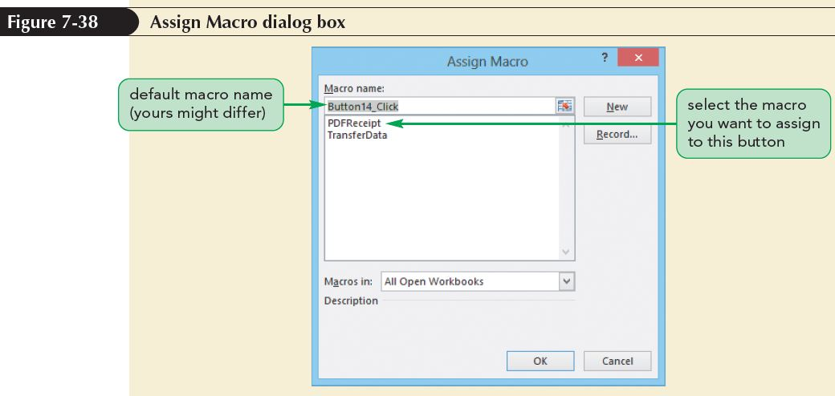
Creating Macro Buttons

Slide 62
Saving a Workbook with Macros
When you save a workbook that contains macros, a dialog box opens indicating that the workbook you are Saving a Workbook with Macros
e trying to save contains features that cannot be saved in a macro-free workbook
The default Excel workbook does not allow macros to be stored as part of the file and has the .xlsx file extension
A macro-enabled workbook has the .xlsm file extension

Slide 63
Saving a Workbook with Macros
In the Macro warning dialog box:
  Click the Yes button if you want to save the workbook without the macros; the macros you created will be lost
  Click the No button if you want to save the workbook with the macros; then save the workbook as a new file—one that allows macros to be saved as part of the file

Slide 64
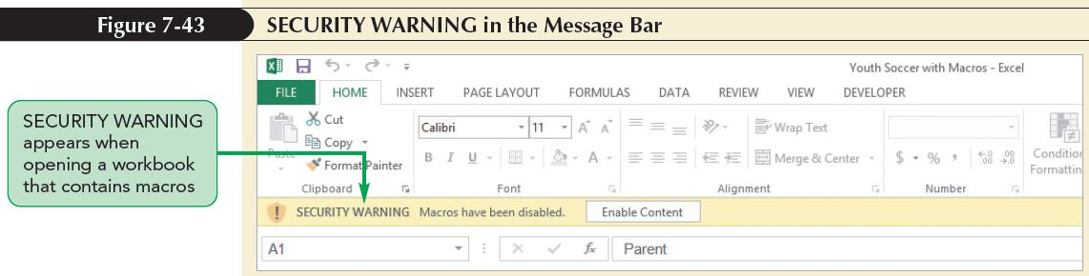
Opening a Workbook with Macros
When you open a file with macros, Excel checks the opening workbook to see if it contains any macros

Slide 65
Removing a Tab from the Ribbon
If you decide you don’t want a tab displayed on the ribbon, you can remove it
To remove the DEVELOPER tab from the ribbon:
  Right-click any tab on the ribbon, and then click Customize the Ribbon
  In the Main Tabs box, click the Developer check box to remove the checkmark
  Click the OK button

