Slide 1
Tutorial 5:
Working with Excel Tables, PivotTables, and PivotCharts

Slide 2
Objectives
Explore a structured range of data
Freeze rows and columns
Plan and create an Excel table
Rename and format an Excel table
Add, edit, and delete records in an Excel table
Sort data

Slide 3
Objectives
Filter data using filter buttons
Filter an Excel table with a slicer
Insert a Total row to summarize an Excel table
Split a worksheet into two panes
Insert subtotals into a range of data
Use Outline buttons to show or hide details

Slide 4
Objectives
Create and modify a PivotTable
Apply PivotTable styles and formatting
Filter a PivotTable
Insert a slicer to filter a PivotTable
Insert a recommended pivot table
Create a PivotChart

Slide 5
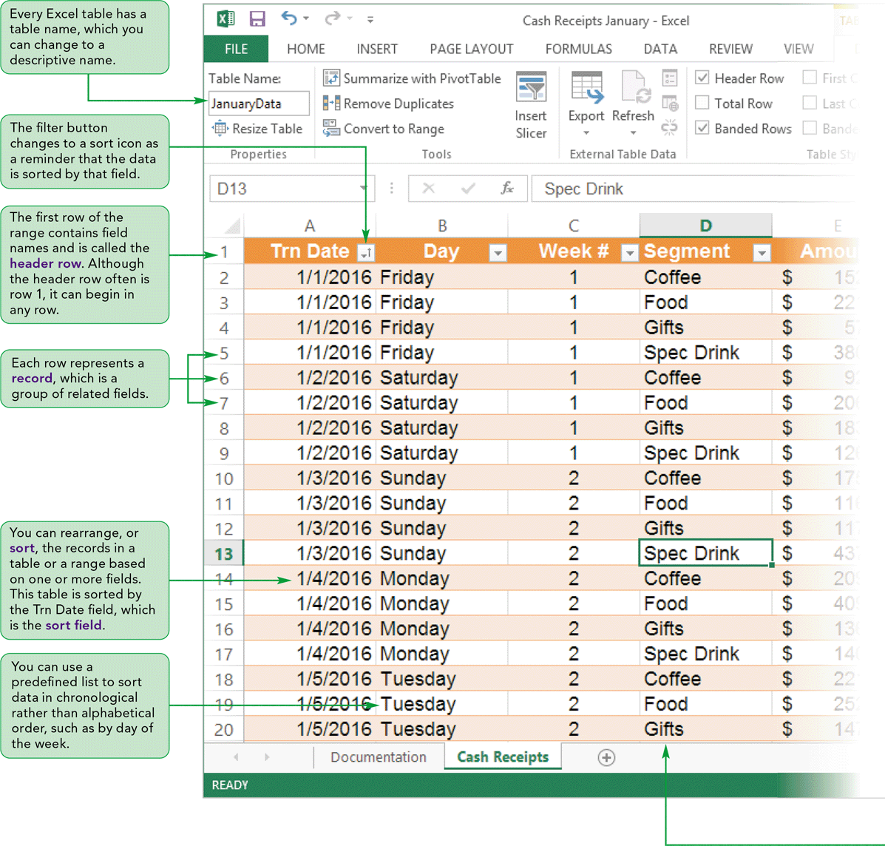
Visual Overview:
Elements of an Excel Table

Slide 6
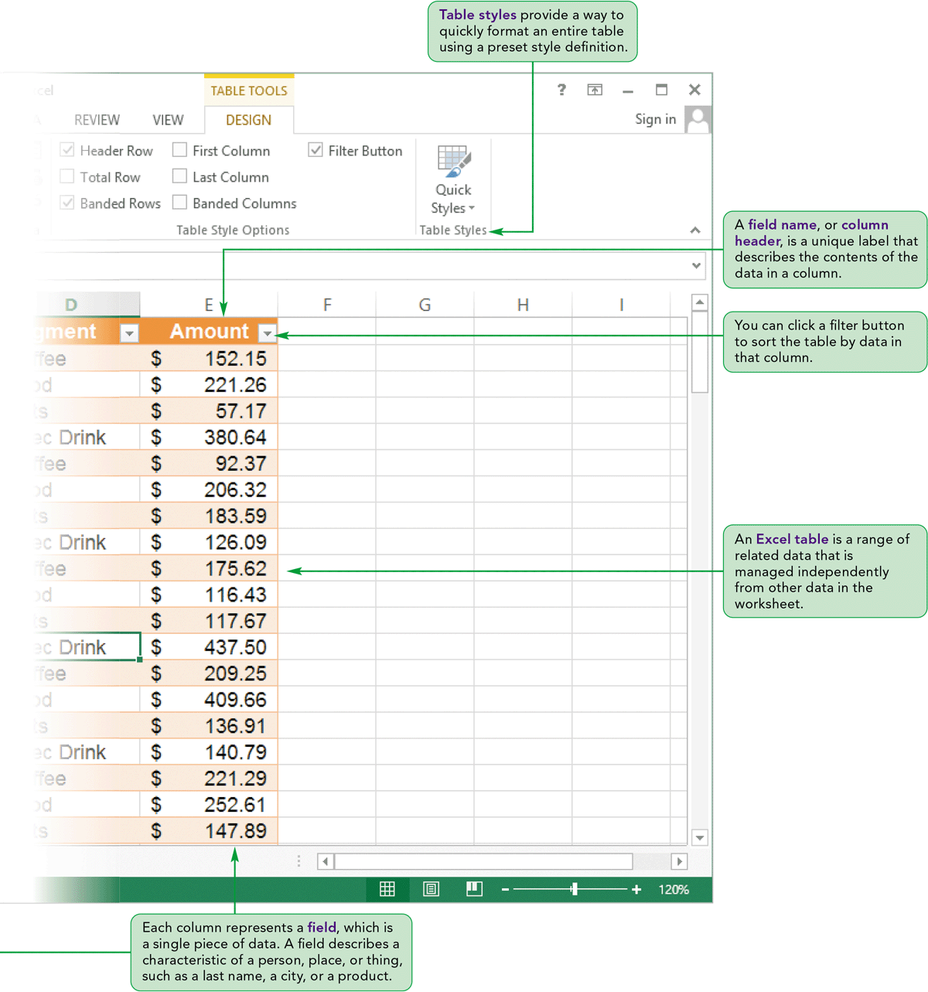
Visual Overview:
Elements of an Excel Table

Slide 7
Planning a Structured Range of Data
A collection of similar data can be structured in a range of columns and rows, representing fields and records, respectively
  Each column represents a field, which is a single piece of data
  Each row represents a record, which is a group of related fields
A structured range of data is commonly referred to as a list or table

Slide 8
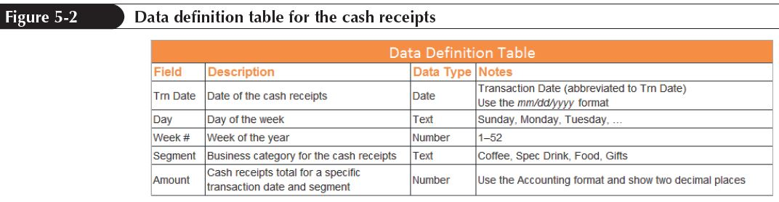
Planning a Structured Range of Data
Data definition table
  Documentation that lists the fields to be maintained for each record and a description of the information each field will include

Slide 9
Planning a Structured Range of Data
Common operations for working with data:
  Add, edit, and delete data in the range
  Sort the data range
  Filter to display only rows that meet specified criteria
  Insert formulas to calculate subtotals
  Create summary tables based on the data in the range (usually with PivotTables)

Slide 10
Planning a Structured Range of Data
Creating an Effective Structured Range of Data
  Enter field names in top row of range
  Use short, descriptive field names
  Format field names to distinguish header row from data
  Enter the same kind of data in a field
  Separate data (including header row) from other information in the worksheet by at least one blank row and one blank column

Slide 11
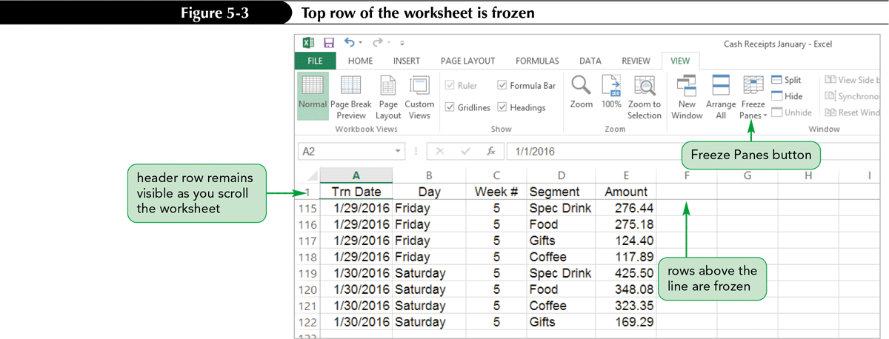
Freezing Rows and Columns
Freezing a row or column keeps headings visible as you work with data in a large worksheet

Slide 12
Creating an Excel Table
Excel tables make it easier to identify, manage, and analyze the groups of related data
When a structured range of data is converted into an Excel table, you see the following:
  A filter button in each cell of the header row
  The range formatted with a table style
  A sizing handle (a small triangle) in the lower-right corner of the last cell of the table
  The TABLE TOOLS DESIGN tab on the ribbon

Slide 13
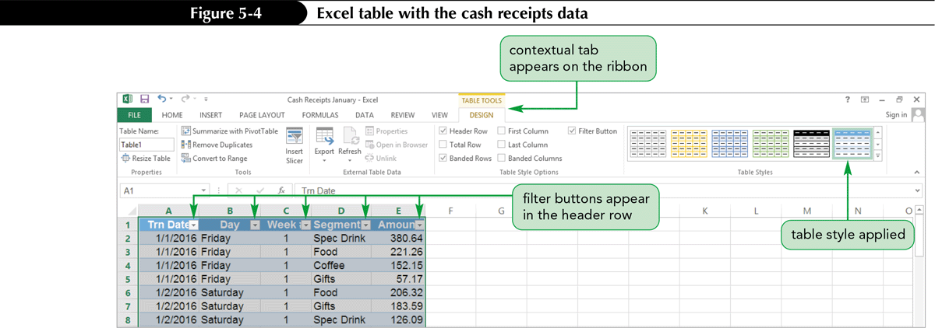
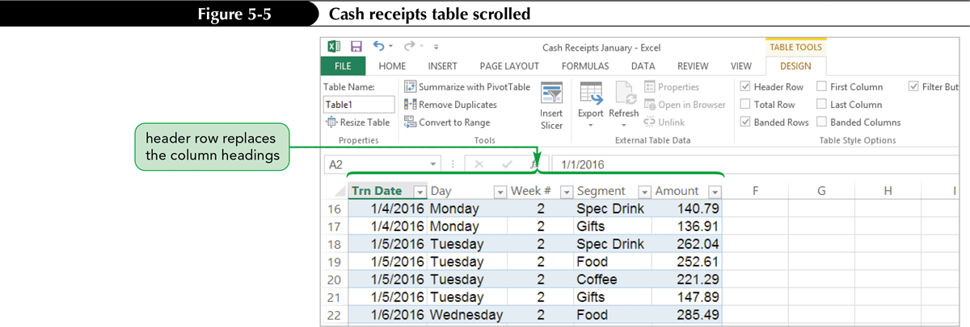
Creating an Excel Table

Slide 14
Creating an Excel Table
Saving Time with Excel Tables
  Format quickly using a table style
  Add new rows and columns that automatically expand the range
  Add a Total row to calculate a summary function (SUM, AVERAGE, COUNT, MIN, MAX)
  Enter a formula in a cell that is automatically copied to all other cells in the column
  Create formulas that reference cells in a table by using table and column names

Slide 15
Creating an Excel Table
Renaming an Excel Table
  Each Excel table in a workbook must have a unique name
  Descriptive names make it easier to identify a table by its content
  Table names must start with a letter or an underscore but can use any combination of letters, numbers, and underscores for the rest of the name
  Table names cannot include spaces

Slide 16
Modifying an Excel Table
Can modify an Excel table by adding or removing table elements or by changing the table’s formatting
Can display or hide the following:
  Header row
  Total row
  First column
  Last column
  Banded rows
  Banded columns
  Filter buttons

Slide 17
Maintaining Data in an Excel Table
As you develop a worksheet with an Excel table, you may need to:
  Add new records to the table
  Find and edit existing records in the table
  Delete records from the table
Adding Records
  Add a record in the first blank row
  Add a record in a specific location by inserting a row within the table for the new record

Slide 18
Maintaining Data in an Excel Table
Finding and Editing Records
  You can manually scroll through the table to find a specific record
  Quicker way to locate a record is to use the Find command
  When using the Find or Replace command, it is best to start at the top of a worksheet to ensure that all cells in the table are searched

Slide 19
Maintaining Data in an Excel Table
Deleting a Record
  Three ways to delete records:
    Select a cell in each record you want to delete, click the Delete button arrow in the Cells group on the HOME tab, and then click Delete Table Rows
    Delete a field by selecting a cell in the field you want to delete, clicking the Delete button arrow, and then clicking Delete Table Columns
    Use the Remove Duplicates dialog box to locate and remove records that have the same data in selected columns

Slide 20
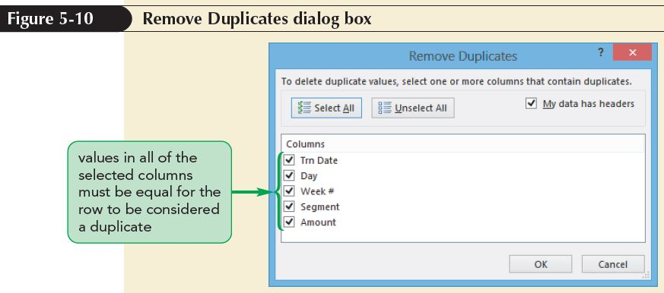
Maintaining Data in an Excel Table

Slide 21
Sorting Data
The records in an Excel table initially appear in the order they were entered; you can view the same records in a different order
Ascending order arranges text alphabetically from A to Z, numbers from smallest to largest, and dates from oldest to newest
Descending order arranges text in reverse alphabetical order from Z to A, numbers from largest to smallest, and dates from newest to oldest

Slide 22
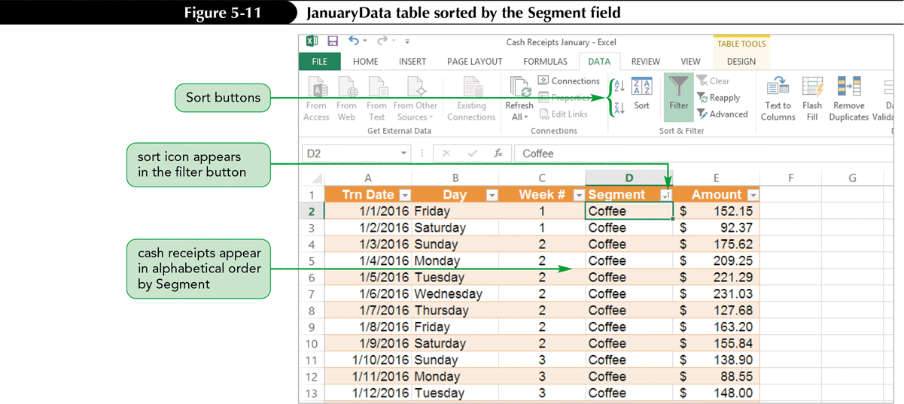
Sorting Data
Sorting One Column Using the Sort Buttons
  Use the Sort A to Z button or the Sort Z to A button to sort data quickly with one sort field

Slide 23
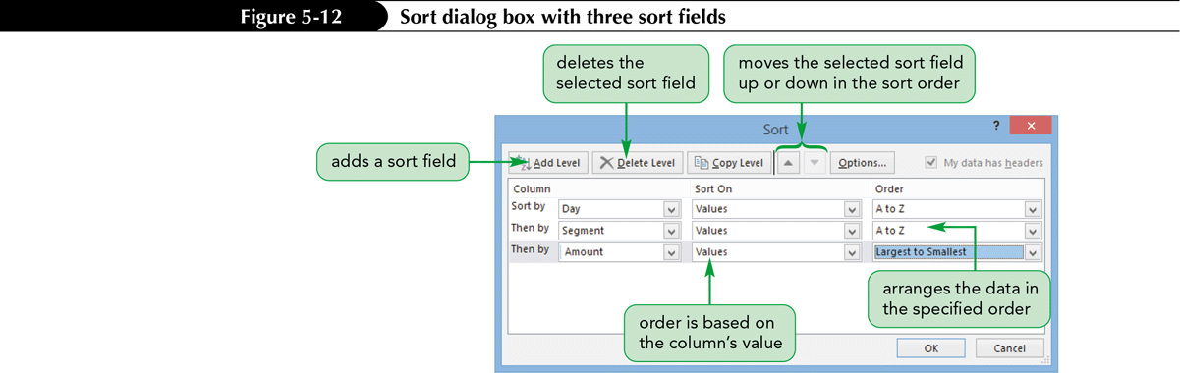
Sorting Data
Sorting Multiple Columns Using the Sort Dialog Box
  The first sort field is called the primary sort field
  The second sort is called the secondary sort field
  Up to 64 sort fields possible

Slide 24
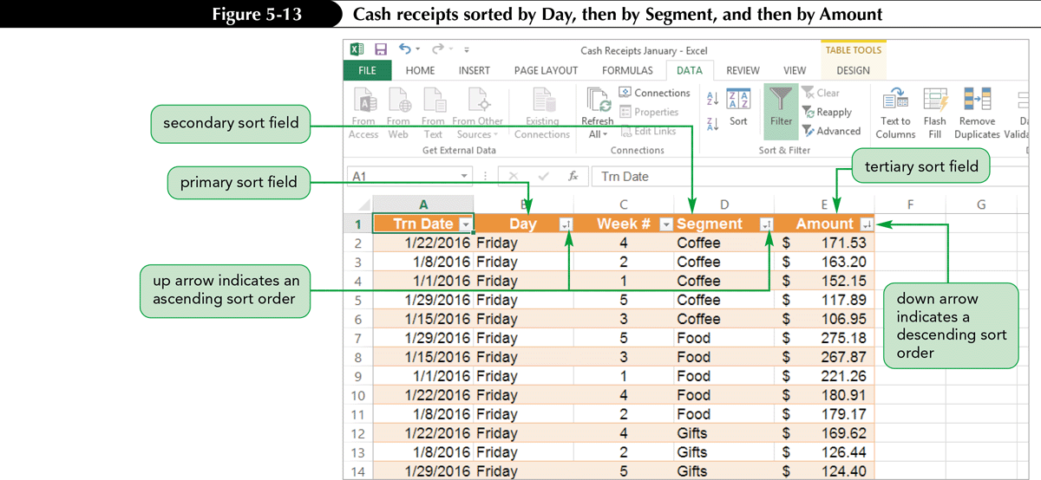
Sorting Data

Slide 25
Sorting Data
Sorting Using a Custom List
  A custom list indicates sequence to order data
  Two predefined custom sort lists
    Day-of-the-week custom list
    Month-of-the-year custom lists
  Can create a custom list to sort records in a sequence you define

Slide 26
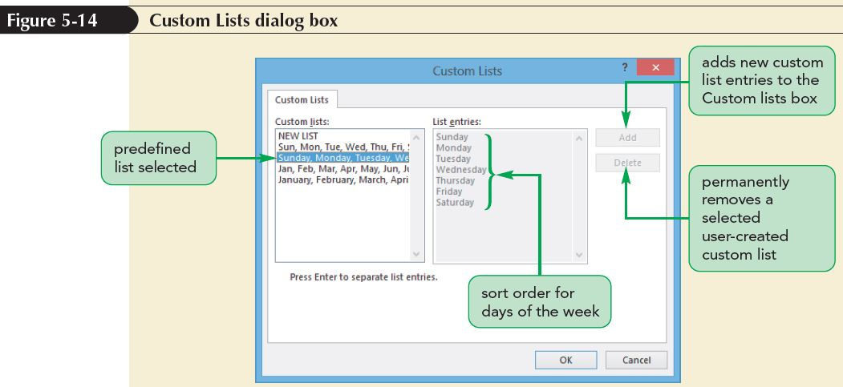
Sorting Data

Slide 27
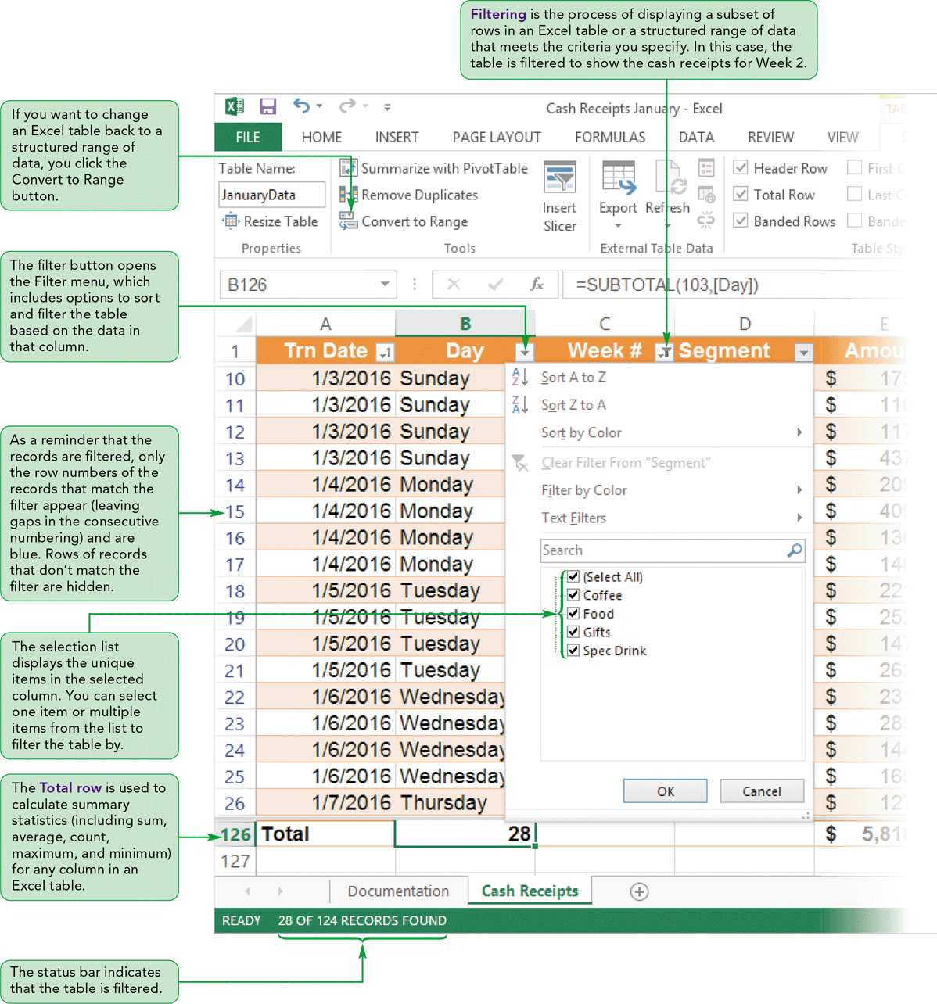
Visual Overview:
Filtering Table Data

Slide 28
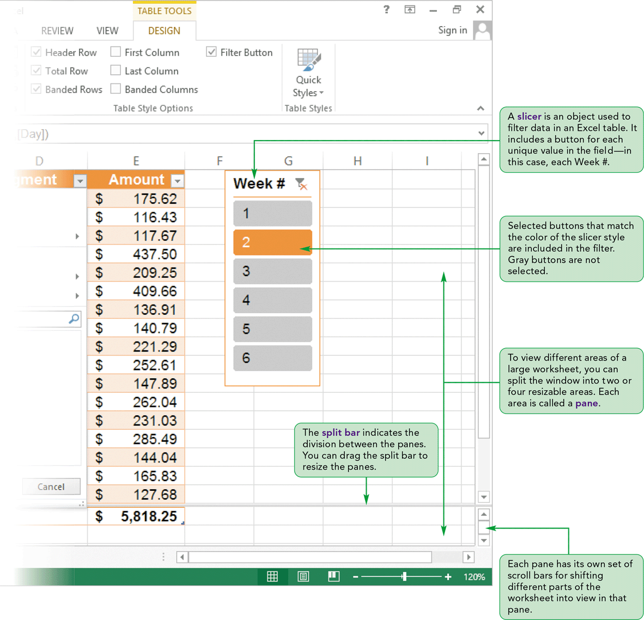
Visual Overview:
Filtering Table Data

Slide 29
Filtering Data
Filtering temporarily hides any records that do not meet specified criteria
After data is filtered, it can be:
  Sorted
  Copied
  Formatted
  Charted
  Printed

Slide 30
Filtering Data
Filtering Using One Column
  Click a filter button to open the Filter menu for that field
  Use options on AutoFilter menu to create three types of filters:
    By cell colors or font colors
    By a specific text, number, or date filter
    By selecting exact values

Slide 31
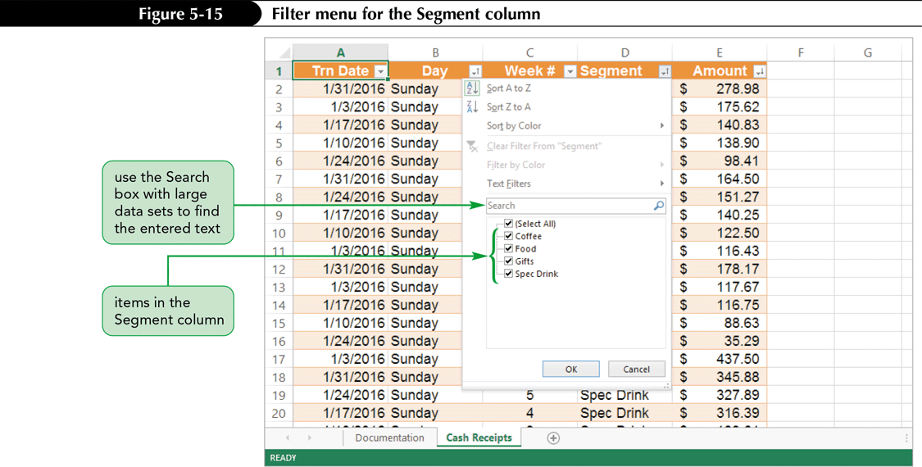
Filtering Data

Slide 32
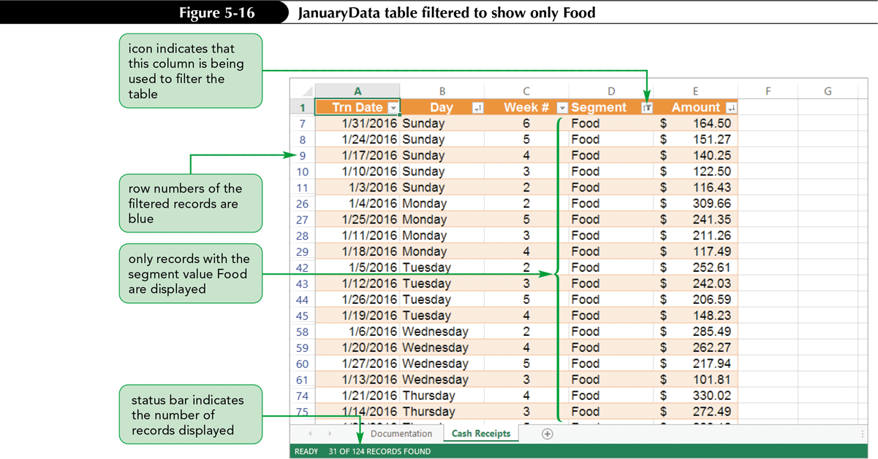
Filtering Data

Slide 33
Filtering Data
Filtering Using Multiple Columns
  Filter by one or more of the other columns
  Further restricts records that appear in a filtered table
  Each additional filter is applied to currently filtered data and further reduces records that are displayed

Slide 34
Filtering Data
Clearing Filters
  To redisplay all data in a filtered table, clear (or remove) the filters
  When one filter is cleared from a column, other filters are still applied
Selecting Multiple Filter Items
  Uses the OR condition
  Requires that only one of the selected criteria be true for a record to be displayed

Slide 35
Filtering Data
Creating Criteria Filters to Specify More Complex Criteria
  Criteria filters enable you to specify various conditions in addition to those that are based on an “equals” criterion
  The types of criteria filters available change depending on whether the data in a column contains text, numbers, or dates

Slide 36
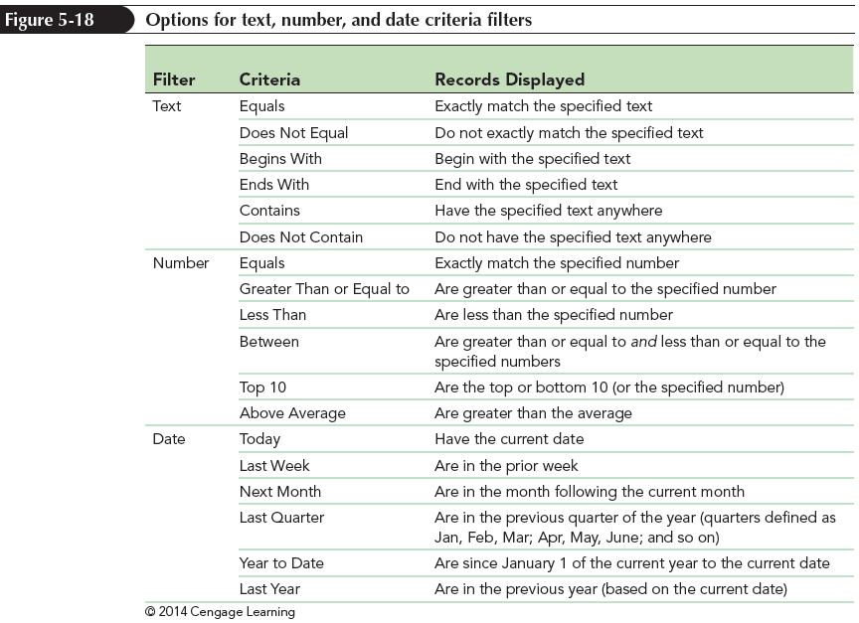
Filtering Data

Slide 37
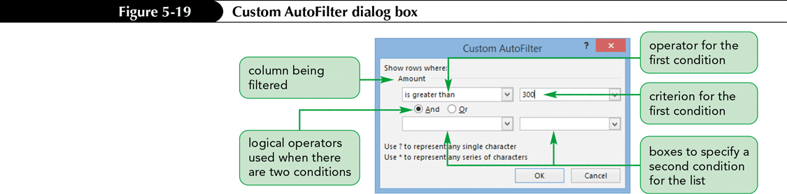
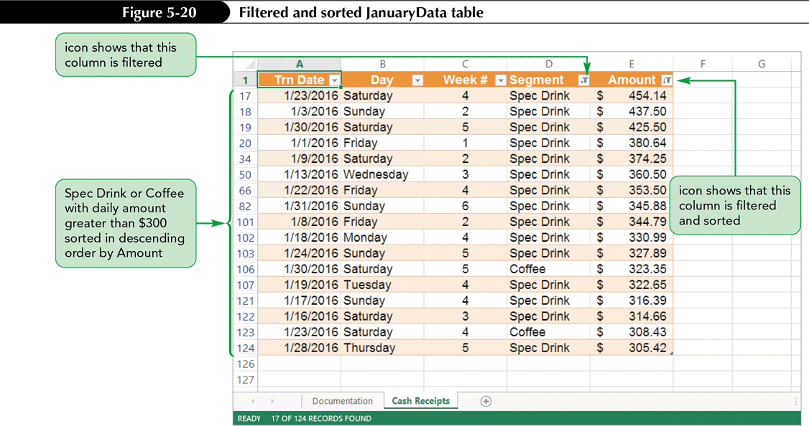
Filtering Data

Slide 38
Filtering Data
Creating a Slicer to Filter Data in an Excel Table
  You can create one or more slicers to filter a table
  Every slicer consists of an object that contains a button for each unique value in that field
  An advantage: a slicer clearly shows what filters are currently applied
  A disadvantage: a slicer can take up a lot of space or hide data if there isn’t a big enough blank area near the table
  You can format the slicer and its buttons, changing its style, height, and width

Slide 39
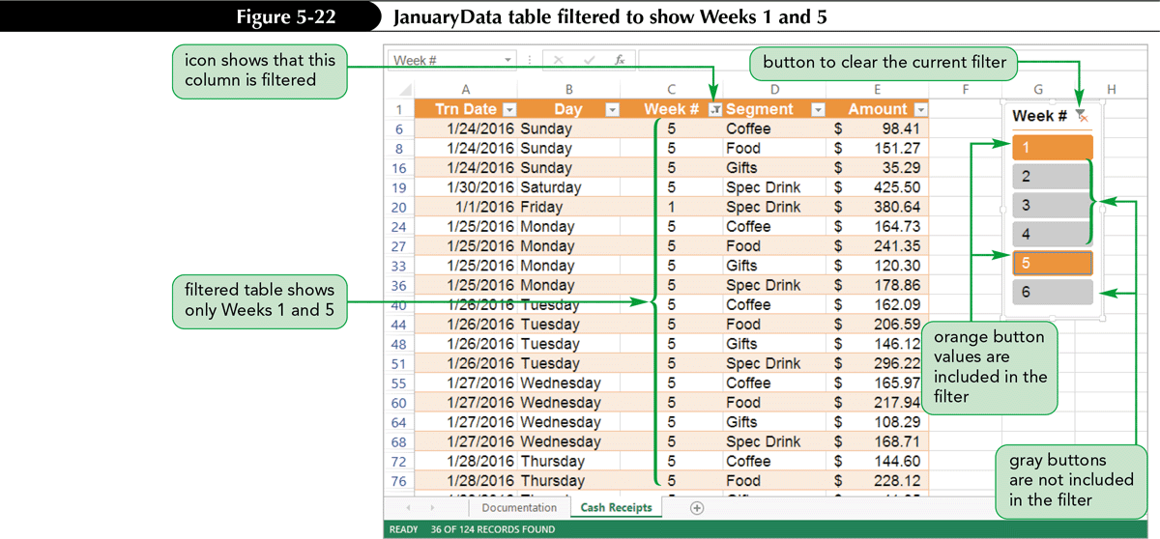
Filtering Data

Slide 40
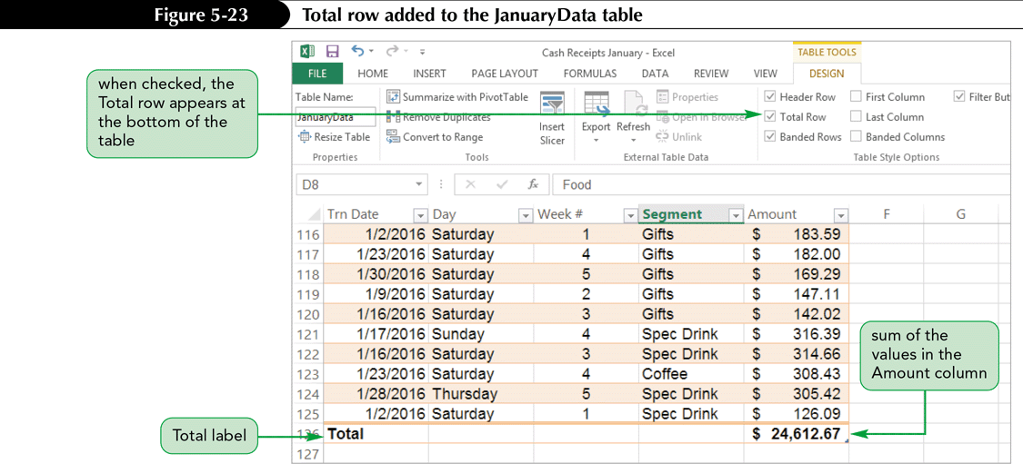
Using the Total Row to Calculate
Summary Statistics
Used to calculate summary statistics (sum, average, count, maximum, and minimum) for any column in a table

Slide 41
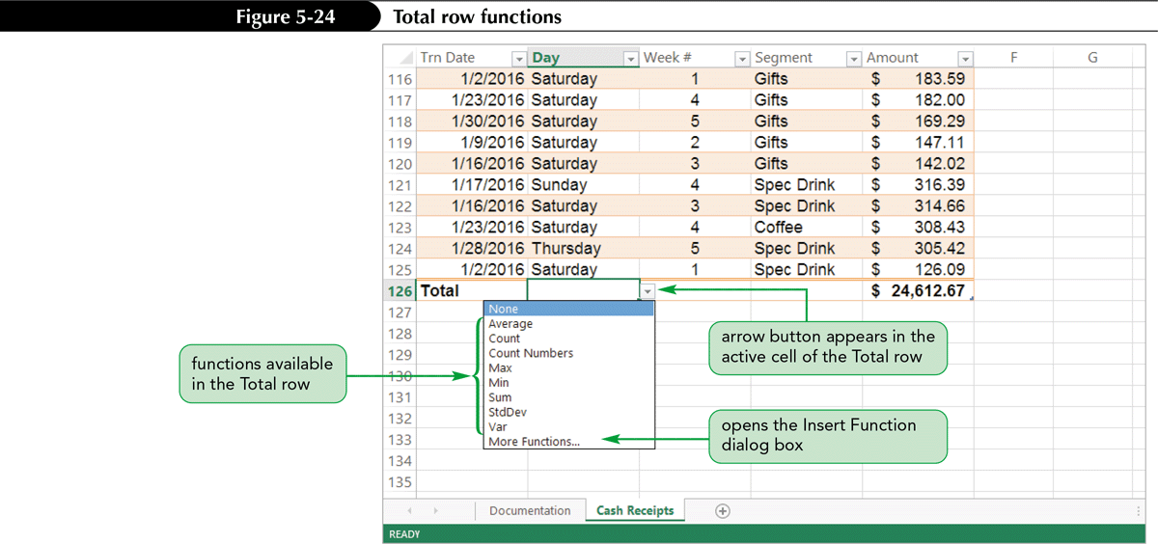
Using the Total Row to Calculate
Summary Statistics

Slide 42
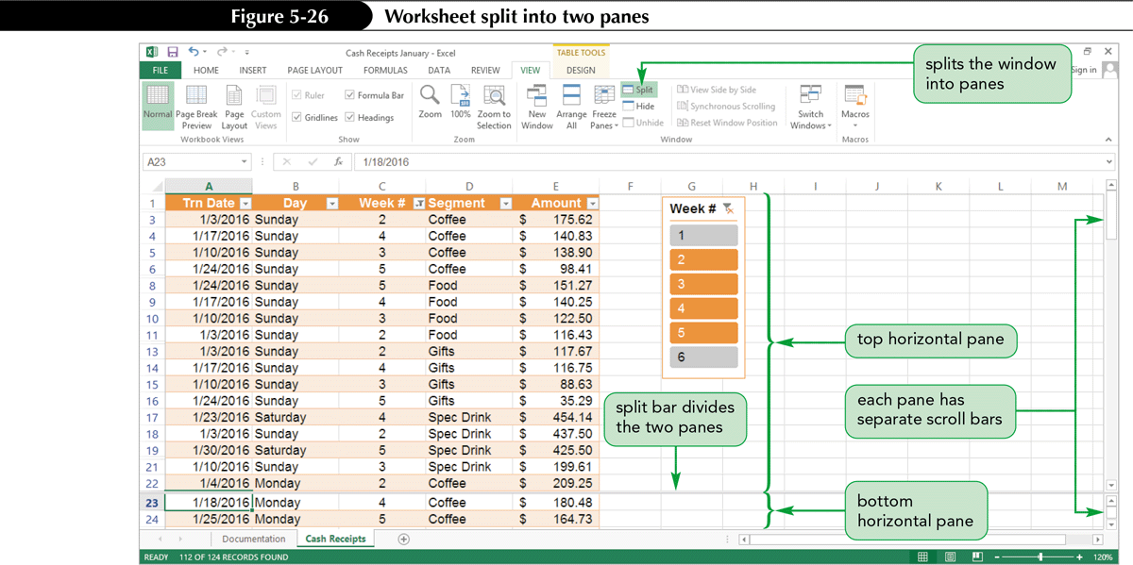
Splitting the Worksheet Window into Panes
Easily view data from several areas of the worksheet at the same time

Slide 43
Inserting Subtotals
Subtotal command
  Offers many kinds of summary information (counts, sums, averages, minimums, maximums)
  Inserts a subtotal row into range for each group of data
  Adds a grand total row below last row of data
  Cannot be used in an Excel table
  You must first convert the Excel table to a normal range

Slide 44
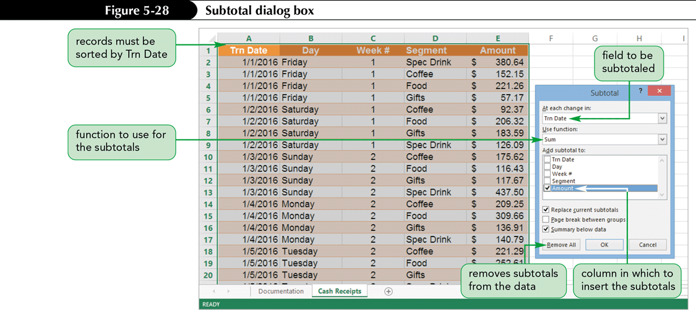
Inserting Subtotals
Need to sort data so that records with the same value in a specified field are grouped together before using Subtotal command

Slide 45
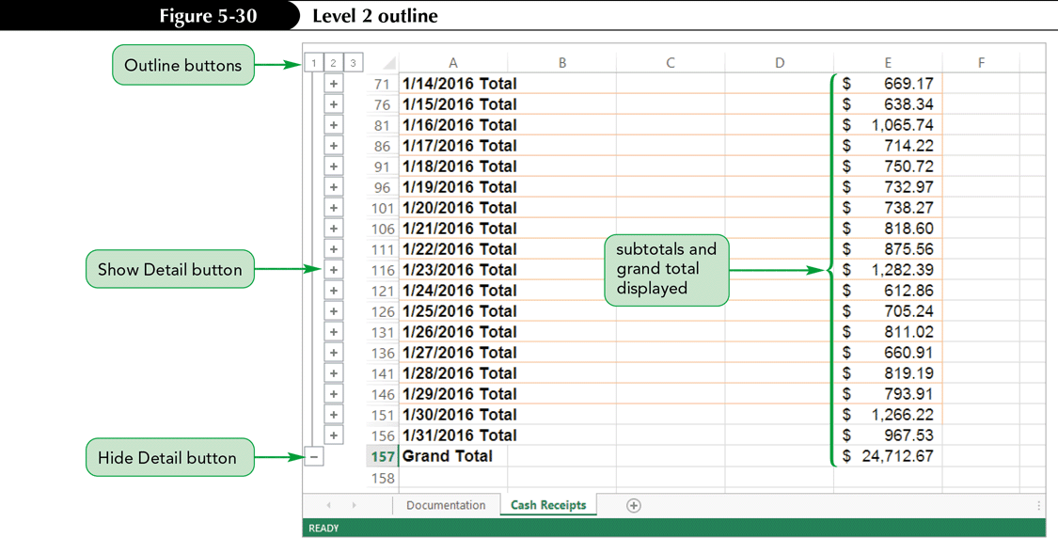
Inserting Subtotals
Using the Subtotal Outline View
  Control the level of detail with buttons
    Level 3: Most detail
    Level 2: Subtotals and grand total, but not individual records
    Level 1: Only the grand total

Slide 46
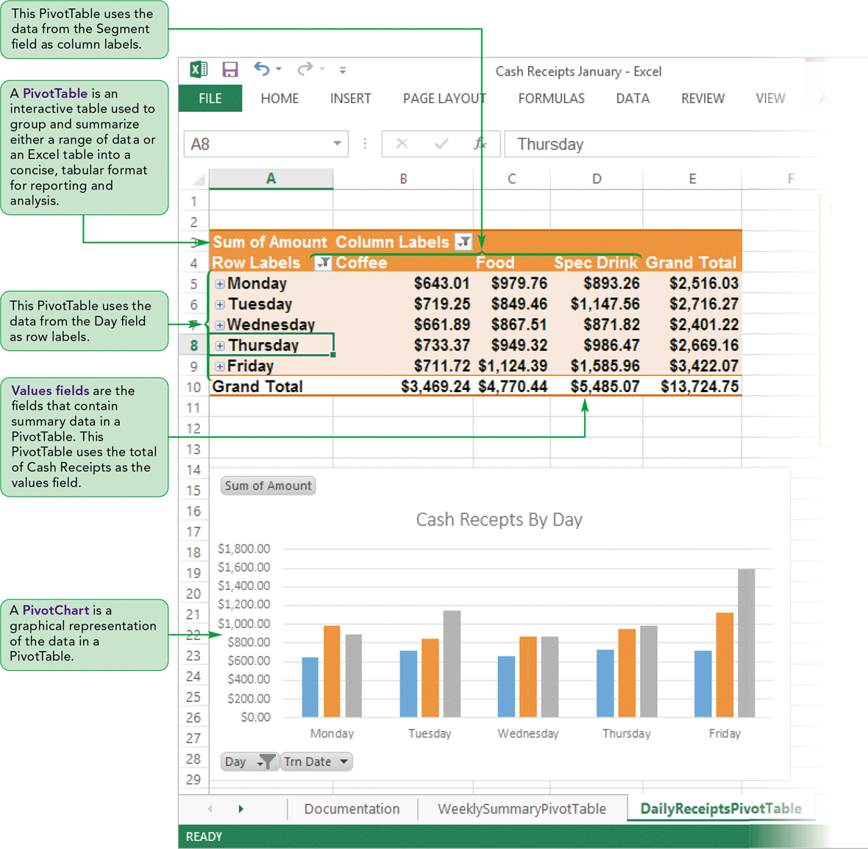
Visual Overview:
PivotTable and PivotChart

Slide 47
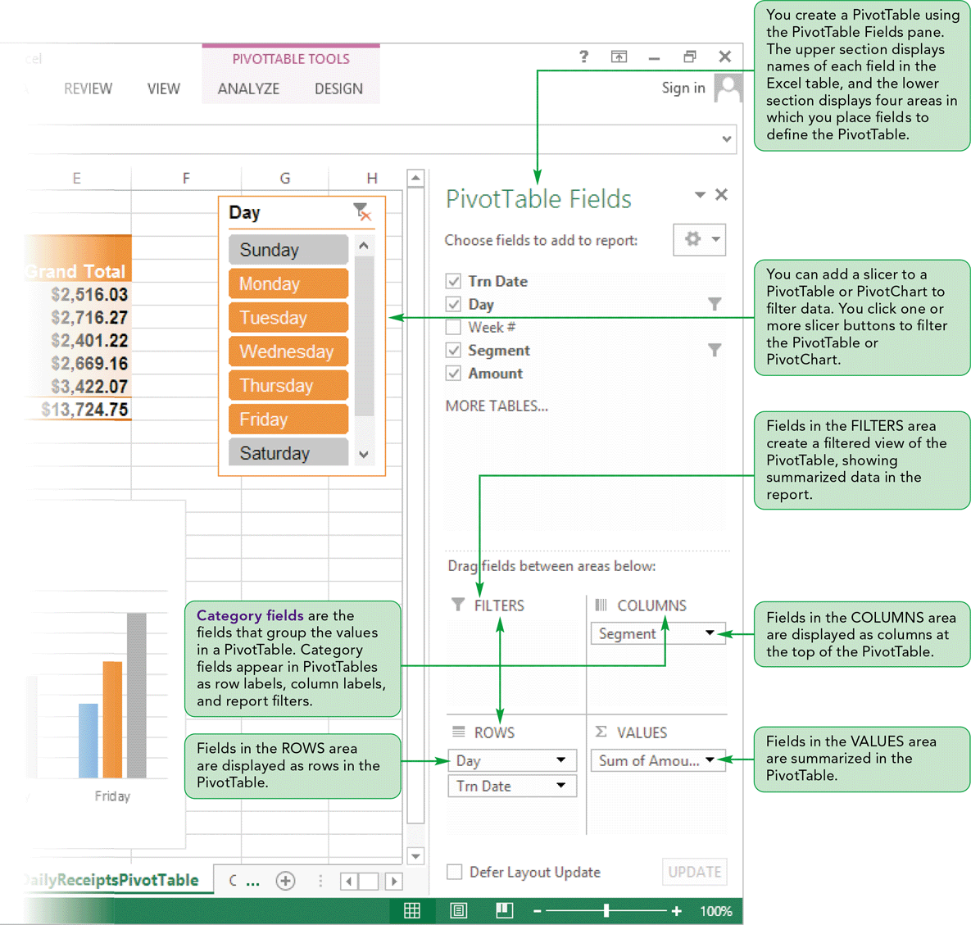
Visual Overview:
PivotTable and PivotChart

Slide 48
Analyzing Data with PivotTables
When a table contains large amounts of data, it often becomes difficult to obtain a clear view of that information
PivotTables help organize data by summarizing data into categories using functions (COUNT, SUM, AVERAGE, MAX, MIN)
Provide ability to “pivot” the table (rearrange, hide, and display different category fields to provide alternative views of the data)

Slide 49
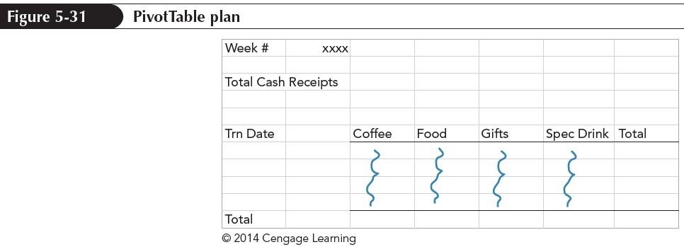
Creating a PivotTable
Useful first step is plan the PivotTable layout

Slide 50
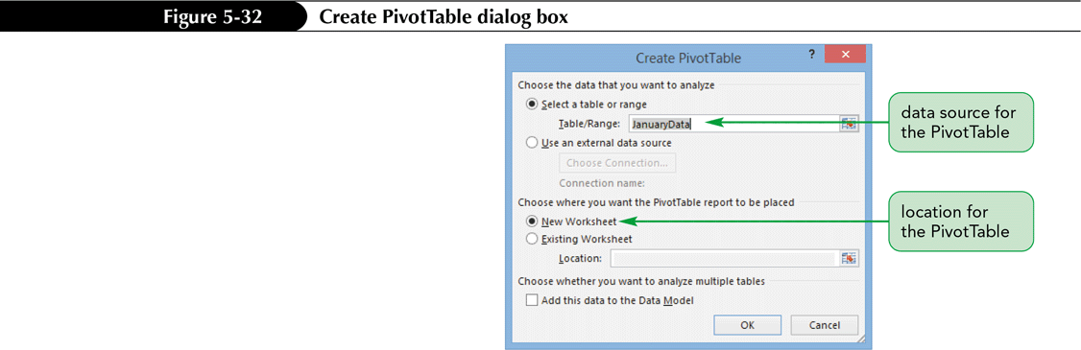
Creating a PivotTable
Use PivotTable dialog box to select data to analyze and location of the PivotTable report

Slide 51
Creating a PivotTable
Adding Fields to a PivotTable
  Fields that contain summary data are Values fields
  Fields that group the values in the PivotTable are Category fields
  Add fields to a PivotTable from the PivotTable Fields pane, which is divided into two sections:
    The upper section (the Fields section) lists the names of each field in the data source
    Select a field check box or drag the field into the lower section to add that field to the FILTERS, ROWS, COLUMNS, or VALUES area

Slide 52
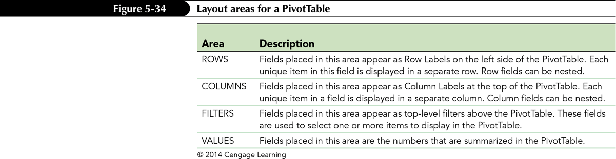
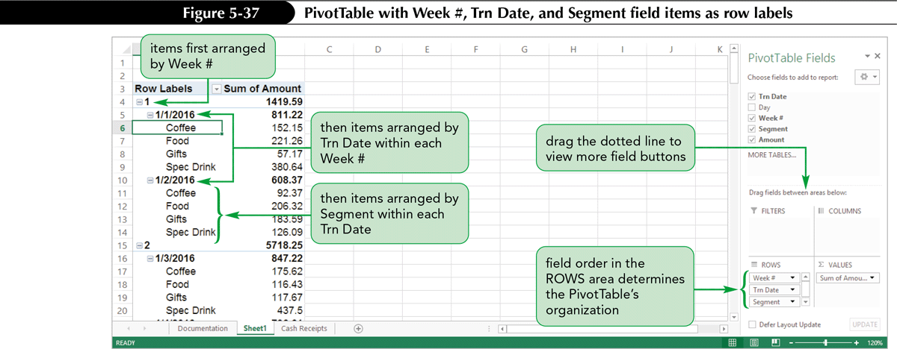
Creating a PivotTable

Slide 53
Creating a PivotTable
Changing the Layout of a PivotTable
  You can add, remove, and rearrange fields to change the PivotTable’s layout
  After you create a PivotTable, you can view the same data in different ways
  Each time you make a change in the areas section of the PivotTable Fields pane, the PivotTable layout is rearranged

Slide 54
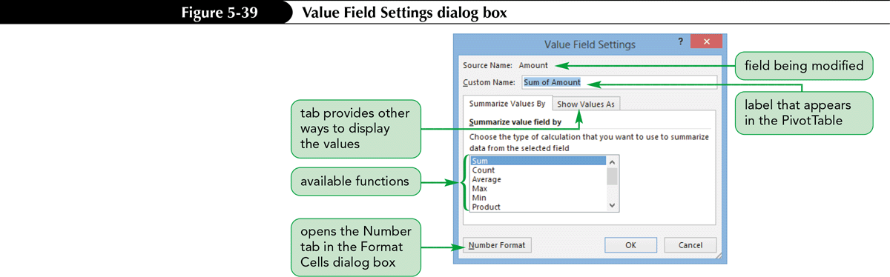
Creating a PivotTable
Formatting a PivotTable
  Quickly format a PivotTable report using one of the built-in styles available
  Format cells in a PivotTable the same way that you format cells in a worksheet

Slide 55
Filtering a PivotTable
To analyze the data in a PivotTable, you might want to show only a portion of the total data
You can do this by filtering the PivotTable
Adding a Field to the FILTERS Area
  Add a report filter to a PivotTable to create a filtered view of the PivotTable report
  Filter PivotTable fields to focus on a subset of items in that field

Slide 56
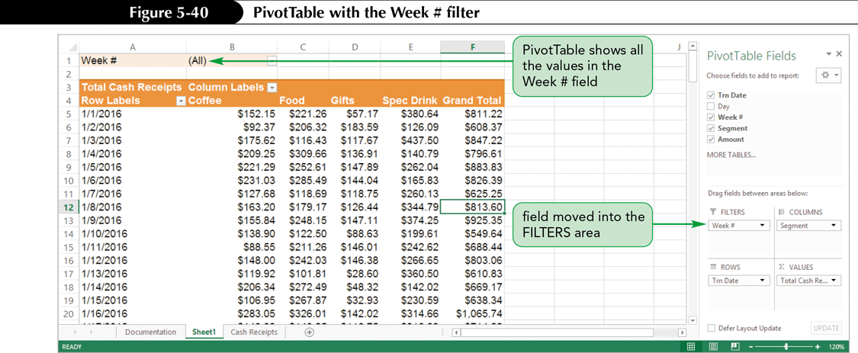
Filtering a PivotTable

Slide 57
Filtering a PivotTable
Filtering PivotTable Fields
  Another way to filter field items in a PivotTable is using the Filter menu
    Open by clicking the Row Labels filter button or the Column Labels filter button
    Then check or uncheck items to show or hide them

Slide 58
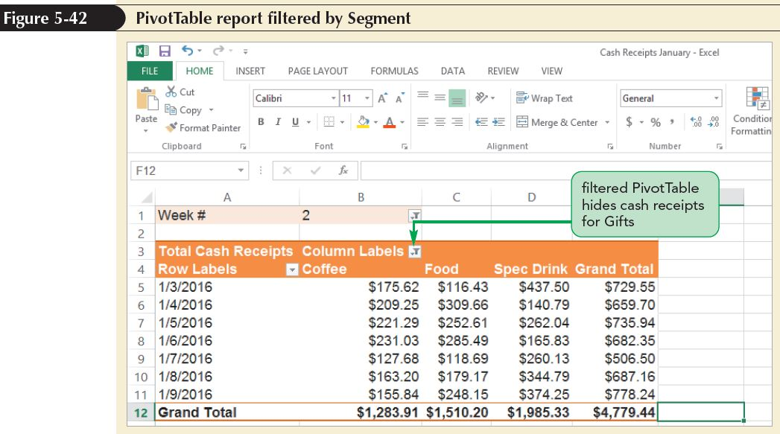
Filtering a PivotTable

Slide 59
Filtering a PivotTable
Creating a Slicer to Filter a PivotTable
  Another way to filter a PivotTable is with a slicer
  Can create a slicer for any field in the PivotTable Fields pane
  The slicer contains a button for each unique value in that field
  You can format the slicer and its buttons, changing its style, height, and width
  You can create more than one slicer at a time

Slide 60
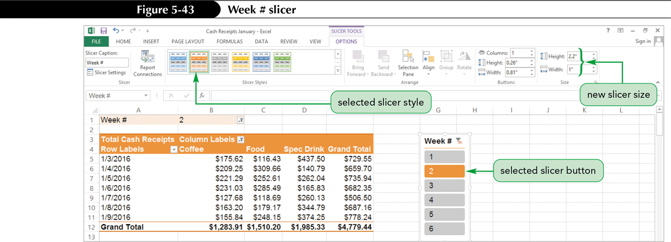
Filtering a PivotTable

Slide 61
Refreshing a PivotTable
You cannot change data directly in a PivotTable; you must edit the data source on which the PivotTable is created
PivotTables are not updated automatically when the source data for the PivotTable is updated
After you edit the underlying data, you must refresh, or update, the PivotTable report to reflect the revised calculations

Slide 62
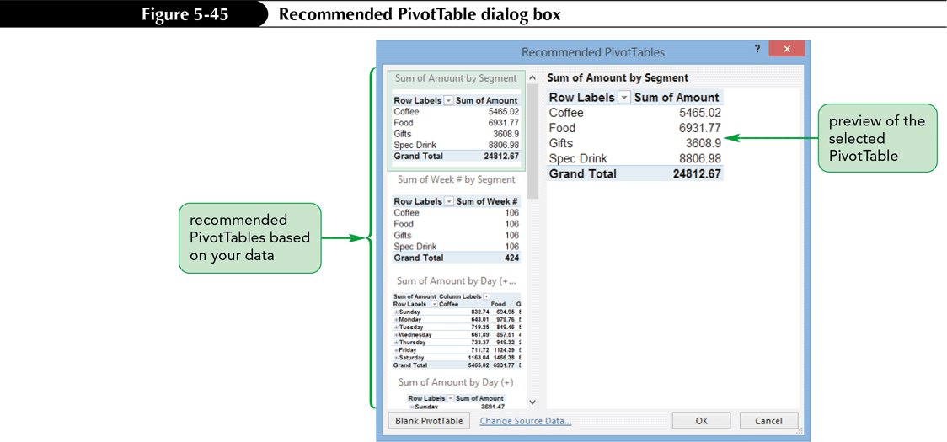
Creating a Recommended PivotTable
The Recommended PivotTables dialog box previews PivotTables based on the source data
Lets you see different options so you can choose the one best meeting your needs

Slide 63
Creating a PivotChart
A PivotChart is a graphical representation of the data in a PivotTable
Allows you to interactively add, remove, filter, and refresh data fields
PivotCharts can have all the same formatting as other charts, including layouts and styles
You can move and resize chart elements, or change formatting of individual data points

Slide 64
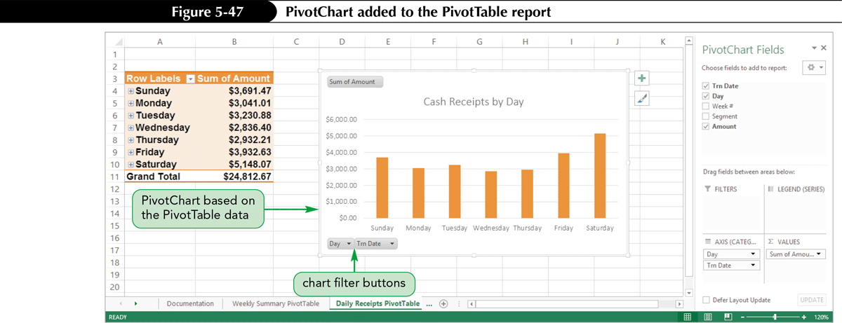
Creating a PivotChart

Slide 65
Creating a PivotChart
The PIVOTCHART TOOLS contextual tabs enable you to work with and format the selected PivotChart the same way as an ordinary chart
A PivotChart and its associated PivotTable are linked; when you modify one, the other also changes
Can quickly display different views of the PivotChart by using the chart filter buttons on the PivotChart to filter the data

